Slide 1
Introduction to NLP
Introduction
Dr. Paul Buitelaar
Data Science Institute, NUI Galway

Slide 2
Learning Outcomes of this Course
Understand basic principles in automatic analysis, interpretation and transformation of textual data
Understand approaches and challenges in syntactic and semantic analysis of textual data
Understand the foundations of NLP in linguistics, statistics and machine learning
Get an insight into NLP applications, in particular information extraction, knowledge graphs and opinion mining
Awareness of ethical, legal and data privacy aspects of NLP

Slide 3
Learning Outcomes of This Lecture
Understand the relevance of NLP applications in society
Get an insight into levels of complexity in human language
Get an insight into state of the art directions in NLP
Understand core aspects of NLP architectures and applications
Get useful pointers to data, research and communities in the field

Slide 4
Overview
Organizational issues
Why NLP
Human language
Some core notions in NLP
Architectures
Applications
Useful pointers

Slide 5
Overview
Organizational issues
Why NLP
Human language
Some core notions in NLP
Architectures
Applications
Useful pointers

Slide 6
Introduction to NLP - Course Overview
01 Introduction
02 Linguistic Concepts
03 Vector Space Model & Word Embeddings
04 Language Modelling
05 Tagging & Hidden Markov Models
06 Probabilistic Parsing
07 Semantic Analysis
08 Information Extraction
09 Knowledge Graphs & Chatbots
10 Opinion Mining, Ethics & Data Privacy
11 Invited Industry Talk
12 Summary and Q&A

Slide 7






The Team
Paul Buitelaar & John McCrae - lectures
Omnia Zayed - labs
Nivranshu Pasricha - labs
Shardul Suryawanshi - labs
Priya Rani - labs

Slide 8
Recommended Reading
Lectures
Daniel Jurafsky, James H. Martin. Speech and Language Processing - An Introduction to Natural Language Processing, Computational Linguistics and Speech Recognition. Pearson Prentice Hall. 3rd edition draft https://web.stanford.edu/~jurafsky/slp3/ed3book.pdf
Labs
Steven Bird, Ewan Klein, and Edward Loper. Natural Language Processing with Python – Analyzing Text with the Natural Language Toolkit. O'Reilly. Contents at http://www.nltk.org/book/
Other
Yoav Goldberg. Neural network methods for natural language processing. Synthesis Lectures on Human Language Technologies. Morgan & Claypool -- chapters 6,7,8
Chris Manning and Hinrich Schuetze. Foundations of Statistical Natural Language Processing. MIT Press. Cambridge. Teaching materials at http://nlp.stanford.edu/fsnlp/

Slide 9
Overview
Organizational issues
Why NLP
Human language
Some core notions in NLP
Architectures
Applications
Useful pointers

Slide 10
What is Natural Language Processing
scientific study and technology development concerned with
algorithms, methods and systems
for the
automatic analysis, interpretation and transformation of human language

Slide 11
Why Natural Language Processing
Search Engines
Process web queries and retrieve relevant information
Machine Translation
Process input words or sentences to be translated
Dialog Systems (Chatbots / Digital Assistants)
Process speech and interpret it into task-specific representations and actions
Other applications: Opinion Mining, Knowledge Graphs

Slide 12
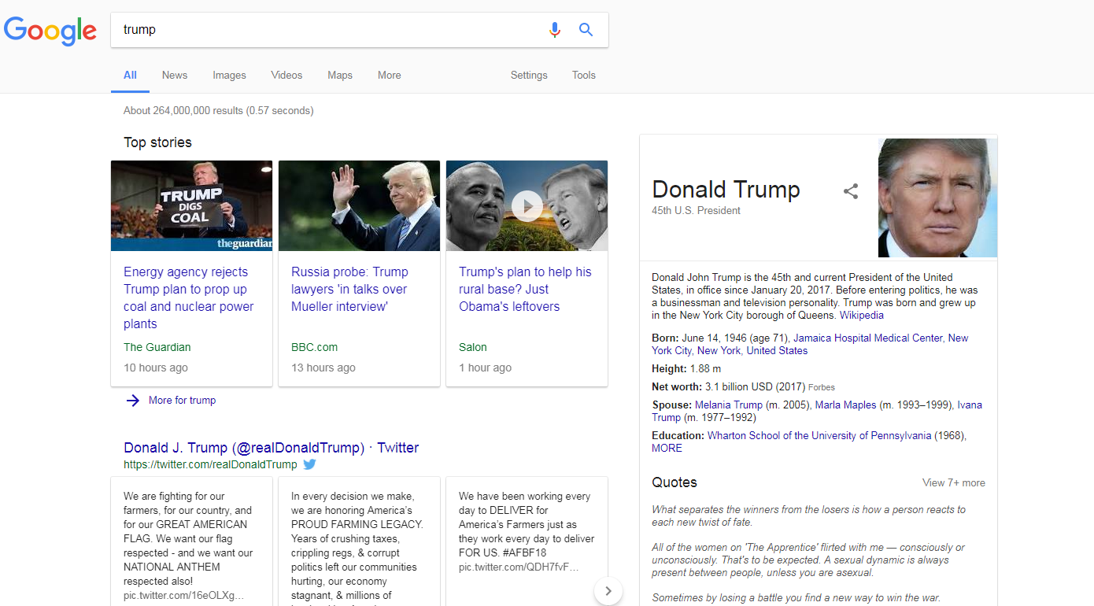
Search Engines

Slide 13
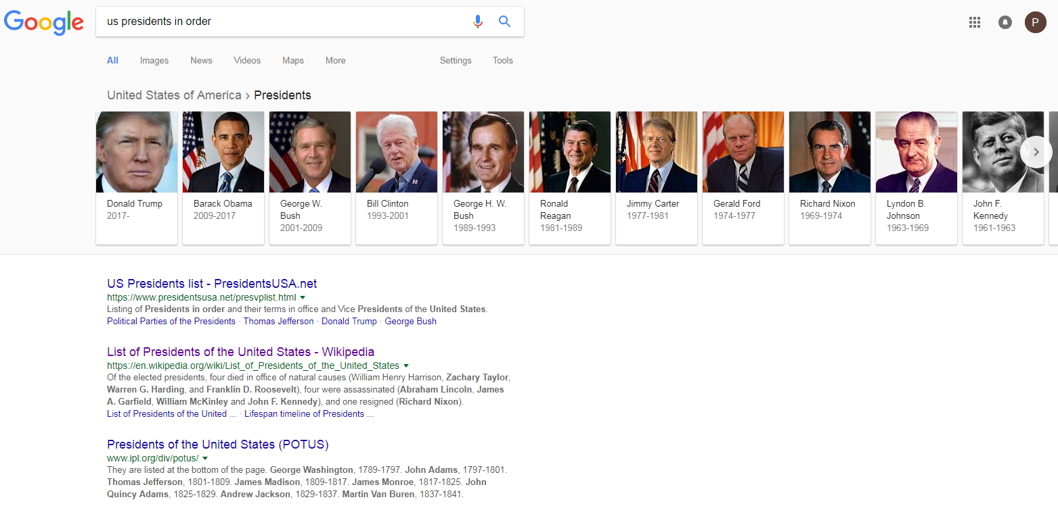
Search Engines

Slide 14
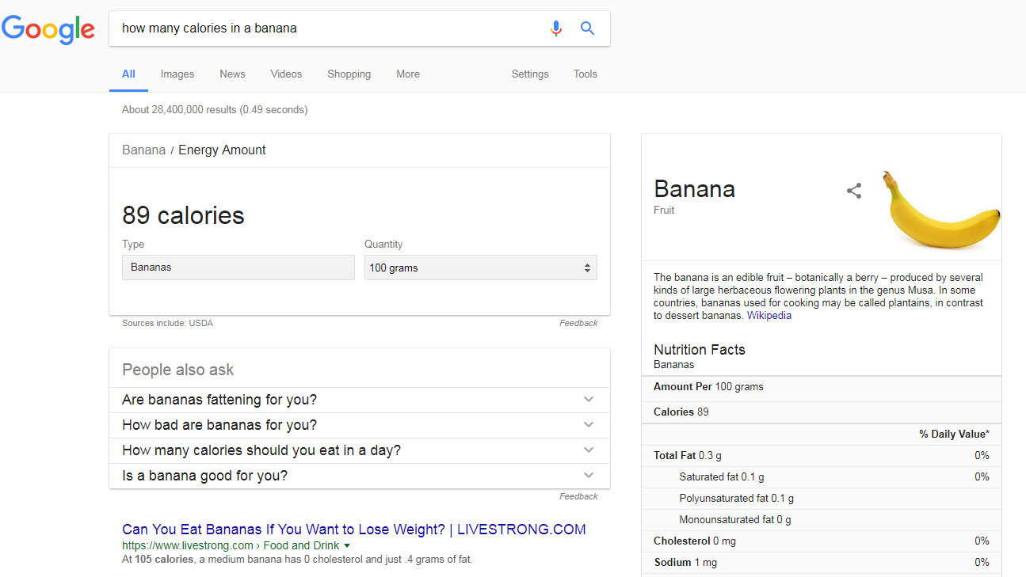
Search Engines

Slide 15
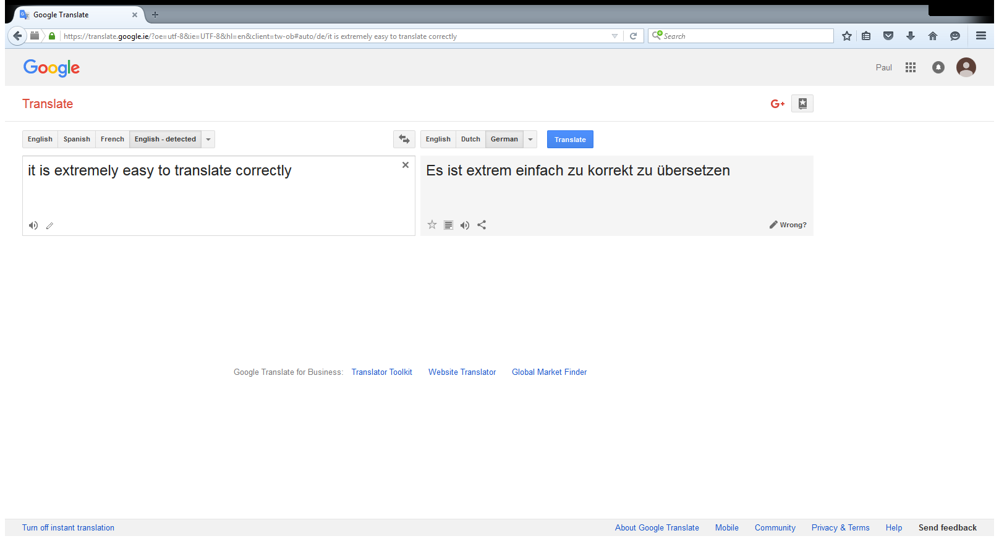
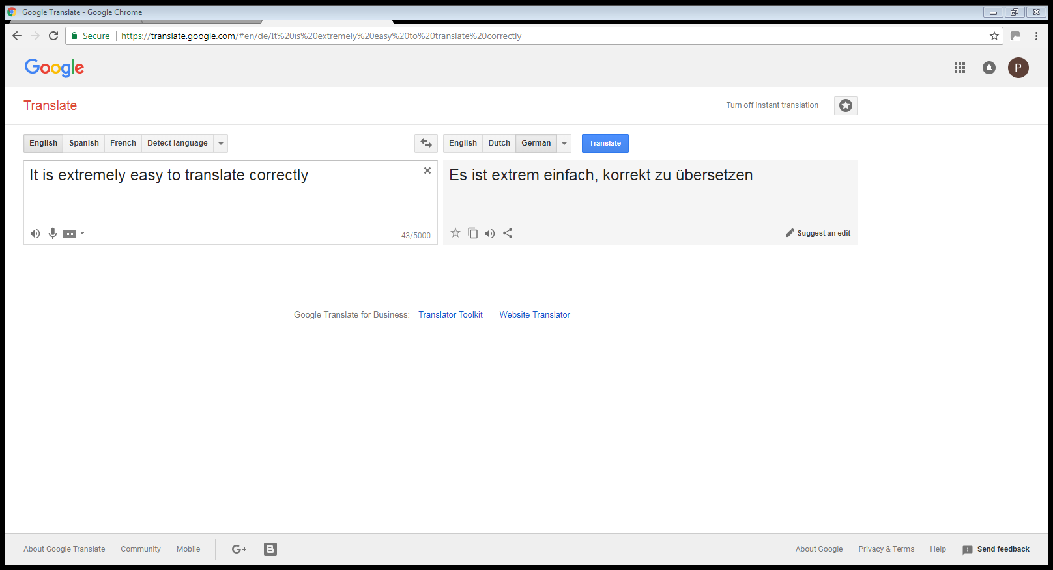
Machine Translation
X
2017
2018

Slide 16


Chatbots

Slide 17
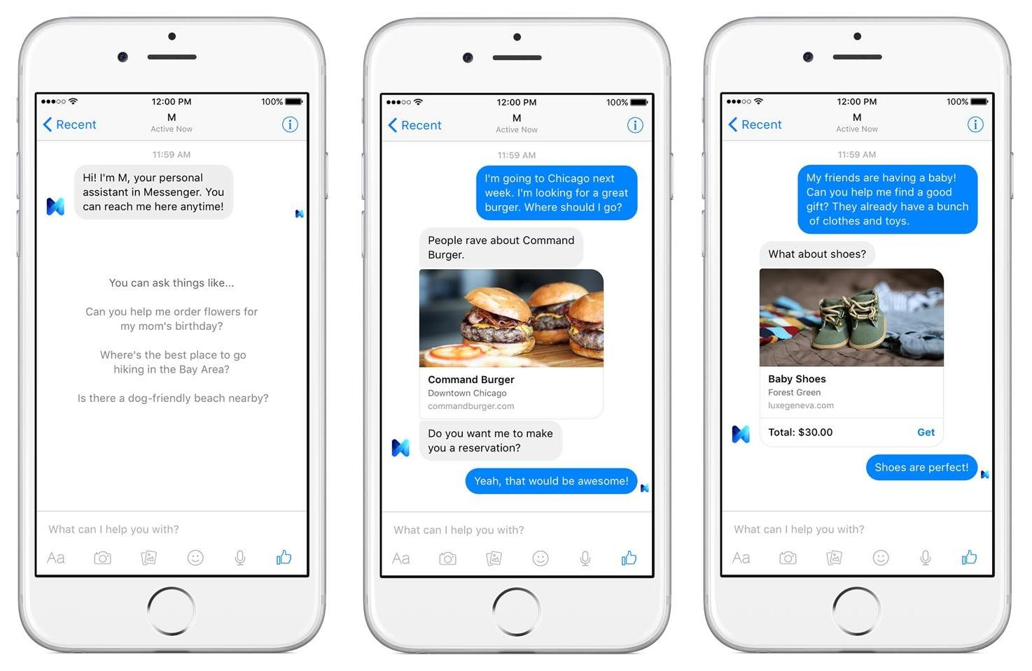
Chatbots - Dialog Systems

Slide 18
Chatbots - Dialog Systems

Slide 19
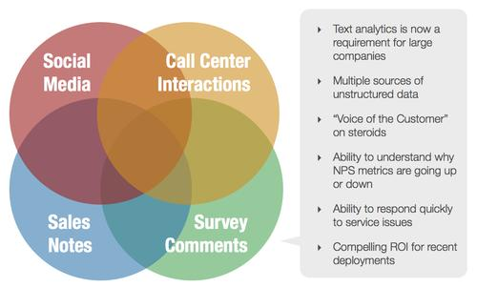
Opinion Mining

Slide 20

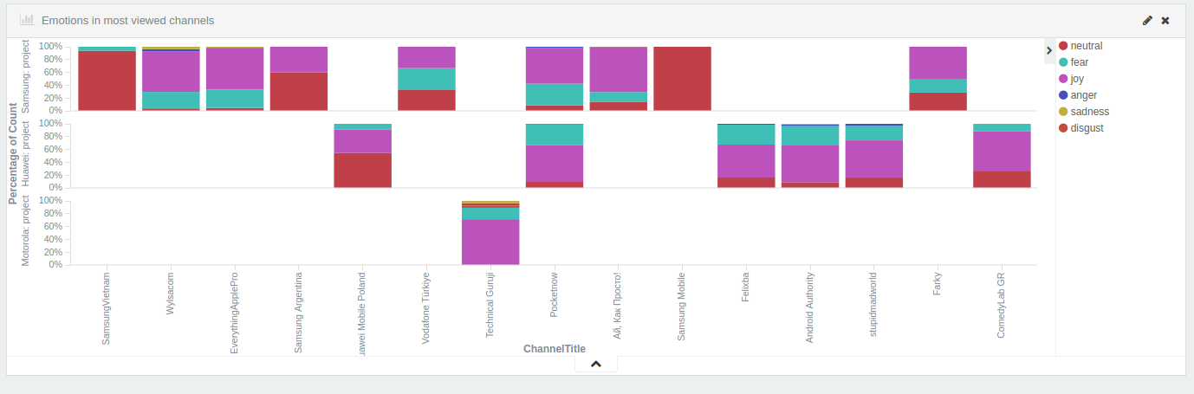
Opinion Mining
http://mixedemotions.insight-centre.org/

Slide 21
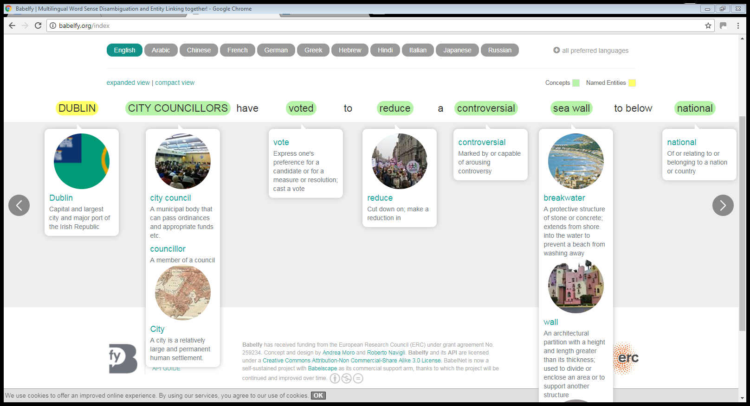
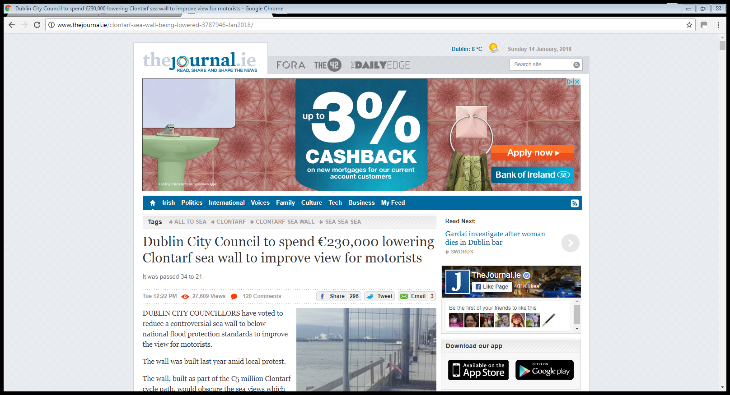

Knowledge Graphs
http://babelfy.org/

Slide 22
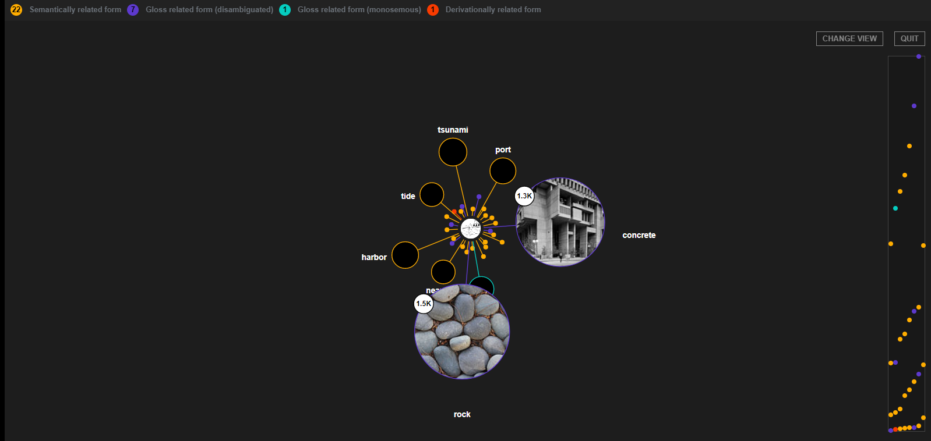
Knowledge Graphs
http://babelfy.org/

Slide 23
Overview
Organizational issues
Why NLP
Human language
Some core notions in NLP
Architectures
Applications
Useful pointers

Slide 24
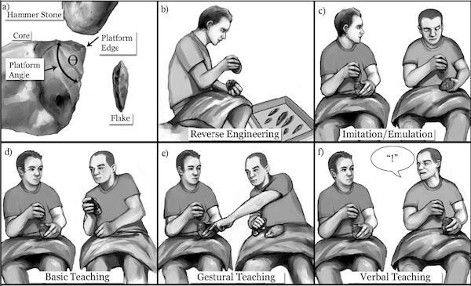
Human Language as a Social Tool

Slide 25
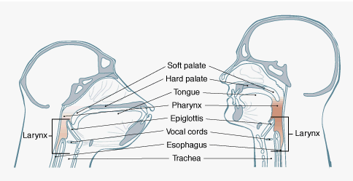
Human Language as a Biological System

Slide 26
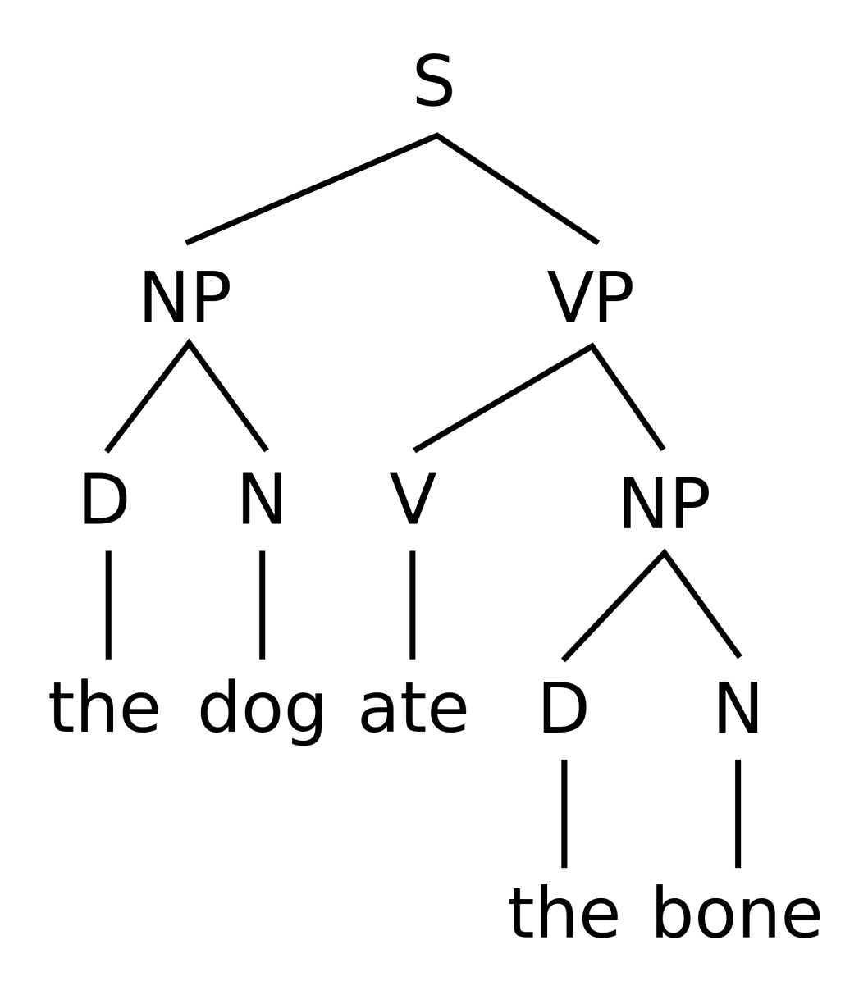
Human Language as a Logical System

Slide 27
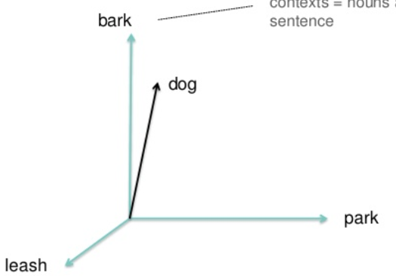
Human Language as a Mathematical System

Slide 28
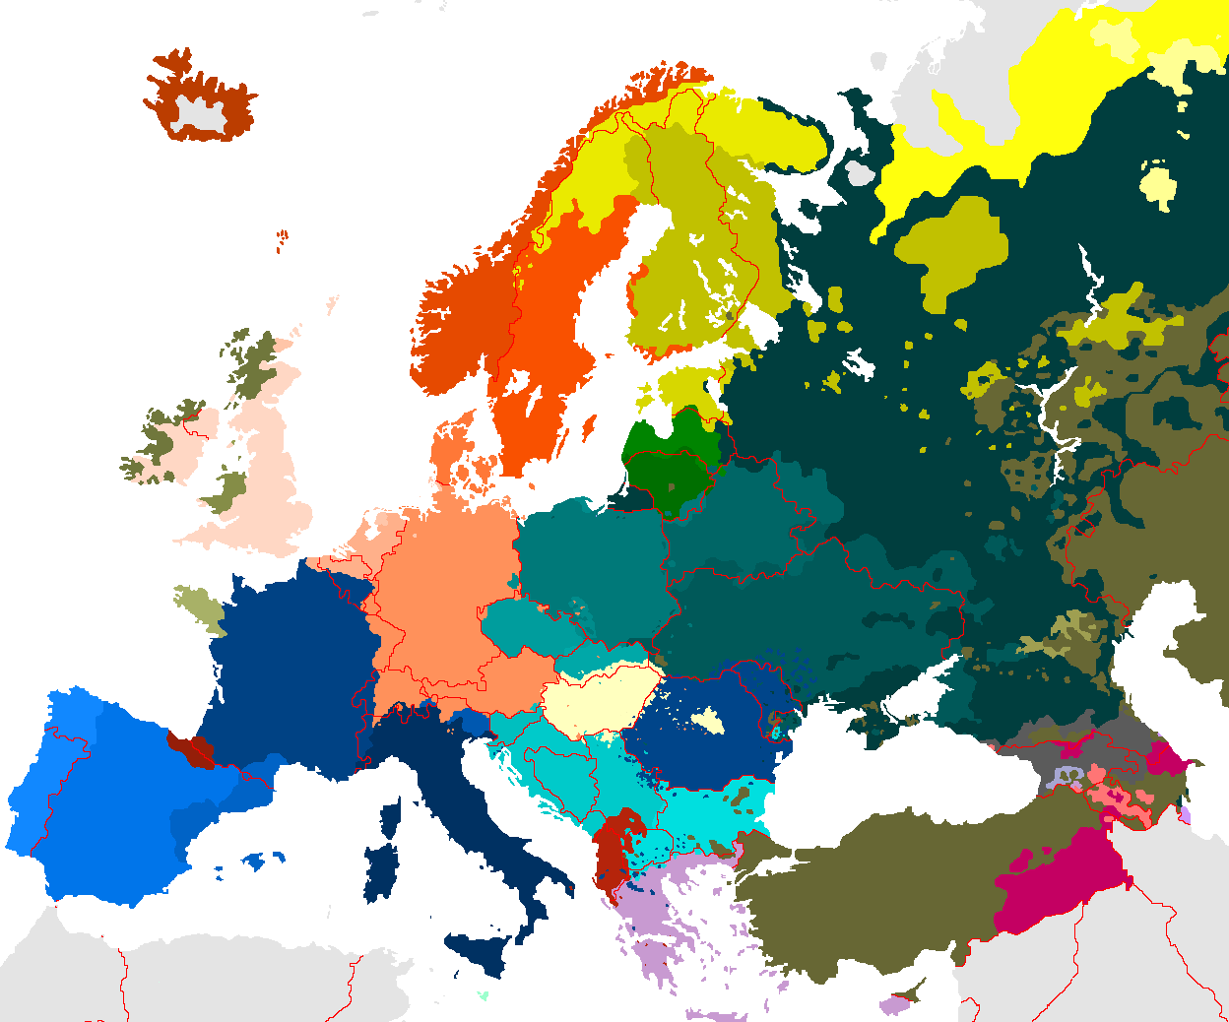
Human Language and Politics

Slide 29
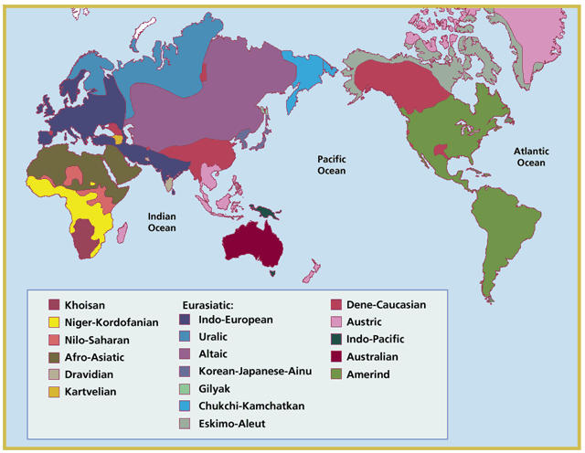
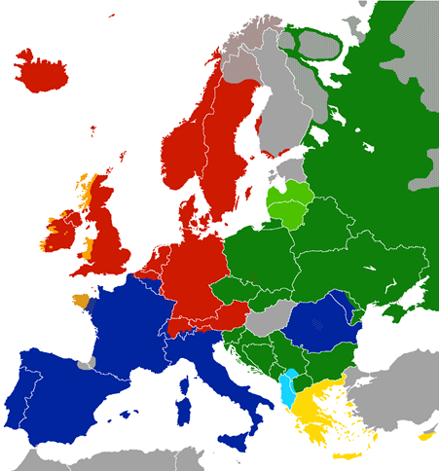
Language Families
NLP applications may be easier to transfer within language families

Slide 30
Overview
Organizational issues
Why NLP
Human language
Some core notions in NLP
Architectures
Applications
Useful pointers

Slide 31
Ambiguity
ambiguity is at the core of human language complexity
human language is
non-deterministic: one word/phrase expressing different meanings
redundant: different words/phrases expressing the same meaning
therefore ambiguous

Slide 32
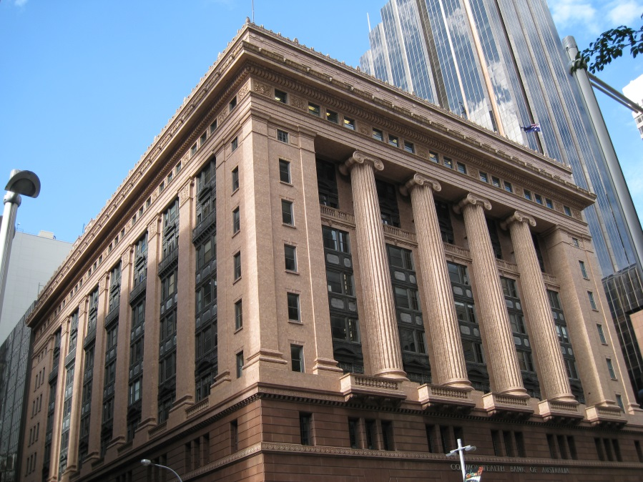
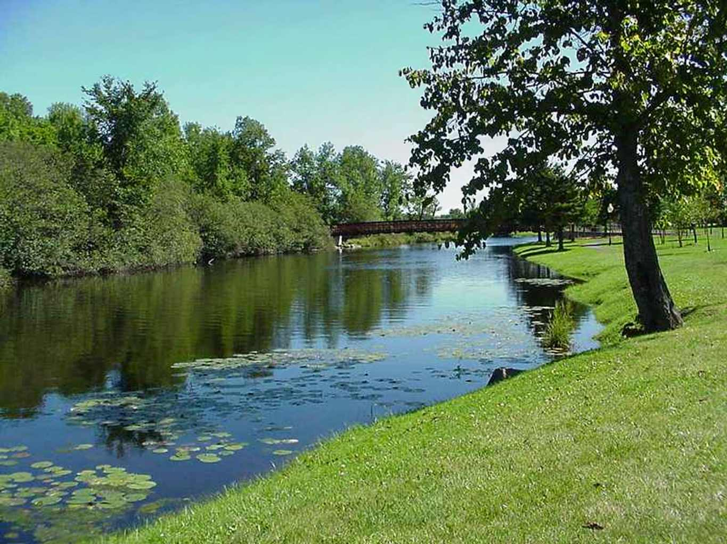
Lexical Ambiguity
savings bank vs. river bank

Slide 33
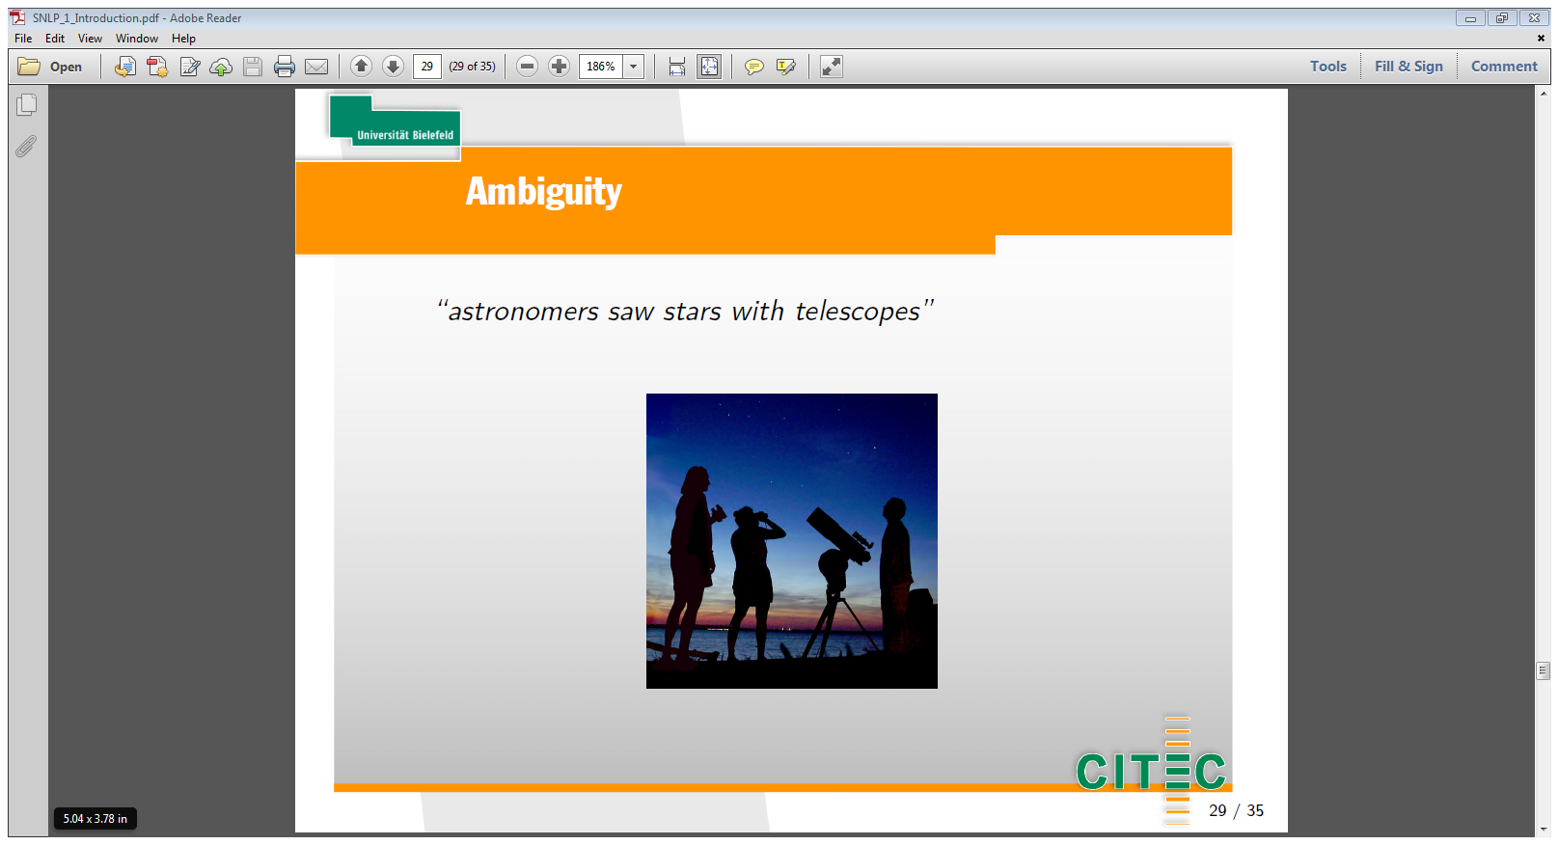
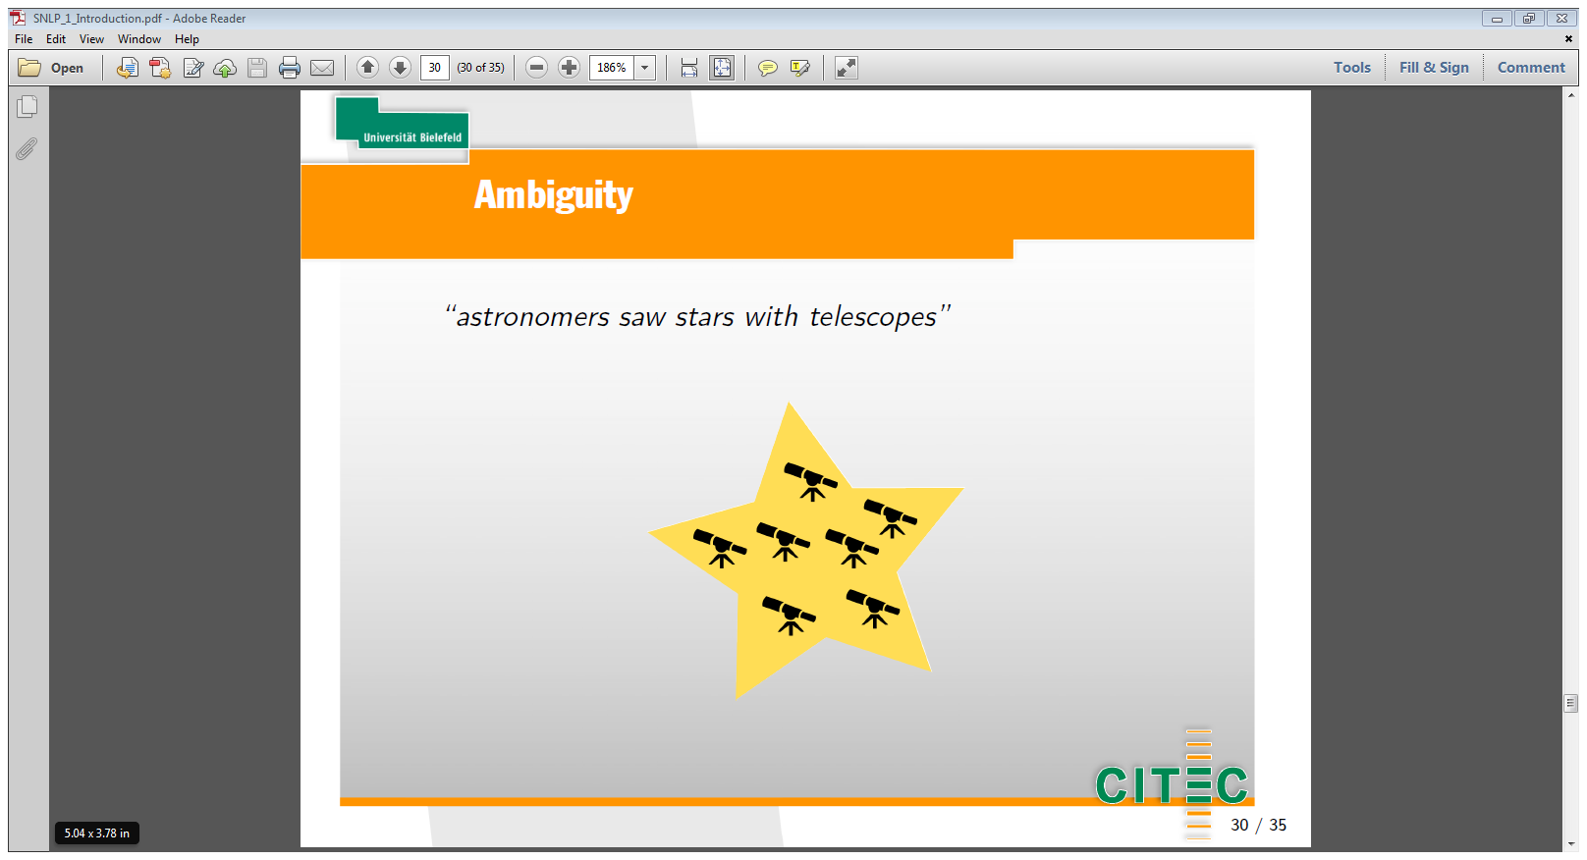
Syntactic Ambiguity
astronomers saw stars with telescopes

Slide 34
Vector Space Model & Word Embeddings
Distributional Semantics: words are similar in meaning if they share similar contexts
Represent words using vectors (embeddings)
Based on language modeling

Slide 35
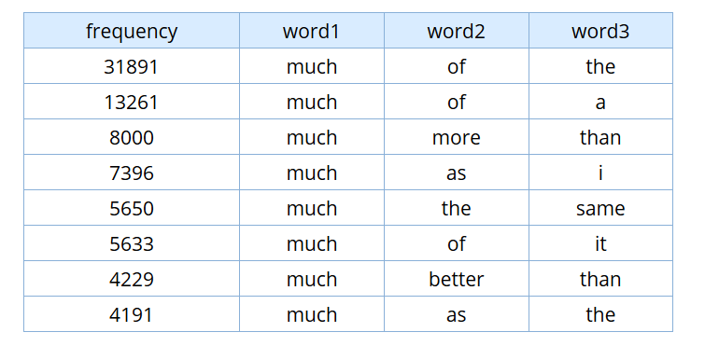
Language Modeling
Frequency and co-occurrence are central to language modelling
Example: n-grams from the Corpus of Contemporary American English
https://www.english-corpora.org/coca/
https://www.ngrams.info/

Slide 36
Overview
Organizational issues
Why NLP
Human language
Some common notions in NLP
Architectures
Applications
Useful pointers

Slide 37
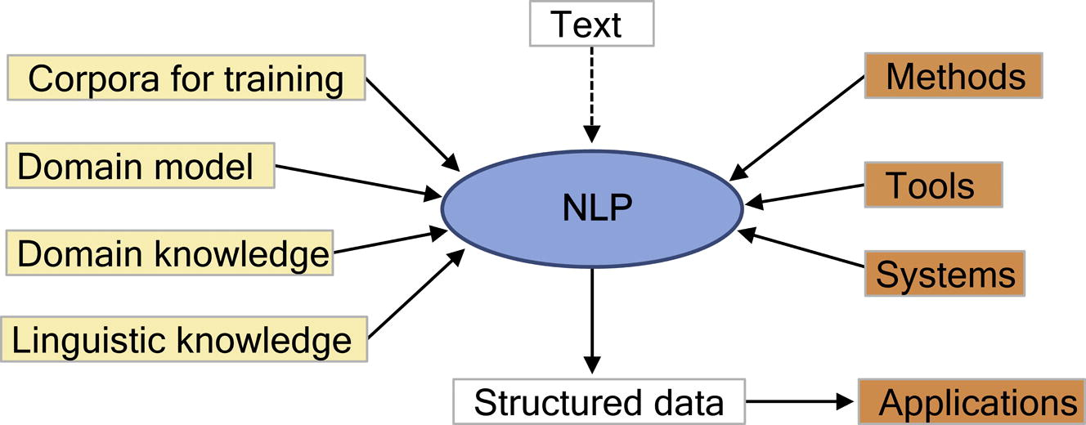
NLP Architecture - General Overview
Friedman, C., Rindflesch, T.C. and Corn, M., 2013. Natural language processing: state of the art and prospects for significant progress, a workshop sponsored by the National Library of Medicine. Journal of biomedical informatics, 46(5), pp.765-773.

Slide 38
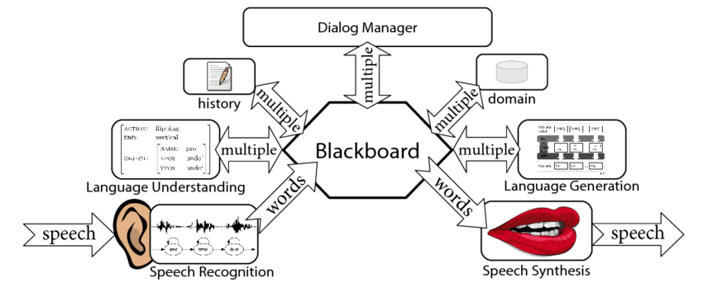
Blackboard Architecture
T. Baumann. Incremental Spoken Dialogue Processing: Architecture and Lower-level Components. PhD thesis, Universität Bielefeld, Germany, 2013.

Slide 39
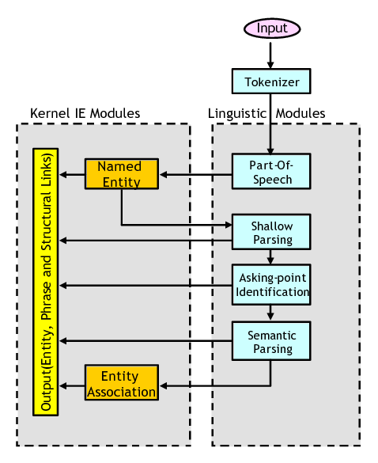
Pipeline Architecture
https://www.researchgate.net/figure/InfoXtract-NLP-IE-System-Architecture_fig1_228960112

Slide 40
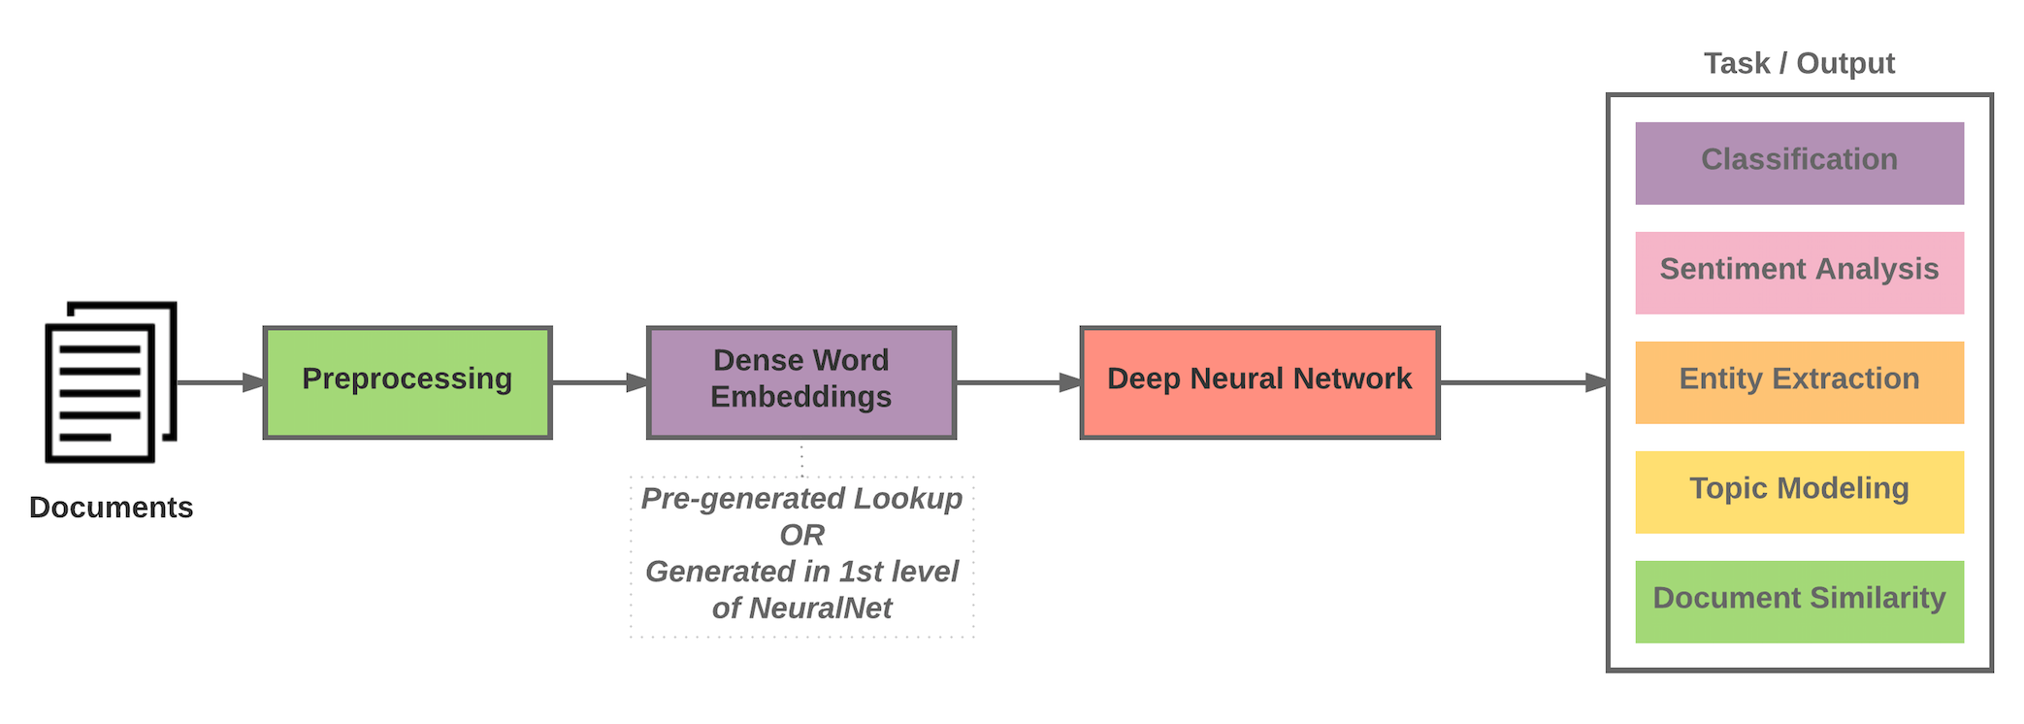
Deep Learning Architecture ‘End-to-End’
http://mattfortier.me/2017/01/31/nlp-intro-pt-1-overview/

Slide 41
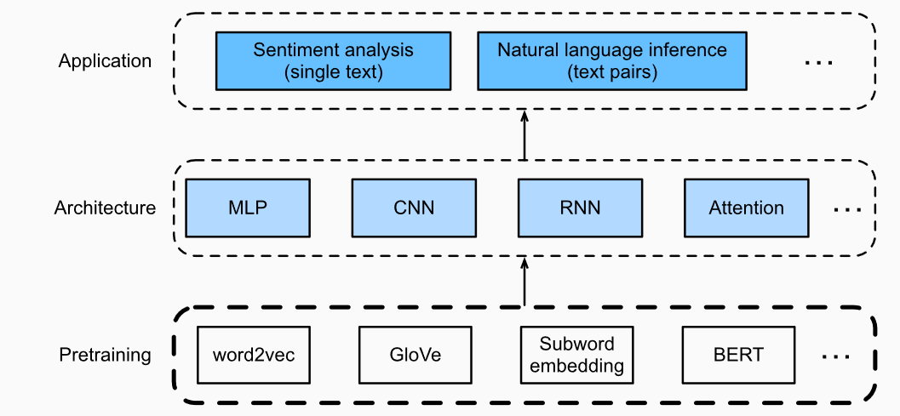
Deep Learning - Pre-Trained Models
https://d2l.ai/chapter_natural-language-processing-pretraining/index.htm l

Slide 42
Overview
Organizational issues
Why NLP
Human language
Some common notions in NLP
Architectures
Applications
Useful pointers

Slide 43
NLP Applications
Classification such as Sentiment Analysis
Retrieval such as Question Answering
Natural Language Generation such as Dialog Systems (Chatbots)
Transformation such as Machine Translation

Slide 44
NLP Applications - Classification
Many NLP tasks can be formulated as a classification problem, e.g.
Sentiment Analysis: classification of a sentence as Pos or Neg
Part of Speech Tagging: classification of a word as a Noun, Verb, Adj,...
Word Sense Disambiguation: classification of ‘bank’ as Sense-1 or Sense-2

Slide 45
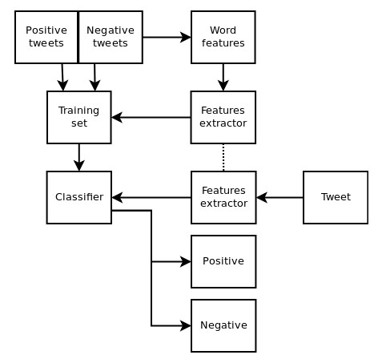
Sentiment Analysis
https://www.pantechsolutions.net/twitter-sentiment-analysis-using-machine-learning-algorithms-on-python

Slide 46
NLP Applications - Retrieval
NLP tasks based on retrieval, e.g.
Question Answering

Slide 47
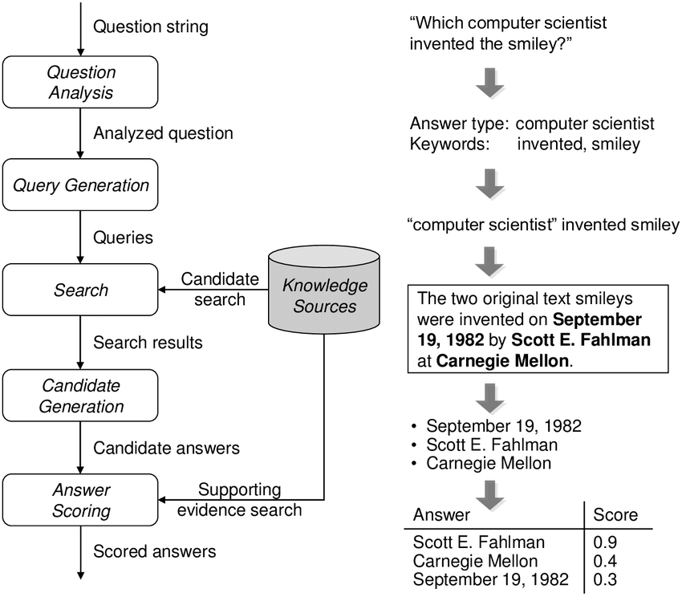
Question Answering
Schlaefer, N., 2011. Statistical Source Expansion for Question Answering (Doctoral dissertation, IBM TJ Watson Research Center).

Slide 48
NLP Applications - Generation
NLP tasks based on generation, e.g.
Dialog Systems (Chatbots)
Natural Language Generation from Data
Abstractive Document Summarization

Slide 49
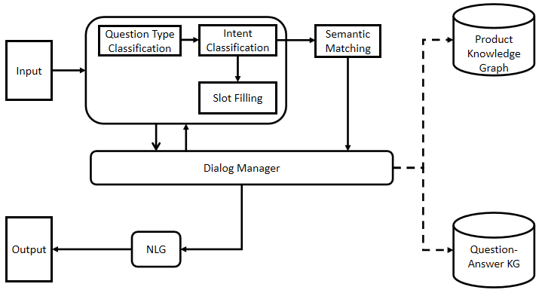
Dialog Systems (Chatbots)
Zhao, G., Zhao, J., Li, Y., Alt, C., Schwarzenberg, R., Hennig, L., Schaffer, S., Schmeier, S., Hu, C. and Xu, F., 2019. MOLI: Smart Conversation Agent for Mobile Customer Service. Information, 10(2), p.63.

Slide 50
NLP Applications - Transformation
NLP tasks based on transformation, e.g.
Machine Translation

Slide 51
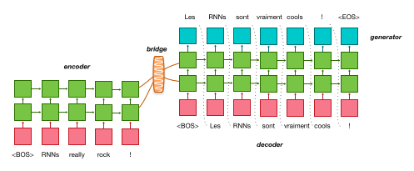
Neural Machine Translation
https://opennmt.net/OpenNMT/applications/

Slide 52
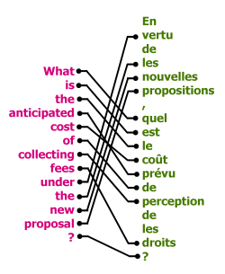
Bilingual Corpus

Slide 53
Overview
Organizational issues
Why NLP
Human language
Some core notions in NLP
Architectures
Applications
Useful pointers

Slide 54

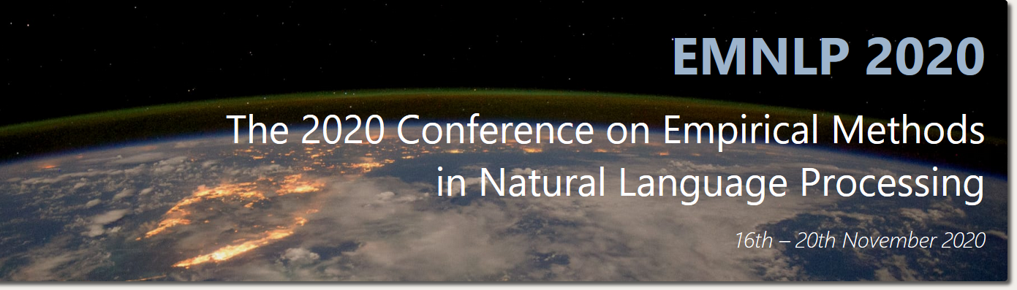


NLP Publications - Conferences

Slide 55
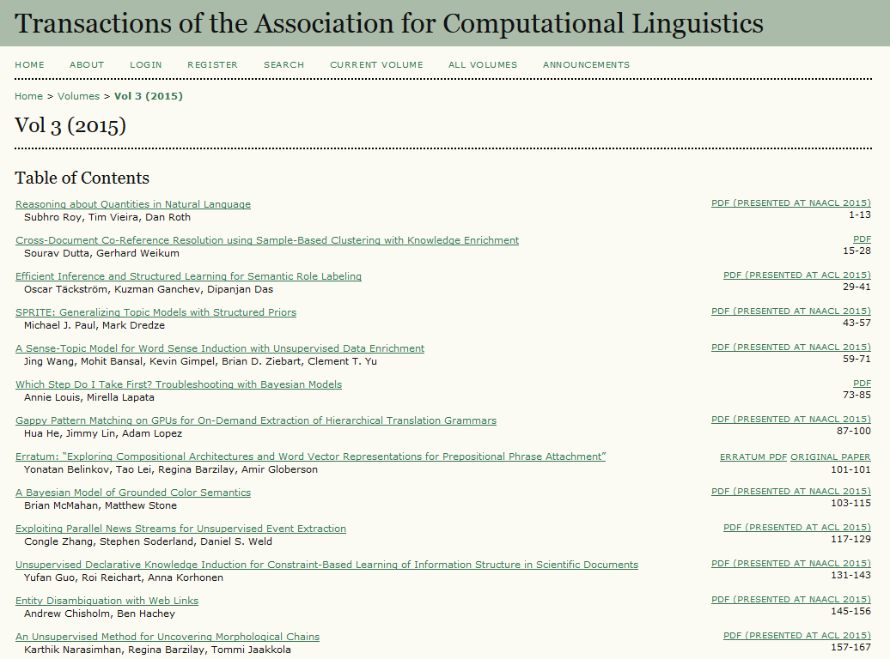
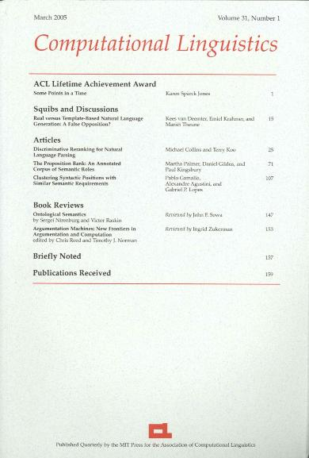


NLP Publications - Journals

Slide 56

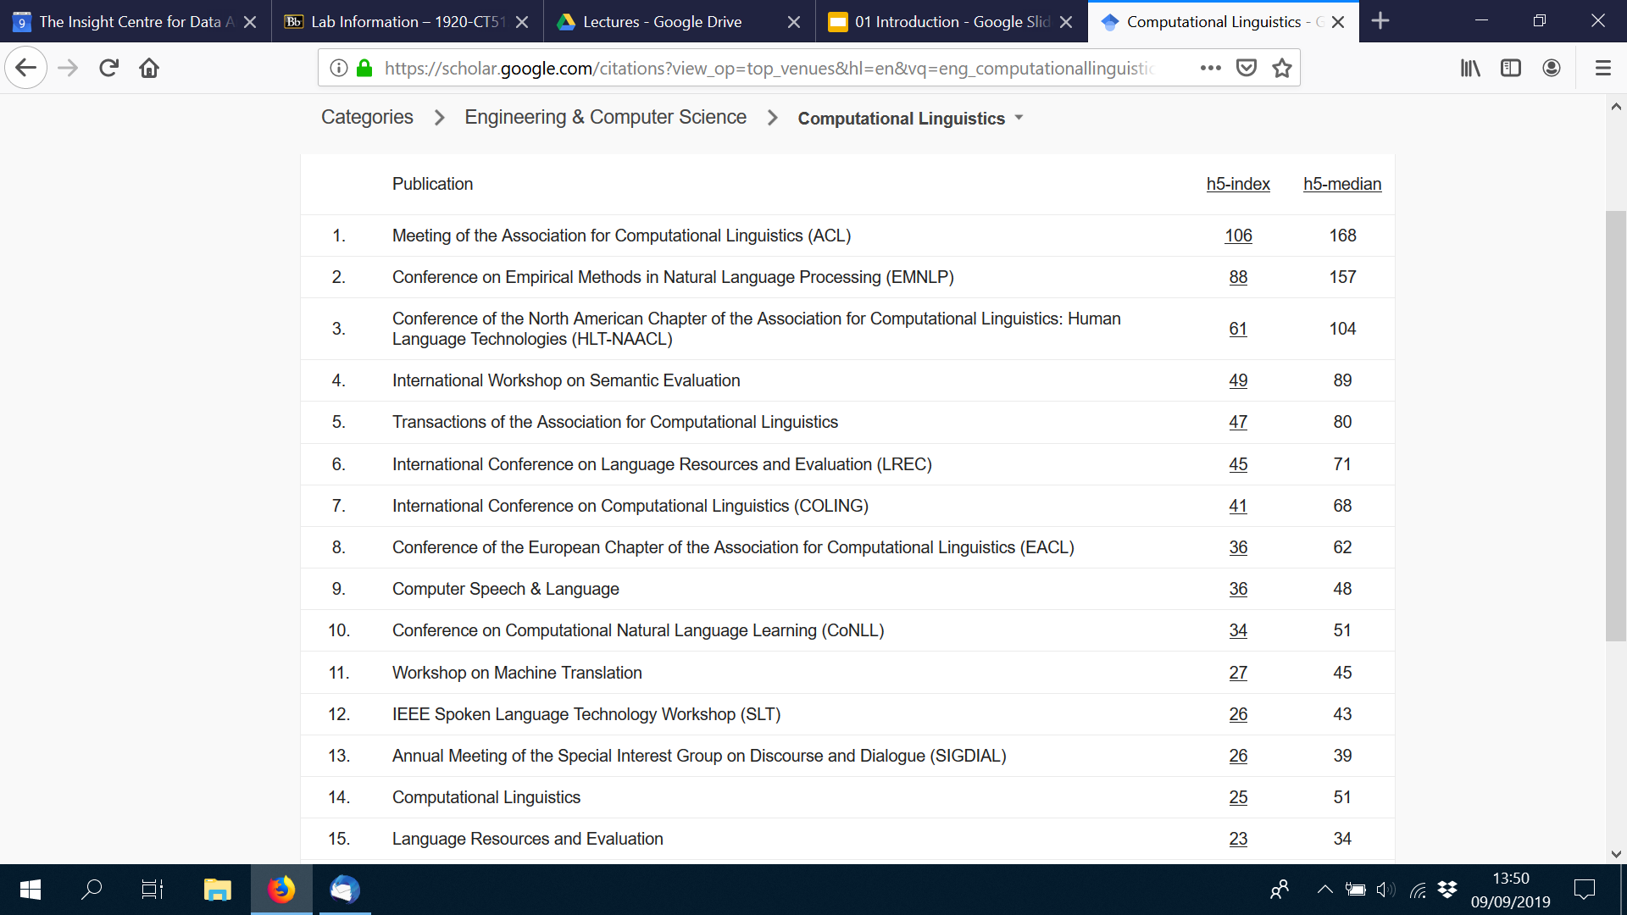
NLP Publications - Ranking

Slide 57
NLP Forums - Mailing Lists
Corpora List
http://clu.uni.no/icame/corpora/
Linguist List
http://www.linguistlist.org/

Slide 58
ACL - Professional Association for NLP
Association for Computational Linguistics (ACL)
http://www.aclweb.org/
ACL Anthology: archive of NLP conference publications
https://www.aclweb.org/anthology/

Slide 59
Lab of this Week
Intro to NLTK - labs will use NLTK in Python
https://www.nltk.org/

Slide 60
Advanced Topics in NLP - CT5121
Optional Semester 2 course by Dr. John McCrae & Dr. Mihael Arčan
Word Embeddings
Recurrent Neural Network (RNN) & Long Short-Term Memory (LSTM)
Machine Translation
Textual Similarity
Topic Models
Linguistic Linked Open Data
Lexicography and Under-resourced Languages

Slide 61
QA

Slide 62
Introduction to NLP
Linguistic Concepts
Dr. Paul Buitelaar
Data Science Institute, NUI Galway

Slide 63
Learning Outcomes of This Lecture
Insight into linguistic foundations of Natural Language Processing
Understand relation between different linguistic levels of analysis
Understand core concepts in morphological, syntactic and semantic analysis
Understand different types of language data

Slide 64
Overview
Foundations in linguistic theory
Linguistic levels of analysis
Morphology
Syntax
Semantics
Types of language data
Corpus
Lexicon

Slide 65
Overview
Foundations in linguistic theory
Linguistic levels of analysis
Morphology
Syntax
Semantics
Types of language data
Corpus
Lexicon

Slide 66
Linguistic Theory
Linguistic study develops a theory that explains
use of language - ‘language performance’
knowledge and acquisition of language - ‘language competence’
NLP is concerned with
use of language - data
knowledge and acquisition of language - models

Slide 67
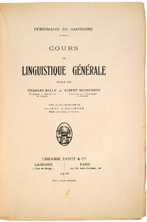
Linguistic Theory – Some History
Structural Linguistics (de Saussure, 1916)
Paradigmatic Relations
relations between words that may replace each other in a sequence
Syntagmatic Relations
relations between words that may combine with each other in a sequence
Ferdinand de Saussure (1916). “Course in General Linguistics”

Slide 68
Structural Linguistics - Example
…
cat
The dog lies on the mat
child
…
Paradigmatic Relations
Syntagmatic Relations

Slide 69
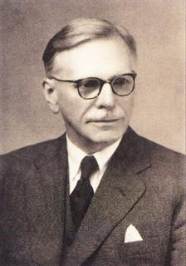
Paradigmatic Relations
Distributional Hypothesis (Firth 1957) - “you shall know a word by the company it keeps”
For example, ‘cat’, ‘dog’, ‘child’ can occur in similar contexts and are therefore similar in meaning (distributional semantics)
Distributional Hypothesis is the basis for the Vector Space Model
Firth, J.R. (1957). "A synopsis of linguistic theory 1930-1955". Studies in Linguistic Analysis: 1–32

Slide 70
Vector Space Model
dog
cat
child

Slide 71
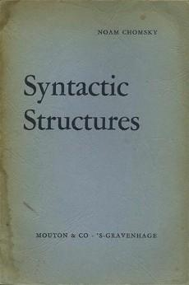
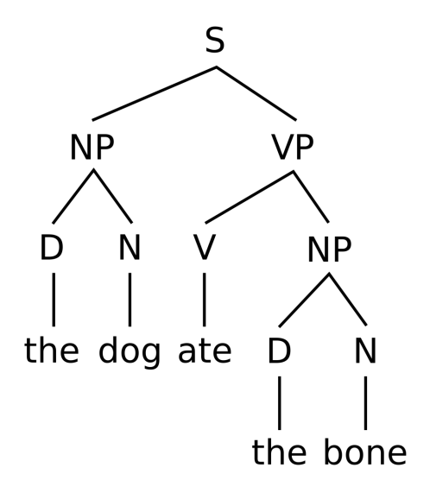
Syntagmatic Relations
Constituency or Phrase Structure (Chomsky, 1957)
Noam Chomsky (1957). “Syntactic Structures”, Mouton & Co.

Slide 72
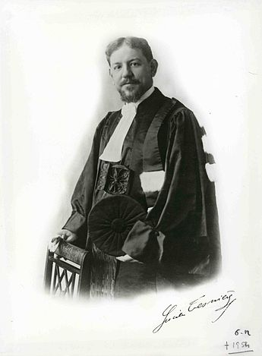
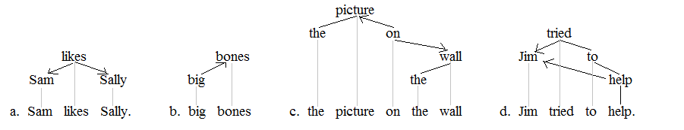
Syntagmatic Relations
Dependency Structure (Tesnière, 1959)
https://en.wikipedia.org/wiki/Dependency_grammar
Tesnière, L. (1959). Eléments de Syntaxe Structurale. Paris Klincksieck.

Slide 73
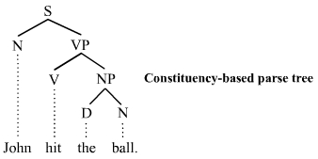
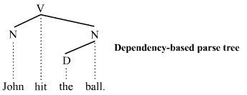
Phrase Structure vs. Dependency Structure
https://en.wikipedia.org/wiki/Parse_tree

Slide 74
Overview
Foundations in linguistic theory
Linguistic levels of analysis
Morphology
Syntax
Semantics
Types of language data
Corpus
Lexicon

Slide 75
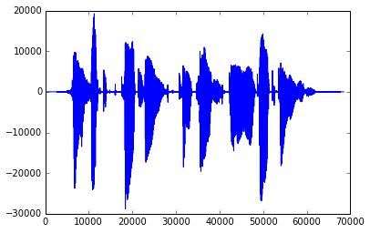
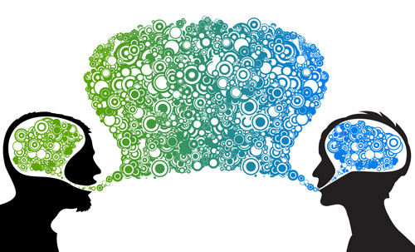
Linguistic Levels of Analysis
Phonology - acoustic signal
Morphology – word structure
Syntax – sentence and phrase structure
Semantics – meaning and reference
Pragmatics - communication

Slide 76
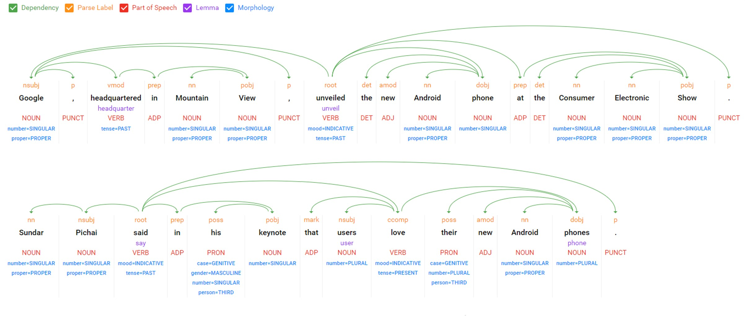
Linguistic Levels of Analysis
Sample top-down output from Google Cloud Natural Language API - image from https://witanworld.com/article/2018/10/28/naturallanguageprocessing-nlp/

Slide 77
Overview
Foundations in linguistic theory
Linguistic levels of analysis
Morphology
Syntax
Semantics
Types of language data
Corpus
Lexicon

Slide 78
Morphology – Stemming
Non-linguistic (simplified) analysis of word structure by removing endings/beginnings of words - leaving a common stem
For example:
learns > learn-s
learning > learn-ing
learned > learn-ed

Slide 79
Morphology – Stemming
Problematic for instance for irregular verbs
For example:
teaches > teach-es
teaching > teach-ing
taught > ??

Slide 80
Morphology – Lemmatization
Linguistic analysis of word structure by a transformation of morphologically related words to a common lemma
For example:
studies ies > y study
studying ing > - study
studied ied > y study
teaches es > - teach
teaching ing > - teach
taught > teach

Slide 81
Morphology – Inflection
Linguistic analysis of internal structure of words into
lemma with inflectional features
For example:
writes write + Verb + 3rd Person + Singular + Present
wrote write + Verb + 3rd Person + Singular + Past
writing write + Verb + Progressive

Slide 82
Morphology – Inflection
Inflectional patterns can be shared across word classes
For example, many English verbs share this pattern:
write s Verb + 3rd Person + Singular + Present
read s Verb + 3rd Person + Singular + Present
work s Verb + 3rd Person + Singular + Present

Slide 83
Morphology – Inflection
But note that there are many irregular inflectional patterns
For example:
wr o te Verb + 3rd Person + Singular + Past
read Verb + 3rd Person + Singular + Past
work ed Verb + 3rd Person + Singular + Past

Slide 84
Morphology – Inflection
Also note ambiguity between syntactic classes (‘part of speech’)
For example, identical but ambiguous inflection of nouns and verbs:
book s Verb + 3rd Person + Singular + Present
book s Noun + Plural

Slide 85
Morphology – Derivation
Inflection: grammatical role and structure of words
Derivation: generation of words from other words
For example:
agreement Noun derived from agree Verb
friendship Noun derived from friend Noun
civilize Verb derived from civil Adjective
civilization Noun derived from civilize Verb

Slide 86
Morphology – Compounds & Decomposition
Compound: concatenation of simple words into a complex word
(note that analysis of compounds is referred to as decomposition)
Compounds are not common in English, but for example:
bookshelves > book + shelves
bedroom > bed + room
policeman > police + man
https://en.wikipedia.org/wiki/Longest_words

Slide 87
Morphology – Compounds in Other Languages
Compounds (morphological decomposition) are very common in German
Flachbildschirm > flach + Bildschirm (flat + screen)
Flachbildschirm > Flachbild + Schirm (flat view + screen)
Flachbildschirm > flach + Bild + Schirm (flat + picture + screen)
also very common in Dutch
bestuurdersaansprakelijkheidsverzekering (driver + liability + insurance)
overeenstemmingsbeoordelingsprocedures (conformity + assessment + procedures)
and in many other languages

Slide 88
Multi-Word Expression (MWE)
Compounds are rare in English but correspond instead to
multi-word expressions
For example, technical terms such as in the health domain
cardiac arrest
or names of people, locations, organisations, etc.
Barack Obama
San Francisco
United Nations

Slide 89
Types & Tokens
The number of tokens is the total occurrence of individual words
The number of types is the total occurrence of unique words
For example, in the sentence ‘the cat sat on the mat’ there are:
6 tokens the, cat, sat, on, the, mat
5 types the, cat, sat, on, mat

Slide 90
Morphology - Types & Tokens
Morphological and MWE analysis effects nature and number of types and tokens in a data set through inflection, derivation, decomposition
For example:
Barack Obama’s bookshelves had books about ancient civilizations
can be analyzed as:
Barack_Obama book shelf have book about ancient civil|civilize|civilization

Slide 91
Non-Linguistic Tokens
Often non-linguistic tokens are used as well, e.g. in tweets:
IRIS, an SMT System developed @unlp_insight, mentioned in #nuigalway newsletter

Slide 92
Overview
Foundations in linguistic theory
Linguistic levels of analysis
Morphology
Syntax
Semantics
Types of language data
Corpus
Lexicon

Slide 93
Part of Speech
Syntactic category of a word (noun, verb, etc.), aka ‘Part of Speech (PoS) tag’
Useful for subsequent syntactic parsing - analysing phrase / dependency structure
PoS tag set for English has 36 tags – see next slide for 25 most common tags
PoS tagging example
John saw the saw and decided to take it to the table .
NNP VBD DT NN CC VBD TO VB PRP IN DT NN .

Slide 94
Penn Treebank PoS Tag Set - for English
Nouns Singular NN dog, fork
Plural NNS dogs, forks
Proper noun - singular, plural NNP, NNPS John, Smiths,…
Personal pronoun PRP I, you, he, she, it
Wh-pronoun WP who, what,…
Verbs Base, infinitive VB eat
Past tense VBD ate
Gerund VBG eating
Past participle VBN eaten
Non 3rd person singular present tense VBP eat
3rd person singular present tense VBZ eats
Modal MD should, can
To Particle TO to eat
Adjectives Basic JJ red, tall
Comparative JJR redder, taller
Superlative JJS reddest, tallest
Adverbs Basic RB quickly
Comparative RBR quicker
Superlative RBS quickest
Prepositions Preposition IN on, in, by, to, with,…
Determiners Basic determiner DT a, an, the
WH-determiner WDT which, that,…
Conjunctions Coordinating Conjunction CC and, but, or
Particles Particle RP off (took off), up (put up),…
https://www.ling.upenn.edu/courses/Fall_2003/ling001/penn_treebank_pos.html

Slide 95
Phrase Structure
Overall structure of groups of words that function as identifiable constituents (phrases)
For example
the dog, the bone Noun Phrase (NP)
ate the bone Verb Phrase (VP)
https://en.wikipedia.org/wiki/Phrase

Slide 96
Phrase Structure Grammar
A (context-free) Phrase Structure Grammar G=(N,Σ,P,S) consists of:
a set of non-terminal symbols N, e.g.
N, V, NP, VP, S
a set of terminal symbols Σ, e.g.
astronomer, cat, see, the
a set of productions P, e.g.
S → NP VP
a start symbol, normally 'S'

Slide 97
Phrase Structure Grammar - Example
G=(N,Σ,P,S)
N: Det, Noun, Prep, Verb, NP, PP, VP, S
Σ: cat, mat, on, sits, the
P: S → NP VP [NP the cat] [VP sits on the mat]
NP → Det Noun [DET the] [N cat] | [DET the] [N mat]
VP → Verb PP [V is] [PP on the mat]
PP → Prep NP [P on] [NP the mat]
Start symbol S [S the cat sits on the mat]

Slide 98
Lexical Rules (Lexicon)
G=(N,Σ,P,S)
N: Det, Noun, Prep, Verb, NP, PP, VP, S
Σ: cat, mat, on, sits, the
P: Det → the
Noun → cat | mat | dots
Prep → on | with
Verb → sits
Start symbol S

Slide 99
Parse Tree based on this Grammar & Lexicon
S
VP
non-terminals
PP
NP
NP
Det
Noun
Verb
Prep
Det
Noun
terminals
the
cat
sits
on
the
mat

Slide 100
Phrase Structure Grammar with Recursion
G=(N,Σ,P,S) consisting of:
N: Det, Noun, Prep, Verb, NP, PP, VP, S
Σ: cat, dots, mat, on, sits, the, with
P: S → NP VP
NP → Det Noun
VP → Verb PP
PP → Prep NP < Recursion
NP → NP PP < Recursion
Start symbol S the cat sits on the mat with the dots

Slide 101
Parse Tree with Recursion
S
VP
PP
NP
PP
NP
NP
NP
Det
Noun
Verb
Prep
Det
Noun
Prep
Det
Noun
the
cat
sits
on
the
mat
with
the
dots

Slide 102
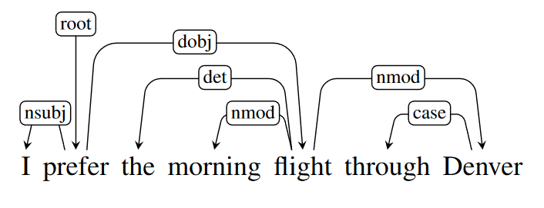
Dependency Structure
Syntactic analysis by use of a set of dependency relations between words, e.g.
Jurafsky & Martin Ch 13

Slide 103
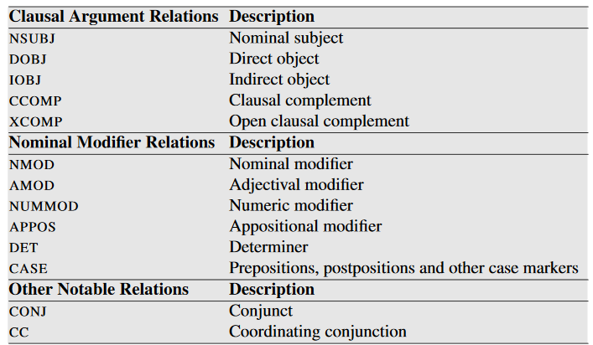
Dependency Relations
Most commonly used are Universal Dependency relations
Jurafsky & Martin p272
https://universaldependencies.org/

Slide 104
Overview
Foundations in linguistic theory
Linguistic levels of analysis
Morphology
Syntax
Semantics
Types of language data
Corpus
Lexicon

Slide 105

Semantics
Semantics studies interpretation and reference
Foundations in ‘semiotics’ (study of symbols and their reference)
Semiotic Triangle (Ogden & Richards, 1923) is interface between:
objects in the world (referents)
cognitive interpretation of these objects (concepts)
symbolic representations for these cognitive interpretations (symbols)
C. K. Ogden and I. A. Richards, The Meaning of Meaning: A Study of the Influence of Language upon Thought and of the Science of Symbolism (1923)

Slide 106
Semantics of Language Data
Semantic analysis of language data is concerned with
how linguistic symbols (words, phrases, sentences)
refer to concepts (entities, relations, events)
about referents (objects in the world)
Relation between linguistic symbols and concepts commonly referred to as ‘meaning’

Slide 107
Levels of Semantic Analysis
Lexical Semantics
meaning of a word (table, large, to book, in, ...)
Compositional Semantics
combined meaning of several words in a phrase (large table, book a table) or sentence (He booked a large table.)
Discourse Semantics
combined meaning of several sentences (He booked a table. It was still available.)
Note: also in dialog (as in chatbots and other dialog systems)

Slide 108
Semantic Analysis Tasks
Word Sense Disambiguation
identify intended meaning (‘sense’) of a word in a specific linguistic context
Semantic Role Labeling
identify implied semantic role of an entity expressed by a word or phrase
Coreference Resolution
identify which words or phrases express the same entity

Slide 109
Word Sense Disambiguation (WSD)
Ambiguous words have different meanings due to homonymy
table in the context of ‘furniture’
table in the context of ‘accounting’
Related to this is synonymy (different words with the same meaning)
table, chart,…
WSD: identify correct word sense for ambiguous words - for example:
To add additional columns, drag the field to the table until you see an insertion point.
Whether on the mantelpiece or on the dining table, vases are a beautiful addition to any home.

Slide 110
Semantic Role Labeling
Verbs introduce Semantic Roles for other words in the sentence
For example, to hit introduces roles for:
Agent who hits
Recipient who was hit
Instrument what was used to hit with
Temporal when did the hitting take place
Location where did the hitting take place
[Kristina AGT] hit [Scott REC] with a [baseball INS] [yesterday TMP] [in the park LOC]

Slide 111
Coreference Resolution
Identify words/phrases referring to the same entity - for example:
Barack Obama nominated Hillary Clinton as his secretary of state on Monday. He chose her because she had foreign affairs experience as a former First Lady.
Example taken from: https://web.stanford.edu/class/cs224n/slides/cs224n-2019-lecture16-coref.pdf

Slide 112
Overview
Foundations in linguistic theory
Linguistic levels of analysis
Morphology
Syntax
Semantics
Types of language data
Corpus
Lexicon

Slide 113
Types of Language Data
Language Data | Specifics
formal reports | complete grammatical sentences
slides | incomplete ungrammatical sentences and phrases
text fields in DBs | incomplete ungrammatical sentences and phrases database structure
emails | incomplete ungrammatical sentences and phrases threads with temporal and social network structure
social media | incomplete ungrammatical sentences, phrases threads with temporal and social network structure multimedia data
… | …

Slide 114
Types of Annotation (Data Labelling)
Annotation | Specifics
part-of-speech | annotation of words with ‘PoS tags’ (N, V, Adj, Prep,...)
word sense | annotation of words with their ‘sense’ (bank_01, bank_02,...)
semantic role | annotation of words with their ‘semantic role’ (Agent, Recipient, Instrument,...)
entity type | annotation of words with a type of ‘entity’ (Person, Location, Organization,…)
translation | words in a ‘corpus’ in language A aligned to words in a ‘corpus’ in language B
… | …

Slide 115
Overview
Foundations in linguistic theory
Linguistic levels of analysis
Morphology
Syntax
Semantics
Types of language data
Corpus
Lexicon

Slide 116
Corpus
A corpus is an (annotated) language dataset
General corpus vs. domain-specific corpus
Annotated corpus vs. ‘raw data’
Monolingual, bilingual, multilingual corpus
Parallel, comparable corpus
Multimodal corpus
Please note: corpus (singular), corpora (plural)

Slide 117
General Corpus
Representative of a language as a whole
e.g. ‘British English from late twentieth century’
Used for training general purpose NLP tools
not tuned to a specific domain
Examples
British National Corpus (BNC) 100 million words, British English text/speech
Open American National Corpus (OANC) 15 million words, American English text/speech
Corpus of Contemporary American English (COCA) 560 million words, American English text
German Reference Corpus 32.85 billion words (Oct. 2017), German text

Slide 118
Domain Corpus
Representative of a domain specific subset of a language
language as used specifically, e.g., in healthcare, finance, legal, …
Used for training domain-specific NLP tools, e.g.
healthcare: corpus of medical documents such as patient records, clinical notes, scientific papers,…
https://www.i2b2.org/NLP/DataSets/Main.php
legal: corpus of legal documents such as national and international laws, legal cases, contracts, ,…
https://archive.ics.uci.edu/ml/datasets/Legal+Case+Reports

Slide 119
Annotated Corpus
Corpus with annotations on word, phrase, sentence or document level
Syntax/Morphology PoS, phrase structure, parse tree,…
Semantics word senses, terms, entities, relations, …
Other translations, multi-modal references, …
Annotated corpus is used in NLP for supervised training and/or evaluation
Annotated (labelled) dataset

Slide 120

Corpus Annotation by Crowdsourcing
Negi, S., 2019. Suggestion mining from text (Doctoral dissertation, NUI Galway).

Slide 121
Monolingual, Bilingual, Multilingual Corpus
Monolingual Corpus
text (or speech data) in one language
more readily available (easy to find data in one language)
Bilingual and Multilingual Corpus
text (or speech data) in two or more languages
consist of pairs (bilingual) or tuples (multilingual) of translations
mostly used for training machine translation systems
not easily available (difficult to find translated data)

Slide 122
Parallel vs. Comparable Corpus
Parallel Corpus
collection of translated documents, e.g. proceedings of the European Parliament with translations between 21 European languages http://www.statmt.org/europarl/
Comparable Corpus
collection of documents on the same topic in different languages, e.g. links between Wikipedia articles in different languages

Slide 123


Parallel Corpus - Example
https://www.linguee.com/

Slide 124



Comparable Corpus - Example
English Wikipedia on French Revolution: Napoleon, war, global view, ….
German Wikipedia on French Revolution: human rights, constitution, …

Slide 125

Multimodal Corpus
Consists not only of language data but also image, audio, video, …
Image from: Blache, P., Bertrand, R. and Ferré, G., 2008, May. Creating and exploiting multimodal annotated corpora: the ToMA project. In International LREC Workshop on Multimodal Corpora (pp. 38-53). Springer, Berlin, Heidelberg.

Slide 126
Overview
Foundations in linguistic theory
Linguistic levels of analysis
Morphology
Syntax
Semantics
Types of language data
Corpus
Lexicon

Slide 127

Lexicon
Database of words with lexical properties such as spelling, pronunciation, morphology, PoS, semantics, …
Originating out of paper dictionaries

Slide 128


Semantic Lexicon
Organized by ‘synsets’ – represents word meaning by use of sets of Synonyms
https://wordnet.princeton.edu/
Organized by ‘frames’ – represents word meaning by use of Semantic Roles
https://framenet.icsi.berkeley.edu/fndrupal/about

Slide 129
WordNet
Word meaning represented in WordNet by use of “synsets” (Miller, 1995)
For example:
{board, plank} represents ‘board’ in the meaning of ‘plank’
{board, committee} represents ‘board’ in the meaning of ‘committee’
Miller, George A. "WordNet: a lexical database for English." Communications of the ACM 38.11 (1995): 39-41.

Slide 130

WordNet - Synsets for the Noun table
http://wordnetweb.princeton.edu/perl/webwn

Slide 131
WordNet - Hypernyms & Hyponyms
Synsets are organized hierarchically in WordNet, expressing generalization (hypernyms) and specialization (hyponyms)
{entity}
…
{whole, unit}
{building material}
{lumber, timber}
{board, plank}
hypernym
hyponym

Slide 132
FrameNet
Based on Frame Semantics (Fillmore 1968)
“frame [is] a description of a type of event, relation, or entity and the participants in it”
Frames express Semantic Roles - for example:
cooking typically relates to an Apply_Heat event
involving a person doing the cooking (Cook)
the food that is to be cooked (Food)
something to hold the food while cooking (Container)
and a source of heat (Heating_instrument)
Fillmore, C. J. (1968). The case for case. In Bach, E.W. and Harms, R. T. (Eds.), Universals in Linguistic Theory, p1–88

Slide 133
Frames, Frame Elements & Lexical Units
Frame Apply_Heat
Frame Elements Cook ; Food ; Container ; Heating_Instrument
Lexical Units bake, boil, cook, simmer, steam, …
Note: lexical units within a frame are synonyms

Slide 134


FrameNet
https://framenet.icsi.berkeley.edu/fndrupal/

Slide 135
Lab of this Week
Exercises in linguistic analysis

Slide 136
QA

Slide 137
Introduction to NLP
Vector Space Model & Word Embeddings
Dr. Paul Buitelaar
Data Science Institute, NUI Galway

Slide 138
Learning Outcomes of This Lecture
Understand the distributional (vector space) model for NLP
Learn how to construct and use word vectors in semantic similarity
Insight into use of linguistic context in constructing word vectors
Introduction to word embeddings and pre-trained models in NLP

Slide 139
Overview
Vector Space Model
Distributional Semantics
Context in Distributional Representations
Word Embeddings

Slide 140
Overview
Vector Space Model
Distributional Semantics
Context in Distributional Representations
Word Embeddings

Slide 141
Vector Space Model
Foundations in Information Retrieval (Salton et al., 1975)
Represent document set by distribution of index terms
Represent distributional model in vector space
Salton, G., Wong, A., & Yang, C. S. (1975). A vector space model for automatic indexing. Communications of the ACM, 18(11), 613-620.

Slide 142
Document Set
Government publishes NPHET advice
Doc1
NPHET concerned about outbreaks in workplaces
Doc2
NPHET advice says it is impossible to predict the trajectory of Covid-19
Doc3

Slide 143
Index Terms
Government publishes NPHET advice
Doc1
Content words (nouns, verbs, adjectives), ignoring stopwords (about, in, it, is, ...)
NPHET concerned about outbreaks in workplaces
Doc2
NPHET advice says it is impossible to predict the trajectory of Covid-19
Doc3

Slide 144
Inverted Index
Index Term | Document ID
advice | 1,3
concerned | 2
Covid-19 | 3
Government | 1
impossible | 3
NPHET | 1,2,3
outbreaks | 2
predict | 3
publishes | 1
says | 3
trajectory | 3
workplaces | 2
Term-Document matrix (alphabetically sorted)

Slide 145
Document Vectors
Index Term | Term ID | Document ID
advice | T1 | 1,3
concerned | T2 | 2
Covid-19 | T3 | 3
Government | T4 | 1
impossible | T5 | 3
NPHET | T6 | 1,2,3
outbreaks | T7 | 2
predict | T8 | 3
publishes | T9 | 1
says | T10 | 3
trajectory | T11 | 3
workplaces | T12 | 2
T1,T2,T3,T4,…,T11, T12
Doc1 [1,0,0,1,0,1,0,0,1,0,0,0]
Doc2 [0,1,0,0,0,1,1,0,0,0,0,1]
Doc3 [1,0,1,0,1,1,0,1,0,1,1,0]

Slide 146
Document Retrieval
Index Term | Term ID | Document ID
advice | T1 | 1,3
concerned | T2 | 2
Covid-19 | T3 | 3
Government | T4 | 1
impossible | T5 | 3
NPHET | T6 | 1,2,3
outbreaks | T7 | 2
predict | T8 | 3
publishes | T9 | 1
says | T10 | 3
trajectory | T11 | 3
workplaces | T12 | 2
Doc1 [1,0,0,1,0,1,0,0,1,0,0,0]
Doc2 [0,1,0,0,0,1,1,0,0,0,0,1]
Doc3 [1,0,1,0,1,1,0,1,0,1,1,0]
What is the NPHET Government advice?

Slide 147
Document Retrieval
Index Term | Term ID | Document ID
advice | T1 | 1,3
concerned | T2 | 2
Covid-19 | T3 | 3
Government | T4 | 1
impossible | T5 | 3
NPHET | T6 | 1,2,3
outbreaks | T7 | 2
predict | T8 | 3
publishes | T9 | 1
says | T10 | 3
trajectory | T11 | 3
workplaces | T12 | 2
Doc1 [1,0,0,1,0,1,0,0,1,0,0,0]
Doc2 [0,1,0,0,0,1,1,0,0,0,0,1]
Doc3 [1,0,1,0,1,1,0,1,0,1,1,0]
What is the NPHET Government advice?
Query [1,0,0,1,0,1,0,0,0,0,0,0]

Slide 148
Vector Space
Government publishes NPHET advice
Doc1 [1,0,0,1,0,1,0,0,1,0,0,0]
What is the NPHET Government advice?
Query [1,0,0,1,0,1,0,0,0,0,0,0]
Doc1
Query
Doc2
Doc3

Slide 149
Term Vectors
Index Term | Term ID | Document ID
advice | T1 | 1,3
concerned | T2 | 2
Covid-19 | T3 | 3
Government | T4 | 1
impossible | T5 | 3
NPHET | T6 | 1,2,3
outbreaks | T7 | 2
predict | T8 | 3
publishes | T9 | 1
says | T10 | 3
trajectory | T11 | 3
workplaces | T12 | 2
Doc1,Doc2, Doc3
T1 [1,0,1]
T2 [0,1,0]
T3 [0,0,1]
….
T10 [0,0,1]
T11 [0,0,1]
T12 [0,1,0]

Slide 150
Vector Space
T1 [1,0,1]
T2 [0,1,0]
T3 [0,0,1]
….
T10 [0,0,1]
T11 [0,0,1]
T12 [0,1,0]
T1
T2,T12
T3,T10,T11

Slide 151
Latent Semantics
Represent index terms by their distribution over documents
Index terms with similar meaning will show similarity in distributions
‘Latent Semantic Analysis’ (LSA) or ‘Latent Semantic Indexing’ (LSI)
(Deerwester et al., 1990)
Deerwester, S., Dumais, S.T., Furnas, G.W., Landauer, T.K. and Harshman, R., 1990. Indexing by latent semantic analysis. Journal of the American society for information science, 41(6), pp.391-407.

Slide 152
Overview
Vector Space Model
Distributional Semantics
Context in Distributional Representations
Word Embeddings

Slide 153
Distributional Hypothesis
“you shall know a word by the company it keeps” - (Firth 1957)
cat and dog occur in similar contexts, therefore similar in meaning
Distributional Semantics
Firth, J.R. (1957). "A synopsis of linguistic theory 1930-1955". Studies in Linguistic Analysis: 1–32

Slide 154


Distributional Semantics - Context Words
Concordance examples generated with https://www.lextutor.ca/conc/

Slide 155
Target and Context Words in a Corpus
Corpus
The cat lies on the mat.
The dog lies on the floor.
The cat sits near the door.
The dog lies near the door
Targets
cat, dog
Vocabulary of context words (V)
the, lies, on, mat, floor, sits, near, door

Slide 156
Co-occurrence Matrix (Context N=1)
Corpus
The cat lies on the mat.
The dog lies on the floor.
The cat sits near the door.
The dog lies near the door
Targets
cat, dog
Vocabulary of context words (V)
the, lies, on, mat, floor, sits, near, door
V | the | lies | on | mat | floor | sits | near | door
cat | 1 | 1
dog

Slide 157
Co-occurrence Matrix (Context N=1)
Corpus
The cat lies on the mat.
The dog lies on the floor.
The cat sits near the door.
The dog lies near the door
Targets
cat, dog
Vocabulary of context words (V)
the, lies, on, mat, floor, sits, near, door
V | the | lies | on | mat | floor | sits | near | door
cat | 2 | 1 |  |  |  | 1
dog

Slide 158
Co-occurrence Matrix (Context N=1)
Corpus
The cat lies on the mat.
The dog lies on the floor.
The cat sits near the door.
The dog lies near the door
Targets
cat, dog
Vocabulary of context words (V)
the, lies, on, mat, floor, sits, near, door
V | the | lies | on | mat | floor | sits | near | door
cat | 2 | 1 |  |  |  | 1
dog | 1 | 1

Slide 159
Co-occurrence Matrix (Context N=1)
Corpus
The cat lies on the mat.
The dog lies on the floor.
The cat sits near the door.
The dog lies near the door
Targets
cat, dog
Vocabulary of context words (V)
the, lies, on, mat, floor, sits, near, door
V | the | lies | on | mat | floor | sits | near | door
cat | 2 | 1 |  |  |  | 1
dog | 2 | 2

Slide 160
Co-occurrence Matrix (Context N=1)
Corpus
The cat lies on the mat.
The dog lies on the floor.
The cat sits near the door.
The dog lies near the door
Targets
cat, dog
Vocabulary of context words (V)
the, lies, on, mat, floor, sits, near, door
V | the | lies | on | mat | floor | sits | near | door
cat | 2 | 1 | 0 | 0 | 0 | 1 | 0 | 0
dog | 2 | 2 | 0 | 0 | 0 | 0 | 0 | 0

Slide 161
Word Vectors for cat, dog
V | the | lies | on | mat | floor | sits | near | door
cat | 2 | 1 | 0 | 0 | 0 | 1 | 0 | 0
dog | 2 | 2 | 0 | 0 | 0 | 0 | 0 | 0

Slide 162
with 3 Non-Zero Dimensions
V | the | lies | on | mat | floor | sits | near | door
cat | 2 | 1 | 0 | 0 | 0 | 1 | 0 | 0
dog | 2 | 2 | 0 | 0 | 0 | 0 | 0 | 0
Notice many zeros (sparse vector)

Slide 163
Vector Space for cat, dog with 3 Dimensions
sits
V | the | lies | on | mat | floor | sits | near | door
cat | 2 | 1 | 0 | 0 | 0 | 1 | 0 | 0
dog | 2 | 2 | 0 | 0 | 0 | 0 | 0 | 0
cat
the
lies
dog

Slide 164

Distributional Similarity
Compute similarity of two words using their vector representations
Compute cosine of angle between two vectors
Cosine similarity (or ‘cosine distance’)
Image from https://www.oreilly.com/library/view/statistics-for-machine

Slide 165




Cosine Similarity
v_{i} w_{i} is the count for word v,w in context i

Slide 166
Cosine Similarity - Example
cat | 5 | 1 | 1 | 1 | 0
dog | 3 | 1 | 1 | 0 | 1
child | 3 | 1 | 1 | 0 | 1
cos (cat, dog) = 15+1+1+0+0 / (√ 25+1+1+1+0 * √ 9+1+1+0+1)
= 17 / (√ 28 * √ 12 )
= 17 / (5.29 * 3.46)
= 0.93
cos (cat, child) = 15+1+1+0+0 / (√ 25+1+1+1+0 * √ 9+1+1+0+1)
= 17 / (√ 28 * √ 12)
= 17 / (5.29 * 3.46)
= 0.93
cos (dog, child) = 9+1+1+0+1 / (√ 9+1+1+0+1 * √ 9+1+1+0+1)
= 12 / (√ 12 * √ 12)
= 12 / (3.46 * 3.46)
= 1.00

Slide 167

Word Similarity & Relatedness
Similarity of cat to other words in the British National Corpus
Notice ‘relatedness’ instead of ‘similarity’ in many cases
Example from http://disi.unitn.it/~bernardi/Courses/CL/Slides/ds_semantics.pdf

Slide 168

Visualizing Word Similarity
Principal Component Analysis (PCA) to project into 2D space
https://en.wikipedia.org/wiki/Principal_component_analysis

Slide 169
Overview
Vector Space Model
Distributional Semantics
Context in Distributional Representations
Word Embeddings

Slide 170
Context
Context window
document, sentence, phrase, word sequence
Context content
stopwords, specific part-of-speech, syntactic dependencies, etc.
Context weights
measure of co-occurrence strength between target and context words

Slide 171
Context Window - Document
As carnivores, cats eat herbivores like mice and voles. Since these herbivores eat grass, the free-roaming cat ingests any grass inside its prey's stomach and intestines. Grass provides the cat with roughage, which helps move hair ingested during grooming along the gastrointestinal tract.
A pet cat has been diagnosed with Covid-19, the first case of animal infection with coronavirus in the UK, the government has confirmed. The animal, which is said to have only experienced mild symptoms, is not believed to been involved in transmitting the disease to its owners or other humans and animals.

Slide 172
Context Window - Sentence
As carnivores, cats eat herbivores like mice and voles.
Since these herbivores eat grass, the free-roaming cat ingests any grass inside its prey's stomach and intestines.
Grass provides the cat with roughage, which helps move hair ingested during grooming along the gastrointestinal tract.
A pet cat has been diagnosed with Covid-19, the first case of animal infection with coronavirus in the UK, the government has confirmed.

Slide 173
Context Window - Word Sequence (N=2)
as carnivores, cats eat herbivores
the free-roaming cat ingests any
provides the cat with roughage
a pet cat has been

Slide 174
Context Content - Remove Stopwords
as carnivores, cats eat herbivores
the free-roaming cat ingests any
provides the cat with roughage
a pet cat has been

Slide 175
Context Content - PoS Tagging
as carnivores-N, cats eat-V herbivores-N
the free-roaming-Adj cat ingests-V any
provides-V the cat with roughage-N
a pet-Adj cat has been

Slide 176
Context Content - Syntactic Dependencies
as carnivores-N-NMOD, cats eat-V herbivores-N-DOBJ
the free-roaming-Adj-AMOD cat ingests-V any
provides-V the cat with roughage-N-POBJ
a pet-Adj-AMOD cat has been

Slide 177

Syntactic Dependencies - Example
Similarity of nouns in syntactic dependency relation DOBJ with verbs in the BNC corpus
For example:
eat-V mushrooms-N-DOBJ
eat-V onions-N-DOBJ
eat-V potatoes-N-DOBJ
use-V spoon-N-DOBJ
use-V pen-N-DOBJ
...
Example from slides by Stefan Evert https://esslli2016.unibz.it/wp-content/uploads/2015/10/dsm_tutorial_part1.slides.pdf

Slide 178
Context - Occurrence, Frequency, Weight
Binary
the value of vector for dimension c is 1 if context c occurs with word w and 0 otherwise
Frequency
the value of vector for dimension c is the number of times that context c occurs with word w
Weight (Relevance, Specificity)
the value of vector for dimension c is a weight, expressing how relevant or specific context c is for word w

Slide 179
Examples
As carnivores, a cat eats mice and voles but eats no grass.
Binary - 1 or 0 depending if the context word occurs in this sentence
{eats:1, mice:1, voles:1, sits:0}
Frequency - count of the context word in this sentence
{eats:2, mice:1, voles:1, sits:0}
Weight - weight of the context word in a corpus of sentences
{eats:0.95, mice:0.56, voles:0.01, sits:0.80}

Slide 180
Context Weight - TF-IDF
Term Frequency - Inverse Document Frequency (TF-IDF)
TF-IDF measures how important a Term is in a Document where it occurs, in comparison to the overall occurrence of this Term in a set of Documents.
TF-IDF is mostly used in IR to put weights on index terms but can be used also in distributional semantics, using words (Terms) and sentences (Docs) here:
TF-IDF(w) = TF(w) * IDF(w)
TF(w) = frequency of word w in sentence s
IDF(w) = log (all sentences / all sentences with w)

Slide 181
Context Weight - PMI
Pointwise Mutual Information (PMI)
PMI is a correlation or association measure that quantifies the likelihood of co-occurrence of two events. In distributional semantics we use PMI to measure the likelihood of co-occurrence of two words across a corpus:
PMI (w₁ , w₂) = log ( P(w₁ , w₂) / P(w₁) * P(w₂))
P(w₁) P(w₂) = probability (relative frequency) of w₁ w₂ occurring in C
= frequency of w₁ w₂ occurring in C / all words W in C
P(w₁ , w₂) = probability of w₁ co-occurring with w₂ in corpus C

Slide 182
PMI - Example
Corpus C with size (all words) = 24
The cat lies on the mat. The cat sits near the door.
The dog lies on the floor. The dog lies near the door
Frequency of target words (w₁)
cat:2, dog:2
Frequency of context words (w₂)
lies:3, sits:1
Frequency of w₁ and w₂ co-occurring
cat lies:1, cat sits:1, dog sits:0, dog lies:2

Slide 183
PMI - Example
PMI (w₁ , w₂ ) = log₂ ( P(w₁ , w₂ ) / P(w₁ ) * P(w₂ ))
PMI (cat, sits) = log₂ (P(cat, sits) / (P(cat) * P(sits)))
= log₂ (1/24 / (2/24 * 1/24))
= log₂ (0.042 / (0.083 * 0.042))
= log₂ (0.042 / 0.004)
= log₂ (10.5) = 1.02
 | lies | sits
cat |  | 1.02
dog

Slide 184
PMI - Example
PMI (w₁ , w₂ ) = log₂ ( P(w₁ , w₂ ) / P(w₁ ) * P(w₂ ))
 | lies | sits
cat | 0.61 | 1.02
dog | 0.90 | 0

Slide 185
Distributional Semantic Model
 | get | see | use | hear | eat | kill
knife | 0.027 | -0.024 | 0.206 | -0.022 | -0.044 | -0.042
cat | 0.031 | 0.143 | -0.243 | -0.015 | -0.009 | 0.131
dog | -0.026 | 0.021 | -0.212 | 0.064 | 0.013 | 0.014
boat | -0.022 | 0.009 | -0.044 | -0.040 | -0.074 | -0.042
cup | -0.014 | -0.173 | -0.249 | -0.099 | -0.119 | -0.042
Adapted from slides by Stefan Evert https://esslli2016.unibz.it/wp-content/uploads/2015/10/dsm_tutorial_part1.slides.pdf

Slide 186
Overview
Vector Space Model
Distributional Semantics
Context in Distributional Representations
Word Embeddings

Slide 187
Word Embeddings
Generalization
Capture similarity on the level of word vectors rather than words
Prediction
Predict words and their contexts by use of language modeling
Dimensionality reduction
Optimize sparse vectors (with lots of zeros) into shorter dense vectors

Slide 188
Generalization
He drove his car on the road.
He drove his car on the street.
He drove his automobile on the street.
He steered his automobile on the street.
She steered his automobile across the street.
She steered her automobile across the street.
She steered her automobile across a street.

Slide 189
Generalization
…
he
…
…
drove
…
…
his
…
…
car
…
…
on
…
…
the
…
…
road
...

Slide 190
Word Embeddings (Vectors) instead of Words
…
he
…
…
drove
…
…
his
…
…
car
…
…
on
…
…
the
…
…
road
...

Slide 191
From DSM to Word Embeddings
Co-occurrence matrix over vectors instead of words
 | drive | park
car
road
 | V(drive) | V(park)
V(car)
V(road)

Slide 192

Prediction
Predict co-occurrence contexts instead of counting as with DSMs
Use language models to assign a co-occurrence probability to a sequence of words (bigrams here)
Formula from https://cs224d.stanford.edu/lecture_notes/LectureNotes1.pdf

Slide 193
Dimensionality Reduction
Reduce a high-dimensional vector space with long sparse vectors of many dimensions into low-dimensional embeddings of short dense vectors of limited dimensions that are expressive for a given task

Slide 194
One-Hot Vectors
Initialize high-dimensional vector space with one-hot vectors: sparse word representations over a vocabulary V with length |V|
For example:
V | |V|
cat | 1 | 0 | 0 | 0 | 0 | 0 | 0 | 0 | 0 | 0 | 0 | 0 | 0
dog | 0 | 1 | 0 | 0 | 0 | 0 | 0 | 0 | 0 | 0 | 0 | 0 | 0
...

Slide 195
Word Embeddings
Initialize high-dimensional vector space with one-hot vectors over a vocabulary V derived from a training corpus
Count or predict (language model) co-occurrence for all words in V within a given context (e.g. bigrams) with co-occurrence taken as positive instance and as negative instance otherwise
Train a low-dimensional embedding space on a classification task that correctly classifies positive and negative co-occurrence instances
Results in a word embedding for this corpus, model and task

Slide 196
Word Embedding
f(w)
High-dimensional vector
Low-dimensional vector
Adapted from a slide by John McCrae & Mihael Arcan - Advanced NLP, CT5121, NUI Galway

Slide 197

Implementation with Word2Vec
Mikolov, Tomas, et al. "Efficient estimation of word representations in vector space." arXiv preprint arXiv:1301.3781 (2013).

Slide 198

Implementation with Word2Vec - Skip-gram
“the quick brown fox”
Image from https://towardsdatascience.com/word-embeddings-intuition-and-some-maths-to-understand-end-to-end-skip-gram-model-cab57760c745

Slide 199
Implementation with Word2Vec - Skip-gram
v₁
daughter
v₂
v_{C}
dot product
v_{w}
of
Skip stop-
words
y
american
v₃
an
v₄
african
softmax
“she was the daughter of an african american”
Adapted from a slide by John McCrae & Mihael Arcan - Advanced NLP, CT5121, NUI Galway

Slide 200
Pre-trained Models
A word embedding can be used as a pre-trained unsupervised model
Current best-performing NLP approaches combine pre-trained models with task-specific, supervised fine-tuning, aka as ‘transfer learning’
Originally, widely used pre-trained models were based on Word2Vec
Many other pre-trained models have now been developed

Slide 201
Brief Overview of Pre-trained Models
Word2Vec, GloVe - local (Word2Vec) and global (GloVe) word-word contexts with single-layer neural network architecture (word embedding)
ULMFiT - 3-layer LSTM neural network architecture
ELMo - bidirectional LSTMs to model word-word contexts from left-to-right and right-to-left
Transformer - attention mechanisms instead of LSTM (RNN) to model long-range interaction between words across a sentence
BERT - transformer, bidirectional, next sentence prediction
T5 - transformer, text as input and output
For more details see https://www.paperswithcode.com/methods/category/language-models

Slide 202
Lab of this Week
Exercises in vector space models for NLP

Slide 203
Introduction to NLP Language Modeling
Dr. John McCrae
Data Science Institute, NUI Galway

Slide 204
Overview
Refresher on Probability
Estimating probabilities
n-grams
Language Model Smoothing
Evaluation of Language Models
Summary

Slide 205
Overview
Refresher on Probability
Estimating probabilities
n-grams
Language Model Smoothing
Evaluation of Language Models
Summary

Slide 206

Probability
p(heads) = 0.5
p(tails) = 0.5
random, repeatable event

Slide 207

Probability
p(rain tomorrow) = 0.3
p(rain yesterday) = 1.0 [or 0.0]
uncertainty of event

Slide 208
Probability in NLP
Probability of words is used in many NLP systems.
We talk about
p(“word”)
What does this mean?

Slide 209
Spelling correction
“I will be there in five minuts”
minuets
minutes

Slide 210

Spelling correction

Slide 211


Translation probability
Band
ribbon
band
volume

Slide 212

Translation Probability

Slide 213
Conditional Probability
What we really need is:
p(“volume”@en | “Band”@de)
Definition of conditional probability
p(A|B)p(B) = p(A∩B)

Slide 214


Bayes Law
If
Then also
Thus

Slide 215


Noisy Channel Model
We can treat p(Band) as a constant

Slide 216
Overview
Refresher on Probability
Estimating probabilities
n-grams
Language Model Smoothing
Evaluation of Language Models
Summary

Slide 217

Estimating probabilities
For a vocabulary V, the most likely estimation of the probability of a word, w, given a count function, c, is:

Slide 218
Example corpus
Do you like green eggs and ham?
I do not like them, Sam-I-am.
I do not like green eggs and ham.
Would you like them here or there?
I would not like them here or there.
I would not like them anywhere.
I do not like green eggs and ham.
I do not like them Sam-I-am.

Slide 219
Frequency counts
and | 3 | like | 8
anywhere | 1 | not | 6
do | 5 | or | 2
eggs | 3 | Sam-I-am | 2
green | 3 | them | 5
ham | 3 | there | 2
here | 2 | would | 3
I | 6 | you | 2
sum=56

Slide 220
Probabilities
and | 0.05 | like | 0.14
anywhere | 0.02 | not | 0.11
do | 0.09 | or | 0.04
eggs | 0.05 | Sam-I-am | 0.04
green | 0.05 | them | 0.09
ham | 0.05 | there | 0.04
here | 0.04 | would | 0.05
I | 0.11 | you | 0.04

Slide 221
Probability of a sentence (unigram)
p(“I like green eggs and ham”)
≅ p(“I”) × p(“like”) × p(“green”) × p(“eggs”) × p(“and”) × p(“ham”)
= 0.11 × 0.14 × 0.05 × 0.05 × 0.05 × 0.05
= 0.00000013

Slide 222
Out-of-vocabulary Problem
p(“Would you like them in a house”)
≅ p(“would”) × p(“you”) × p(“like”) × p(“them”) × p(“in”) × p(“a”) × p(“house”)
= 0.05 × 0.04 × 0.13 × 0.09 × ??? × ??? × ???
= 0.05 × 0.04 × 0.13 × 0.09 × 0 × 0 × 0
= 0

Slide 223
Solutions to data sparsity
Get a bigger corpus!
Not always possible
More complex probabilities require exponentially larger corpora

Slide 224

Add-one smoothing
Simple idea: add one to every count

Slide 225
Probabilities
and | 0.06 = (3+1)/(56+20) | like | 0.13
anywhere | 0.03 | not | 0.10
do | 0.08 | or | 0.04
eggs | 0.06 | Sam-I-am | 0.04
green | 0.06 | them | 0.08
ham | 0.06 | there | 0.04
here | 0.04 | would | 0.06
I | 0.10 | you | 0.04
OOV | 0.01

Slide 226
OOV with Add-One Smoothing
p(“Would you like them in a house”)
≅ p(“would”) × p(“you”) × p(“like”) × p(“them”) × p(“in”) × p(“a”) × p(“house”)
= 0.06 × 0.06 × 0.13 × 0.08 × 0.01 × 0.01 × 0.01
= 0.000000000065

Slide 227

Problems with add one smoothing
Not a probability distribution with OOV as does not sum to one
Overestimates low probabilities and underestimates frequent probabilities
Laplace smoothing (or add alpha) has two parameters:
α, the amount to add
N, the expected number of OOV
It is not clear how to find α or N

Slide 228


Probability Mass
Some of the probability of should be assigned to unseen events

Slide 229
Count of counts
n₁ | anywhere | 1
n₂ | Sam-I-am, you, here, or there | 5
n₃ | green, eggs, and, ham, would | 5
n₄ |  | 0
n₅ | do, them | 2
n₆ | I, not | 2
n₇ |  | 0
n₈ | like | 1

Slide 230
Linear fit on count-of-counts
We can estimate n₀
n_{r}
r

Slide 231



Good-Turing Smoothing
Idea: Assign probability mass of words that occur r + 1 times to words that occur r times
Thus p of a word is

Slide 232
Good-Turing Smoothing
n_{r} is difficult to calculate as
Unknown for n₀
Often zero for high r
Or poorly estimated for high r
Implementations of Good-Turing Smoothing thus use linear regression to estimate n_{r}

Slide 233
Overview
Refresher on Probability
Estimating probabilities
n-grams
Language Model Smoothing
Evaluation of Language Models
Summary

Slide 234

Bag-of-words
Up until now we have treated words as disconnected units.
This is called ‘bag-of-words’
eggs
would
like
ham
green

Slide 235



Context
vessel

Slide 236
Context
fishing vessel
blood vessel
copper vessel

Slide 237

Probability of a sentence (language modelling)
Recalling the definition of conditional probability
Hence by induction
IMPORTANT: Note the order here. e.g.,
p(w₄|w₁w₂w₃)

Slide 238

N-gram approximation
As seen already ‘data sparsity’ is a major issue, this is nearly impossible for long-sequences of words (n-grams)
Solution: Approximate using a fixed window of previous words
1-gram = unigram
2-gram = bigram
3-gram = trigram
4-gram = four-gram
etc.
Look back only m - 1 words

Slide 239
Example corpus
Do you like green eggs and ham?
I do not like them, Sam-I-am.
I do not like green eggs and ham.
Would you like them here or there?
I would not like them here or there.
I would not like them anywhere.
I do not like green eggs and ham.
I do not like them Sam-I-am.

Slide 240
Bigram counts
and there | 1 | here or | 1 | them Sam-I-am | 2
and ham | 3 | I do | 4 | them here | 2
do you | 1 | I would | 2 | them anywhere | 1
do not | 4 | like green | 3 | would you | 1
eggs and | 3 | like them | 5 | would not | 2
green eggs | 3 | not like | 6 | you like | 2
here and | 1 | or there | 1

Slide 241


Bigram probabilities
Do not do the following. It is not correct. Why?

Slide 242
Bigram probabilities
p(there|and) | 0.25 | p(or|here) | 0.50 | p(Sam-I-am|them) | 0.40
p(ham|and) | 0.75 | p(do|I) | 0.67 | p(here|them) | 0.40
p(you|do) | 0.20 | p(would|I) | 0.33 | p(anywhere|them) | 0.20
p(not|do) | 0.80 | p(green|like) | 0.38 | p(you|would) | 0.33
p(and|eggs) | 1.00 | p(them|like) | 0.62 | p(not|would) | 0.67
p(eggs|green) | 1.00 | p(like|not) | 1.00 | p(like|you) | 1.00
p(and|here) | 0.50 | p(there|or) | 1.00

Slide 243
Applying bigram probabilities
p(“would you like green eggs and ham”)
≅ p(“would”) × p(“you”|”would”) × p(“like”|”you”) × p(“green”|”like”) × p(“eggs”|”green”) × p(“and”|”eggs”) × p(“ham”|”and”)
= 0.05 × 0.33 × 1.0 × 0.38 × 1.0 × 1.0 × 0.75
= 0.0047

Slide 244
Machine Translation
For machine translation we wish to choose the best translation
p(“see the band live” | “die Band live sehen”)
vs.
p(“see the volume live” | “die Band live sehen”)
Thus, we wish to find
argmax p(t | f)
where t is translation, f is foreign text.

Slide 245
Machine Translation
By Bayes’ Law:
p(t₁|f) = p(f | t₁) × p(t₁) ÷ p(f)
p(t₂|f) = p(f | t₂) × p(t₂) ÷ p(f)
It follows that p(t₁|f) > p(t₂|f) iff
p(f | t₁) × p(t₁) > p(f | t₂) × p(t₂)

Slide 246
Noisy channel model for MT
Thus find the maximum of p(t|f) is equivalent to finding:
argmax p(f|t) p(t)
Translation Model (see Semester 2)
Language Model

Slide 247
Language Models for Machine Translation
Say we have a foreign sentence
“die Band live sehen”
Given our noisy channel model we can say:
p(“see the band live”|”die Band live sehen”) ∝
p(“die Band live sehen”|“see the band live”) × p(“see the band live”)

Slide 248
Language models for Machine Translation
Let’s say the translation model generates to candidate translations
p(“die Band live sehen”|”see the band live”) = 0.005
p(“die Band live sehen”|”see the volume live”) = 0.008
Under a bigram model
p(“see the band live”) ≅ p(“see”) × p(“the”|”see”) × p(“band”|”the”) × p(“live”|”band”)
p(“see the volume live”) ≅ p(“see”) × p(“the”|”see”) × p(“volume”|”the”) × p(“live”|”volume”)

Slide 249
Probabilities (based on Wikipedia)
the ● | 120,998,336 | band ● | 663,338 | volume ● | 107,180
the band | 309,897 | band live | 235 | volume live | 2
the volume | 12,147
p(“band”|”the”) × p(“live”|”band”) = 0.0026 × 0.00035 = 1.2 × 10⁻⁶
p(“volume”|”the”) × p(“live”|”volume”) = 0.00010 × 0.000019 = 1.9 × 10⁻⁹
p(”see the band live”|“die Band live sehen”) ∝ 0.005 × 1.2 × 10⁻⁶ = 5.9 × 10⁻⁹
p(”see the volume live”|“die Band live sehen”) ∝ 0.008 × 1.9 × 10-⁹ = 1.5 × 10⁻¹¹

Slide 250
Overview
Refresher on Probability
Estimating probabilities
n-grams
Language Model Smoothing
Evaluation of Language Models
Summary

Slide 251
Higher-order n-gram smoothing
Consider we have two bigrams which don’t occur in the corpus, e.g.,
c(“I ham”) = 0
c(“I like”) = 0
Then (also with Good-Turing smoothing) it follows
p(“ham”|”I”) = p(“like”|”I”)
However, p(“like”) > p(“ham”) therefore it follows that we should have
p(“ham”|”I”) < p(“like”|”I”)

Slide 252


Back-off
Simple solution: if c(w₁w₂) = 0 use c(w₂)
However, now we do not have a true probability distribution (and overestimate some unlikely n-grams)
So we must discount the counts
Where d_{r} is the probability mass of seen examples and ⍺ is such that

Slide 253

Interpolation
We simply interpolate the unigram probability into the bigram probability as follows
Generalizes to higher n-grams as

Slide 254

Witten-Bell Smoothing
Some bigrams nearly occur almost as much as the unigram, e.g., “San Francisco”, “helter skelter”
p(“helter skelter”) ≅ p(“skelter”)
We should therefore have that
p(“UNK|helter”) ≪ p(“skelter|helter”)
We achieve this with the ‘diversity of history’

Slide 255


Witten-Bell Interpolation Example
Probability mass for unknown following words

Slide 256
Overview
Refresher on Probability
Estimating probabilities
n-grams
Language Model Smoothing
Evaluation of Language Models
Summary

Slide 257


What makes a good language model?
Should produce high probabilities for valid (English) sentences. Should produce low probabilities for ungrammatical sentences
Evaluation normally looks only at first condition. If language model produces valid probability distribution
Perplexity is the most widely used evaluation metric

Slide 258
Perplexity Example
<s> I do so like green eggs and ham! </s>
<s> Thank you </s>
<s> Thank you Sam-I-am </s>
Add start and end tokens to show sentence boundaries

Slide 259
State-of-the-Art for Language Models
Method | Perplexity
Add-one | 383.2
Add-alpha | 113.2
Good-Turing | 112.9
Method | Perplexity
Kneser-Ney 5-gram | 125.7
Recurrent Neural Network | 101.0
RNN + KN5 | 92.9
Koehn (2009)
Mikolov
(2012)
Method | 2-gram | 3-gram | 4-gram
Good-Turing | 96.2 | 62.9 | 59.9
Interpolation (Witten-Bell) | 97.1 | 63.8 | 60.4
Back-off (Modified Kneser-Ney) | 95.4 | 61.6 | 58.6
Interpolated back-off | 94.5 | 59.3 | 54.0
Koehn (2009)
Statistical Machine Translation, P. Koehn (2009).
Statistical language models based on neural networks. T. Mikolov (2012)

Slide 260
Overview
Refresher on Probability
Estimating probabilities
n-grams
Language Model Smoothing
Evaluation of Language Models
Summary

Slide 261
Key points
Probability of words is used to choose most-likely correct solution
Noisy Channel Model is frequently used
p(A|B) ∝ p(B|A) p(A)
Probabilities can be estimated from corpora
Data sparsity makes this hard
Out-of-vocabulary words must also be handled in applications
Smoothing is technique to assign probabilities to unseen and low probability events
Assumes there is a ‘probability mass’ associated with unseen events
This can be estimated by linear count-of-counts
Good-Turing is a method that assigns probability mass of higher counts to lower counts

Slide 262
Key points
Context is vital for understanding language
We can use n-grams to model this n-gram language model, e.g. bigram model over three words
p(w₁w₂w₃) ≅ p(w₃|w₂) × p(w₂|w₁) × p(w₁)
n-gram language models are used to choose most likely output in machine translation, spelling correction, etc.
Higher-order n-gram probabilities can be smoothed by using lower-order probabilities
Back-off
Interpolation

Slide 263
Lab of this Week
Exercises on word frequencies, n-grams, probabilistic modelling for text classification.

Slide 264
QA

Slide 265
QA

Slide 266
Introduction to NLP
Tagging and Hidden Markov Models
Dr. John McCrae
Data Science Institute, NUI Galway

Slide 267
Overview
Revision
Hidden Markov Model
Tagging
HMM Language Models
Learning Hidden Markov Models
Summary

Slide 268
Overview
Revision
Hidden Markov Model
Tagging
HMM Language Models
Learning Hidden Markov Models
Summary

Slide 269
Probability
We create probability over events p(A)
Combinations of events p(A∩B)
Events given other events p(A|B∩C)

Slide 270
Probability of a sentence
p(“I like green eggs”) is the probability of the intersection of 4 events:
p(w₁=”I”∩w₂=”like”∩w₃=”green”∩w₄=”eggs”)
This can be hard to estimate for long sentences

Slide 271
Conditional Probabilities
We can express this in terms of conditional probabilities
p(“I like green eggs”) =
p(“eggs”|”I like green”) ×
p(“green”|”I like”) ×
p(“like”|”I”) ×
p(“I”)

Slide 272
N-gram approximations
We can express this in terms of conditional probabilities
p(“I like green eggs”) ≈
p(“eggs”|”green”) ×
p(“green”|”like”) ×
p(“like”|”I”) ×
p(“I”)

Slide 273
Overview
Revision
Hidden Markov Model
Tagging
HMM Language Models
Learning Hidden Markov Models
Summary

Slide 274
Syntax
Goal of a language model is to predict whether a sentence is in English (or another language)
Syntax is important
Correct: Happy children play (Adj Noun Verb)
Incorrect: Children happy play (Noun Adj Verb)
Trees next week

Slide 275
Tags as probabilities
We now have two kinds of events:
p(w₁=”happy”∩w₂=”children”∩w₃=”play”
∩t₁=Adj∩t₂=Noun∩t₃=Verb)
This is not possible to calculate for long sentences => Approximation

Slide 276
Hidden Markov Model (without approximation)
p(w₁,w₂,w₃,t₁,t₂,t₃) =
p(w₃|t₃,t₂,t₁,w₁,w₂) ×
p(t₃|t₂,t₁,w₁,w₂) ×
p(w₂|t₂,t₁,w₁) ×
p(t₂|t₁,w₁) ×
p(w₁|t₁) ×
p(t₁)

Slide 277
Hidden Markov Model (with approximation)
p(w₁,w₂,w₃,t₁,t₂,t₃) ≈
p(w₃|t₃) ×
p(t₃|t₂) ×
p(w₂|t₂) ×
p(t₂|t₁) ×
p(w₁|t₁) ×
p(t₁)

Slide 278
Hidden Markov Model
p(t₁|t₀)
p(t₂|t₁)
p(t₃|t₂)
t₀
t₁
t₂
t₃
p(w₁|t₁)
p(w₂|t₂)
p(w₃|t₃)
w₁
w₂
w₃

Slide 279

Hidden Markov Model
The general form for this is:
We introduce a variable t₀ which always has the same value (‘START’)

Slide 280
HMM Example
For “John likes Mary”, the probability of tagging it as “NOUN VERB NOUN” is
p(w₁=John,w₂=likes,w₃=Mary,t₁=N,t₂=V,t₃=N) =
p(N|V) × p(V|N) × p(N|Start) ×
p(John|N) × p(likes|V) × p(Mary|N)

Slide 281
Stochastic Transition Matrices
 | V | N
Start | 0.2 | 0.8
V | 0.2 | 0.6
N | 0.6 | 0.4
 | John | likes | Mary
V | 0.2 | 0.6 | 0.2
N | 0.4 | 0.2 | 0.4

Slide 282
HMM Example
p(w₁=John,w₂=likes,w₃=Mary,t₁=N,t₂=V,t₃=N) =
p(N|V) × p(V|N) × p(N|Start) ×
p(John|N) × p(likes|V) × p(Mary|N) =
0.6 × 0.6 × 0.8 × 0.4 × 0.6 × 0.4 = 0.028

Slide 283
Formal Definition
An HMM is a 4-tuple μ=(S,K,A,B)
Set of states (tags) | S={s₁(=σ),...,s_{N}}
Output alphabet | K={k₁,...,k_{M}}
State transition probabilities | A={a_{ij}} i,j ∈ S
Symbol Emission probabilities | B={b_{ij}} i ∈ S, j ∈ K
State sequences (hidden) | T={t₁, …, t_{T} } y_{T} ∈ S
Output sequence (observed) | W={w₁,...,w_{T}} x_{T} ∈ K

Slide 284
Three fundamental problems for HMMs
What is the probability of a sequence given an observation and a model?
What is P(DET N VBZ DET N|the cat chases the mouse, µ)?
What is the probability of an observation given the model?
What is P(the cat chases the mouse|µ)?
What is the model that maximizes the likelihood of the observed data and known sequences?
What µ maximizes P(the cat chases the mouse, DET N VBZ DET N|µ)?
What µ maximizes P(the cat chases the mouse|µ)?

Slide 285
Overview
Revision
Hidden Markov Model
Tagging
HMM Language Models
Learning Hidden Markov Models
Summary

Slide 286
Tagging
Tagging is the process of assigning (exactly) one class to (each) word
Part-of-Speech Tagging
Named Entity Recognition
This | is | an | example
DT | VBZ | DT | NN
in | New | York | City | yesterday
O | B | I | I | O

Slide 287

HMMs for Tagging
How do we use HMMs for tagging?

Slide 288
Example
If S={V,N}, what is the most likely tagging of “cats drink”?
p(N,N,cats,drink) = p(N|Start) × p(N|N) × p(cats|N) × p(drink|N)
p(N,N,cats,drink) | 0.023
p(N,V,cats,drink) | 0.034
p(V,N,cats,drink) | 0.017
p(V,V,cats,drink) | 0.021
Complexity is O(TN^{T})

Slide 289
Example
What about three words, e.g., “cats drink milk”?
p(N,N,N,cats,drink,milk) = p(N|Start) × p(N|N) × p(N|N)
p(cats|N) × p(drink|N) × p(milk|N)
p(V,N,N,cats,drink,milk) = p(V|Start) × p(N|V) × p(N|N)
p(cats|V) × p(drink|N) × p(milk|N)

Slide 290
Dynamic Programming
a.k.a., caching
a.k.a., DRY
a.k.a., remembering the results of previous calculations

Slide 291

Recursive algorithm for HMMs
Still exponential complexity
Notes:
FIX!

Slide 292
Example (Python)
def pi(s, i):
if i == 0 && s == “start”:
return 1.0
else if i == 0:
return 0.0
return max(a(s,t) * b(w[i],s) * pi(t, i -1)
for t in states)

Slide 293
Dynamic programming (Python)
def pi(s, i):
if i == 0 && s == “start”:
return 1.0
else if i == 0:
return 0.0
else if mem[s,i]:
return mem[s,i]
else:
p = max(a(s,t) * b(w[i],s) * pi(t, i -1)
for t in states)
mem[s,i] = p
return p

Slide 294

Viterbi algorithm
Set 𝜋_{s,0}=0 except for 𝜋_{Start,0}=1
Set y_{s} = []
For i from 1 to T
For s ∊ S
Set
Append t to y_{s}
Return y_{s} + s where s
maximizes 𝜋_{s,T}
Can be more efficiently implemented using only two vectors for 𝜋_{s,i} and 𝜋_{s,i-1}

Slide 295
Viterbi Algorithm Example - Table
 | John | cat | has | a
N | 0.3 | 0.3 | 0.1 | 0.3
V | 0.1 | 0.1 | 0.7 | 0.1
 | p(N|.) | p(V|.)
N | 0.7 | 0.3
V | 0.5 | 0.5
Start | 0.9 | 0.1
“John has”

Slide 296
Viterbi Algorithm Example
Previous state (i=0)
Next state (i=1)
Start | N | V
1.0 | 0.0 | 0.0
[] | [] | []
Start | N | V
0.0 | max(0.9 × 0.3, 0.0, 0.0) = 0.27 | max(0.1 × 0.1, 0.0, 0.0) = 0.01
 | [Start] | [Start]

Slide 297
Viterbi Algorithm Example
Previous state (i=1)
Next state (i=2)
N | V
0.27 | 0.01
[Start] | [Start]
N | V
max(0.27 × 0.7 × 0.1, 0.01 × 0.5 × 0.1) = 0.019 | max(0.27 × 0.3 × 0.7, 0.01 × 0.5 × 0.7) = 0.057
[Start, N] | [Start,N]

Slide 298
Viterbi Algorithm Example
Final state:
As 𝜋_{V,2} > 𝜋_{N,2}
return [Start, N, V]
Complexity is O(TN²)

Slide 299
Overview
Revision
Hidden Markov Model
Tagging
HMM Language Models
Learning Hidden Markov Models
Summary

Slide 300


HMM as a language model
Recall the law of total probability
Hidden Markov Models can also work as language models

Slide 301

Calculating HMM LM probability
We can follow same principle of calculating all values
Direct calculation of this is exponential.
Instead we modify the Viterbi algorithm.

Slide 302

Forward algorithm
Set 𝛼_{s,0}=0 except for 𝛼_{Start,0}=1
For i from 1 to T
For s ∊ S
Set
Return Σ𝛼_{s,T}
𝛼_{s,i} is the sum of probabilities up to state s at word i

Slide 303
Forward algorithm Example
Previous state (i=0)
Next state (i=1)
Start | N | V
1.0 | 0.0 | 0.0
Start | N | V
0.0 | 0.9 × 0.3 + 0.0 +0.0 = 0.27 | 0.1 × 0.1 +0.0 +0.0 = 0.01

Slide 304
Forward Algorithm Example
Previous state (i=1)
Next state (i=2)
Final p = 0.019 + 0.060 = 0.0796
N | V
0.27 | 0.01
N | V
0.27 × 0.7 × 0.1 + 0.01 × 0.5 × 0.1 = 0.019 | 0.27 × 0.3 × 0.7 + 0.01 × 0.5 × 0.7 = 0.060

Slide 305


Backward Algorithm
Alternatively we can calculate probabilities backwards:
These backward probabilities can be calculated using a dynamic programming approach much as for the forward variables.
Notes:
\beta_{s,i}=P(w_{t+1}\ldots w_T | t_i=s, \mu)

Slide 306

Forward-Backward Procedure
If we combine these forward and backward variables, we can find the probability of the sequence given any single tag

Slide 307
Overview
Revision
Hidden Markov Model
Tagging
HMM Language Models
Learning Hidden Markov Models
Summary

Slide 308


Supervised Learning
If we now the tags for some set of words we can directly obtain the probabilities by counting

Slide 309
Supervised Learning Example
V | N | V | O | N | O | N
Do | you | like | green | eggs | and | ham
N | N | V | N | O
Mr | green | eggs | you | on
N | V | O | N
you | are | like | ham

Slide 310
Counts
 | N | V | O
Do | 0 | 1 | 0
You | 3 | 0 | 0
Like | 0 | 1 | 1
Green | 1 | 0 | 1
Eggs | 1 | 1 | 0
And | 0 | 0 | 1
Ham | 2 | 0 | 0
Mr | 1 | 0 | 0
on | 0 | 0 | 1
are | 0 | 1 | 0
 | N | V | O
N | 1 | 3 | 2
V | 2 | 0 | 2
O | 3 | 0 | 0
Start | 2 | 1 | 0

Slide 311
Probabilities
 | N | V | O
Do | 0/8 | 1/4 | 0/4
You | 3/8 | 0/4 | 0/4
Like | 0/8 | 1/4 | 1/4
Green | 1/8 | 0/4 | 1/4
Eggs | 1/8 | 1/4 | 0/4
And | 0/8 | 0/4 | 1/4
Ham | 2/8 | 0/4 | 0/4
Mr | 1/8 | 0/4 | 0/4
on | 0/8 | 0/4 | 1/4
are | 0/8 | 1/4 | 0/4
 | N | V | O
N | 1/6 | 3/6 | 2/6
V | 2/4 | 0/4 | 2/4
O | 3/3 | 0/3 | 0/3
Start | 2/3 | 1/3 | 0/3

Slide 312


Unsupervised Learning
The unsupervised case is where we don’t have tags
In the supervised case we set probabilities using observed counts
In the unsupervised count we can instead use expected counts
Notes:
p^*(t|s) = \frac{E[c(t,s)]}{E[c(s)]}

Slide 313


Expected Counts
If we throw a coin 4 times, we expect to see 2 heads on average
We can say the same about our tags, e.g.,
Notes:
E[c(heads)] = \sum_{i=1}^4 p(heads) = 2

Slide 314


Unsupervised probabilities
This means we can calculate probabilities in an unsupervised setting by simply using expectancies
Notes:
p^*(s_i|s_j) = \frac{E[c(t_{i-1}=s_j, t_{i}=s_i)]}{\sum_{s'}E[c(t_{i-1}=s_j,t_i=s')])}

Slide 315
Updating probabilities
Problem: we need the transmission and emissions probabilities, A, B, in order to calculate p*(s_{i}|s_{j}) and p*(w|s), which we then use to update A, B! This is a chicken and egg problem.
Solution: Start with random A and B and iterate until convergence
NB. It can be a bit mind-blowing that this actually works, it can be shown formally why, but this is beyond the scope here

Slide 316
Baum-Welch Algorithm
Initialize A and B at random
Repeat until convergence
Calculate p*(s_{i}|s_{j}) and p*(w|s) using A,B
Update A ← p*(s_{i}|s_{j}), B ← p*(w|s)
This algorithm is a special case of the Expectation-Maximization (E-M) algorithm
A detailed (non-examinable) walkthrough of the Baum-Welch algorithm is here:
https://colab.research.google.com/drive/1iDWy-5T-84eD61LhLdL7vwvmfhaYNg7J?usp=sharing

Slide 317

Unsupervised learning
Finding the model that maximizes the likelihood of the data involves estimating the parameters of the HMM. This problem can be formulated as follows. Given a set of states S, an output alphabet T and observation W, compute the parameters a and b of the HMM so that the probability of the observed data is maximized:

Slide 318
Learning the model’s parameters
There is no known analytic method to select the μ that maximizes the above formula.
We can use an iterative hill-climbing algorithm known as the Baum-Welch algorithm that is a special case of the so called Expectation-Maximization algorithm.

Slide 319
Expectation-Maximization Algorithm
Chicken and egg problem: To estimate the model we need counts of random variables that we can not directly observe.
The E-M Algorithm applies the following procedure:
Initialize the model
Estimate the counts
Re-compute the model given the estimated counts
Repeat 2 and 3 until convergence

Slide 320

Baum-Welch Algorithm
Recall our previous definition of forward and backward variables, and let
(Probability of each state)
(Transition probability)
Notes:
\gamma_i(t) = P(t_i=t|W,\mu) = \frac{\alpha_{t,i}\beta_{t,i}}{\sum_{s\in S}\alpha_{s,i}\beta_{s,j}}
\xi_i(s,t) = P(t_i=s,t_{i+1}=t|W,\mu) = \frac{\alpha_{s,i}a_{s,t}\beta_{t,i+1}b_{t,w_{i+1}}}{\sum_{s'\in S}\sum_{t'\in T}\alpha_{s',i}a_{s',t'}\beta_{t',i+1}b_{t',w_{i+1}}}

Slide 321
Gamma and Xi
*
*
s
*
ɣ_{i}(s) is the probability of all models where the state is t_{i}=s
w₁
w₂
w₃
*
s
t
*
ξ_{i}(s) is the probability of all models where the state is t_{i-1}=s and t_{i}=t
w₁
w₂
w₃

Slide 322



Baum-Welch Algorithm
The most likely estimators of our probabilities are thus:
Notes:
a^*_{s,t} = \frac{\sum_{i=1}^{T-1} P(t_i=s,t_{i+1}=t|W,\mu)}{\sum_{i=1}^{T-1} P(t_i=s|W,\mu)} = \frac{\sum_{i=1}^{T-1} \xi_i(s,t)}{\sum_{i=1}^{T-1} \gamma_i(s)}
b^*_{s,w} = \frac{\sum_{i=1}^T \mathbf{1}(w_i=w) \gamma_i(s)}{\sum_{i=1}^T \gamma_i(s)}
\mathbf{1}(w_i=w) = \left\{\begin{matrix}
1 & \text{if~} w_i=w\\
0 & \text{otherwise}
\end{matrix}\right.

Slide 323
Baum-Welch for Speech Recognition
In practice, Baum-Welch is most useful as a semi-supervised method
Some tags are observed, some not
Most frequently in speech recognition:
Train the system on known data
Adapt to an individual speaker

Slide 324

Semi-supervised Baum-Welch
Semi-supervised Baum-Welch, combines the supervised and unsupervised modes.
We use the expected counts for the unlabelled data and the observed counts for the labelled data, e.g.,
Similarly for emission probabilities

Slide 325
Example of semi-supervised Baum-Welch
We may have some corpus with WAV files and IPA Transcription
> iz ðɪs ɹaɪt
And wave transcription (not shown here)
We may then come across a speaker who pronounces it like this (R-labialization)
> iz ðɪs ʋaɪt

Slide 326

Example of semi-supervised Baum-Welch
By Baum-Welch training we can recognise `SEE:R` as coming from the class ‘ɹ’

Slide 327
Overview
Revision
Hidden Markov Model
Tagging
HMM Language Models
Learning Hidden Markov Models
Summary

Slide 328
Summary
Syntax is important for understanding sentences
Sequence model is a good model for:
Part-of-speech
Named Entity Recognition
Speech Recognition
Sequence model needs to be approximated, HMM is most widely used approximation
There are an exponential number of hidden states, so naive application of this is exponential

Slide 329
Summary
Dynamic programming approaches enable polynomial time calculation of
Most likely sequence (and its probability)
Total probability of a sequence (language model)
HMMs are frequently learnt in a supervised setting (with known tags)
In some applications (speech recognition) unsupervised learning is applied
Baum-Welch algorithm is a special case of expectation-maximization

Slide 330
Lab of this Week
Exercises on POS tagging using NLTK

Slide 331
QA

Slide 332
Introduction to NLP
Probabilistic Parsing
Dr. John McCrae
Data Science Institute, NUI Galway

Slide 333
Overview
Parsing with Probabilistic Context-free Grammars (PCFGs)
Probabilistic Cocke-Younger-Kasami (CYK) algorithm
Problems with and solutions for PCFGs
Comparison of LMs, HMMs and PCFGs
Summary

Slide 334
Overview
Parsing with Probabilistic Context-free Grammars (PCFGs)
Probabilistic Cocke-Younger-Kasami (CYK) algorithm
Problems with and solutions for PCFGs
Comparison of LMs, HMMs and PCFGs
Summary

Slide 335

Parsing
Parsing is the problem of finding the tree structure of a sentence

Slide 336

Ambiguity
Parses are often ambiguous

Slide 337
Probabilistic Grammars: Motivation
Probabilities on parses allow us to choose the best (most-likely) parse tree
Probabilities also allow parsers to be language models
Better handling of language structure
Generalization over part-of-speech
Constrain next word candidates
More complexity
No framework has become truly standard

Slide 338
Context-free grammars
Recall, a context-free grammar G=(N,Σ,P,S) consists of:
A set of non-terminal symbols N
e.g., 'N', 'VP', 'S'
A set of terminal symbols Σ
e.g., 'cat', 'astronomer', 'the'
A set of productions P
e.g., 'S → NP VP'
A start symbol
Normally 'S'

Slide 339

Probabilistic context-free grammar
A probabilistic context-free grammar G=(N,Σ,P,S,D) consists of:
N, Σ, P, S as for a CFG
A function D:P→[0,1] which assigns a probability to each production
A PCFG is consistent iff
And there are no infinite derivations for any finite string (e.g., S→S)
Notation
Lowercase letters: Terminal (word), e.g. a,the
Capital letters: Non-terminal, e.g., N, V
Greek letters: Sequence of terminal and non-terminals
𝛜 : Empty sequence
Notes:
\sum_{\{\beta \,:\, n \rightarrow \beta \in P \}} D(n \rightarrow \beta) = 1 ~~~ \forall \,n \in N

Slide 340
Example: PCFG
Rule | Prob | Rule | Prob
S → NP VP | 0.80 | VP → V NP | 0.90
S → Aux NP VP | 0.20 | VP → V NP NP | 0.10
NP → PN | 0.45 | N → flights | 1.00
NP → Nom | 0.05 | V → book | 1.00
NP → Pro | 0.50 | Aux → can | 1.00
Nom → N | 0.95 | PN → Lufthansa | 1.00
Nom → PN Nom | 0.05 | Pro → you | 1.00

Slide 341



Calculating the probability of a parse
We wish to know how likely a parse T is, given input S
Ergo, the best parse is
And as the parse tree contains all words in the sentence
Hence
Where r(n) is the rule used to generate n
Notes:
P(T|S)=P(T,S)P(S)
T^*=\arg\max_T P(T,S)
P(T,S)=P(T)P(S|T)=P(T)
P(T,S)=\prod_{n\in T}D(r(n))

Slide 342

Example: Parsing with PCFG

Slide 343
Example: Parsing with PCFG
Tree 1
P(Tree 1) = 0.2 × 0.5 × 0.1 × 0.05 × 0.45 × 0.95 × 1.0 × 1.0 × 1.0 × 1.0 × 1.0
= 0.00021
Exercise: Tree 2
S → Aux NP VP | 0.20 | Aux → can | 1.00
NP → Pro | 0.50 | Pro → you | 1.00
VP → V NP NP | 0.10 | V → book | 1.00
NP → Nom | 0.05 | PN → Lufthansa | 1.00
NP → PN | 0.45 | N → flights | 1.00
Nom → N | 0.95

Slide 344
Overview
Parsing with Probabilistic Context-free Grammars (PCFGs)
Probabilistic Cocke-Younger-Kasami (CYK) algorithm
Problems with and solutions for PCFGs
Comparison of LMs, HMMs and PCFGs
Summary

Slide 345
Finding the best parse
It is not practical to find all parse trees (exponential number)
Recall, we can find the parse of a CFG in O(N³)
We can also find the best parse in O(N³)
Two most commonly used algorithms are easily adaptable to PCFG
Earley algorithm
Cocke-Younger-Kasami (CYK) algorithm

Slide 346
Probabilistic Cocke-Younger-Kasami Algorithm
CYK is essentially a bottom-up parser
Can be adapted to PCFGs with dynamic programming
Input:
A PCFG
n words w₁,…,w_{n}
Data structure:
A table t_{i,j,a} ∈ R where 1≤i<j≤n and a∈N
Output:
The best parse T=argmax_{T}P(T)

Slide 347

CYK

Slide 348

CYK

Slide 349

CYK

Slide 350

CYK

Slide 351

CYK

Slide 352
CYK Algorithm
Set t_{i,j,a} = 0 for all values
For i = 1, …., n
For A → w_{i} ∈ P
t_{i,i+1,A} = D(A → w_{i})
For k = 1, … , n ; i = 1, … , n - k + 1 ; j = i + k
For A → β ∈ P
If β matches between i and j
S = D(A → β) × ∏_{i’,j’,A’} t_{i’,j’,A’} where {i’,j’,A} are the matches
If s > t_{i,j,A}
t_{i,j,A} = s
Return t_{1,n,S} (S is the start symbol)

Slide 353
CYK Algorithm (for Language Modelling)
Set t_{i,j,a} = 0 for all values
For i = 1, …., n
For A → w_{i} ∈ P
t_{i,i+1,A} = D(A → w_{i})
For k = 1, … , n ; i = 1, … , n - k + 1 ; j = i + k
For A → β ∈ P
If β matches between i and j
S = D(A → β) × ∏_{i’,j’,A’} t_{i’,j’,A’} where {i’,j’,A} are the matches
t_{i,j,A} ← t_{i,j,A} + s
Return t_{1,n,S} (S is the start symbol)
Return the probability of sentence: ∑_{T}P(T)

Slide 354
Chomsky Normal Form
First, we define Chomsky Normal Form as a grammar such that every rule is of the form:
A→BC
A→a
A→ϵ
It is known that for any CFG G there is a weakly equivalent grammar CNF(G) in Chomsky Normal Form.

Slide 355
Chomsky Normal Form
CYK is more efficient and easier to implement with a CNF grammar
To convert to normal formal:
Merge rules with a single non-terminal RHS
e.g., Nom→N:0.95, N→flights:1.0 to Nom→flights:0.95
Split rules with more than two non-terminal RHSs
e.g., S→Aux NP VP:0.20 to S→Aux X:0.20, X→NP VP:1.0

Slide 356
CYK for language modelling
The CYK algorithm can be adapted to generate language models scores
How? (Think about Forward Algorithm last week)

Slide 357

Supervised learning of PCFGs
If we have a gold-standard corpus of known trees we can learn from this
Corpus of trees is called a treebank
PCFG probabilities can be obtained by counting
Smoothing can be applied.
Notes:
D(A\rightarrow \beta) = \frac{c(A\rightarrow \beta)}{c(A)}

Slide 358
Unsupervised learning of PCFGs
Suppose we have the grammar but not the probabilities
We cannot just apply our grammar as there are many ambiguous parse
We can apply a method called the Inside-Outside algorithm, analogous to the forward-backward algorithm
Learn probabilities by expectation maximization.
Can be useful in a semi-supervised setting
Learning from a treebank and a larger unannotated corpus

Slide 359
Overview
Parsing with Probabilistic Context-free Grammars (PCFGs)
Probabilistic Cocke-Younger-Kasami (CYK) algorithm
Problems with and solutions for PCFGs
Comparison of LMs, HMMs and PCFGs
Summary

Slide 360
Lexical Dependencies
In a CFG the expansion of one non-terminal is independent of any other non-terminal
In Francis et. al (1999)
Subjects are
91% pronouns
9% lexical noun phrases
Direct objects are
34% pronouns
66% lexical noun phrases
Ergo, we would need to distinguish between NP in subject and direct object positions
Francis, H. S., Gregory, M. L., and Michaelis, L. A. (1999). Are lexical subjects deviant?. In CLS-99

Slide 361
Lexical Attachment
Lexical attachment is very word dependent
For example:
he hit the man with a bat
he hit the man with a hat
PCFGs cannot model lexical dependencies

Slide 362

Parse ambiguity

Slide 363
Formalisms for statistical parsing
We will look at two solutions for parsing:
Lexicalized PCFGs
Further differentiate non-terminals by associating them with lexical items
Leads to increased sparsity
Dependency grammars
Model links between individual words in the parse
Complex to combine with standard CFG

Slide 364

Lexicalized PCFGs
In a lexicalized grammar each non-terminal is further distinguished with a terminal
Heuristic rules decide which non-terminal is the head of the parent

Slide 365
Lexicalized PCFGs
Lexicalizing the grammar creates many more rules
Extremely sparse
It is common to make some partial independence assumption, e.g.,
In addition, most parses still apply significant smoothing methods (see lecture 3)
Notes:
P(VP(\text{built}) \rightarrow V(\text{built})~NP(\text{pyramids}))) \simeq P(VP(\text{built}) \rightarrow V(\cdot)~NP(\cdot)) P(VP(\text{built}) | NP(\text{pyramids}))

Slide 366

Dependency grammars
Dependency grammars are different to constituency grammars as
Links are directed and between words
Links have labels (e.g., ‘subj’)
They form an acyclic graph
Dependency grammars are especially good for languages with free word order

Slide 367


Evaluation of Parsing
Parsers are generally evaluated according to the PARSEVAL metrics
In addition we report cross-brackets
This is where the parser outputs ((A B) C) but the candidate is (A (B C))
Modern parsers achieve 90%+ precision and recall and 1% cross-bracketing
Notes:
\text{recall} = \frac{\text{\# correct constituents in parse}}{\text{\# consituents in treebank}}
\text{precision} = \frac{\text{\# correct constituents in parse}}{\text{\# consituents in parse}}

Slide 368
Overview
Parsing with Probabilistic Context-free Grammars (PCFGs)
Probabilistic Cocke-Younger-Kasami (CYK) algorithm
Problems with and solutions for PCFGs
Comparison of LMs, HMMs and PCFGs
Summary

Slide 369
LMs, HMMs and PCFGs
Language models, Hidden Markov Models and Probabilistic Context Free Grammars are special cases of probabilistic graphical models
They consist of
A set of observed variables X
A set of hidden variables Y
A set of parameters (probabilities) μ
An independence assumption - this generates the structure of the model

Slide 370
Bigram Language Model
x₀
x₁
x₂
x₃
μ = {p(x_{i}|x_{i-1})}
No hidden variables!

Slide 371
Hidden Markov Model
Hidden variables
y₀
y₁
y₂
y₃
x₁
x₂
x₃
Observed variables

Slide 372
Probabilistic Context-Free Grammar
y₀
p(y₀|y₁,x₁)
y₁
p(y₁|x₂,x₃)
x₁
x₂
x₃

Slide 373
Problems for Probabilistic Graphical Models
Probability of observed sequence
p(X|μ) = Σ_{Y} p(X,Y|μ)
Most likely hidden state
max_{Y} p(X,Y|μ)
Learning problem
Supervised: max_{μ} p(X,Y|μ)
Unsupervised: max_{μ,Y} p(X,Y|μ)
Dynamic
Programming
Counting
E-M algorithm

Slide 374
Topic Models
Per document ‘topic’ variable
y₀
x₁
x₂
x₃

Slide 375
Topic Models
Per document and per word ‘topic’ variable
y₀
z₁
z₂
z₃
x₁
x₂
x₃

Slide 376
Latent Dirichlet Allocation
Dirichlet priors
β
φ
topics
ɑ
θ
z
x
words
documents
Words
(observed)
‘Probability Distributions’
Topics

Slide 377
Overview
Parsing with Probabilistic Context-free Grammars (PCFGs)
Probabilistic Cocke-Younger-Kasami (CYK) algorithm
Problems with and solutions for PCFGs
Comparison of LMs, HMMs and PCFGs
Summary

Slide 378
Summary
PCFGs extends CFGs by adding weights to each production
The best parse tree can be found in cubic time
PCFGs have problems
Cannot capture non-direct dependencies
Cannot capture sibling dependencies
Sometimes, cannot distinguish unlike trees
Lexicalized PCFGs fix these issues by adding a head word to each non-terminal
Dependency Grammars instead incorporate generalized links between words

Slide 379
Lab of this Week
Exercises on probabilistic parsing using NLTK

Slide 380
QA

Slide 381
Introduction to NLP Semantic Analysis
Dr. Paul Buitelaar
Data Science Institute, NUI Galway

Slide 382
Learning Outcomes of This Lecture
Overview of main tasks in semantic analysis of language
Understand how to develop a Word Sense Disambiguation approach
Insight into Semantic Role Labeling
Insight into Coreference Resolution

Slide 383
Overview
Semantic Analysis
Word Sense Disambiguation
Semantic Role Labelling
Coreference Resolution

Slide 384
Overview
Semantic Analysis
Word Sense Disambiguation
Semantic Role Labelling
Coreference Resolution

Slide 385
Semantic Analysis
Semantic analysis of language data is concerned with how words refer to concepts about objects in the world
Challenge is ambiguity: which word(s) refer to which concept(s)?

Slide 386
Levels of Semantic Analysis
Lexical Semantics
meaning of words
Compositional Semantics
combined meaning of words in a phrase or sentence
Discourse Semantics
combined meaning of words across several sentences

Slide 387
Semantic Analysis Tasks
Lexical Semantic Analysis: word sense disambiguation
identify correct word meaning or ‘word sense’
Compositional Semantic Analysis: semantic role labeling
identify correct ‘semantic role’ for each word/phrase
Discourse Semantic Analysis: coreference resolution
identify which words/phrases refer to the same ‘entity’ across sentences

Slide 388
Overview
Semantic Analysis
Word Sense Disambiguation
Semantic Role Labelling
Coreference Resolution

Slide 389


Lexical Semantic Ambiguity
Words can have different meanings due to homonymy
table in the interpretation of ‘furniture’
table in the interpretation of ‘accounting’

Slide 390
Word Sense Disambiguation
Identify correct word meaning or ‘word sense’ for ambiguous words:
To add additional columns, drag the field to the [table ACCOUNTING] until you see an insertion point.
Whether on the mantelpiece or on the dining [table FURNITURE], vases are a beautiful addition to any home.

Slide 391
Word Senses
Word senses are defined by a semantic lexicon such as WordNet
A semantic lexicon defines word senses explicitly, by use of lists
Word senses can also be defined implicitly by use of clusters
Here we focus on explicitly defined word senses

Slide 392
Explicit vs. Implicit Word Senses
table
Sense 1: FURNITURE
Sense 2: ACCOUNTING
Sense 3: GEOGRAPHICAL

Slide 393

WordNet Senses for table
Remember that WordNet uses ‘synsets’ to express word senses
http://wordnetweb.princeton.edu/perl/webwn?s=table

Slide 394
Data Labeling - WordNet Glosses
Word | Sense | SynSets | WordNet ‘glosses’ (examples)
table | #1 | table#1, tabular array#1 | see table 1
 | #2 | table#2 | it was a sturdy table
 | #3 | table#3 | I reserved a table at my favourite restaurant
 | #4 | table#4, mesa#1 | the tribe was relatively safe on the table
 | #5 | table#5 | he entertained the whole table
 | #6 | table#6, board#4 | she sets a fine table

Slide 395
Data Labeling - Corpus Data
Word | Sense | Corpus Data (manual annotation)
table | #1 | To add additional columns, drag the field to the table until you see an insertion point.
 |  | In addition to rows, you can also divide a table into columns.
 | #2 | Whether on the mantelpiece or centre stage on the dining table, vases are a beautiful addition to any home.
 |  | Our dining tables and chairs are of the highest quality, crafted from solid premium wood.

Slide 396

Basic Algorithm for WSD - ‘Simplified Lesk’
Jurafsky & Martin p365
Lesk, M. E. (1986). Automatic sense disambiguation using machine readable dictionaries: How to tell a pine cone from an ice cream cone. Proceedings of the 5th International Conference on Systems Documentation, Toronto, CA, pp. 24–26.

Slide 397
Lesk Algorithm – Example WSD of table
The toolbar includes a basic table drawing feature that lets you divide the canvas into rows and columns that you can use to organize your text.

Slide 398
Lesk Algorithm – WordNet Senses
The toolbar includes a basic table drawing feature that lets you divide the canvas into rows and columns that you can use to organize your text.
Word | Sense | SynSets
table | #1 | table#1, tabular array#1
 | #2 | table#2

Slide 399
Lesk Algorithm – Signature
The toolbar includes a basic table drawing feature that lets you divide the canvas into rows and columns that you can use to organize your text.
Word | Sense | Signature (from corpus data)
table | #1 | add additional columns divide drag field insertion point rows see
 | #2 | beautiful centre chairs crafted dining highest home mantelpiece premium quality solid stage sturdy vases wood

Slide 400
Lesk Algorithm – Overlap
The toolbar includes a basic table drawing feature that lets you divide the canvas into rows and columns that you can use to organize your text.
Word | Sense | Signature
table | #1 | add additional columns divide drag field insertion point rows see
 | #2 | beautiful centre chairs crafted dining highest home mantelpiece premium quality solid stage sturdy vases wood

Slide 401
Lesk Algorithm – Best Sense
The toolbar includes a basic table drawing feature that lets you divide the canvas into rows and columns that you can use to organize your text.
Word | Sense | Signature
table | #1 | add additional columns divide drag field insertion point rows see
 | #2 | beautiful centre chairs crafted dining highest home mantelpiece premium quality solid stage sturdy vases wood

Slide 402
WSD - Vector Space Model
WSD target:
To add columns and rows, drag the field to the table until you see an insertion point.
Corpus data for senses:
In addition to rows, you can also divide a table#1 into columns.
This table#2 is of the highest quality, crafted from solid wood.
Vocabulary (nouns in WSD target and corpus data):
[columns, rows, field, point, quality, wood]
Vectors (binary):
table [1,1,1,1,0,0] table#1 [1,1,0,0,0,0]
table#2 [0,0,0,0,1,1]

Slide 403
WSD - Vector Space Visualization
table#1
table
table#2

Slide 404
WSD Training
Supervised
WordNet glosses
Manual annotation of corpus data with word senses (see link below)
Semi-supervised
‘Distant supervision’ on Wikipedia categories
Unsupervised
Graph-based WSD
http://globalwordnet.org/resources/wordnet-annotated-corpora/

Slide 405

Wikipedia Categories - table
https://en.wikipedia.org/wiki/Table

Slide 406
table as “furniture, information, landform”
https://en.wikipedia.org/wiki/Table_(furniture)
A table is an item of furniture with a flat top and one or more legs, used as a surface for working at, eating from or on which to place things. ... There are also a range of specialized types of tables, such as drafting tables, used for doing architectural drawings, and sewing tables.
https://en.wikipedia.org/wiki/Table_(information)
A table is an arrangement of data in rows and columns, or possibly in a more complex structure. ... Tables appear in print media, handwritten notes, computer software, architectural ornamentation, traffic signs, and many other places. … In books and technical articles, tables are typically presented apart from the main text in numbered and captioned floating blocks.
https://en.wikipedia.org/wiki/Table_(landform)
The term "flat" is relative when speaking of tables, and often the naming or identification of a table (or table hill or mountain) is based on the appearance of the terrain feature from a distance or from below it.

Slide 407
Labelled Data by Wikipedia Category
https://en.wikipedia.org/wiki/Table_(furniture)
A table:furniture is an item of furniture with a flat top and one or more legs, used as a surface for working at, eating from or on which to place things. ... There are also a range of specialized types of tables:furniture, such as drafting tables:furniture, used for doing architectural drawings, and sewing tables:furniture.
https://en.wikipedia.org/wiki/Table_(information)
A table:information is an arrangement of data in rows and columns, or possibly in a more complex structure. ... Tables:information appear in print media, handwritten notes, computer software, architectural ornamentation, traffic signs, and many other places. … In books and technical articles, tables:information are typically presented apart from the main text in numbered and captioned floating blocks.
https://en.wikipedia.org/wiki/Table_(landform)
The term "flat" is relative when speaking of tables:landform, and often the naming or identification of a table:landform (or table:landform hill or mountain) is based on the appearance of the terrain feature from a distance or from below it.

Slide 408
Aligning Wikipedia & WordNet for WSD
Wikipedia: Table_(furniture) - WordNet table#2
A table#2 is an item of furniture with a flat top and one or more legs, used as a surface for working at, eating from or on which to place things.
Wikipedia: Table_(information) - WordNet table#1
A table#1 is an arrangement of data in rows and columns, or possibly in a more complex structure.
Wikipedia: Table_(landform) - WordNet table#4
The term "flat" is relative when speaking of tables#4, and often the naming or identification of a table#4 (or table#4 hill or mountain) is based on the appearance of the terrain feature from a distance or from below it.

Slide 409

Graph-based Methods for WSD
WordNet graph for the verb drink with word sense: drink#1, imbibe#3 - take in liquids
Example adapted from “Navigli, R. and Lapata, M. (2010). An experimental study of graph connectivity for unsupervised word sense disambiguation. IEEE Transactions on Pattern Analysis and Machine Intelligence, 32(4), 678–692.”

Slide 410
Graph-based Methods for WSD
Can we use this graph to disambiguate words in the sentence “She drank some milk.”

Slide 411
Graph-based Methods for WSD
Identify shortest path between “drank” (verb “to drink”) and “milk” (noun)

Slide 412

Graph-based Methods for WSD
d(u,v) = 1

Slide 413
Graph-based Methods for WSD
d(u,v) = 2
“She drank some milk.”
d(u,v) = 4
d(u,v) = 1

Slide 414
Overview
Semantic Analysis
Word Sense Disambiguation
Semantic Role Labelling
Coreference Resolution

Slide 415
Entities, Roles & Events
Consider the following sentence
“Kristina hit Scott with a baseball.”
There are several actors/items (‘entities’) with different ‘roles’ in the hitting ‘event’
Kristina
Scott
baseball
Notes:
But, there are actually many variations of the same sentence.
Despite the fact that there are so many syntactic variations of the sentence, what we really need is probably just a simple semantic analysis to know that Kristina is the person who hit something or someone; Scott is the vitim who got hit; the baseball is used to hit, and the whole event happened yesterday.

Slide 416
Entities, Roles & Events
Different sentences with ‘entities’ in the same ‘roles’ can express the same ‘event’
Kristina hit Scott with a baseball.
Scott was hit by Kristina with a baseball.
Scott was hit with a baseball by Kristina.
After a slide by Yih and Toutanova
Notes:
But, there are actually many variations of the same sentence.
Despite the fact that there are so many syntactic variations of the sentence, what we really need is probably just a simple semantic analysis to know that Kristina is the person who hit something or someone; Scott is the vitim who got hit; the baseball is used to hit, and the whole event happened yesterday.

Slide 417
Semantic Roles
We can define ‘semantic roles’ for each entity of an event expressed by a sentence, e.g.
AGENT (AGT), EXPERIENCER (EXP), INSTRUMENT (INS)
[Kristina AGT] hit [Scott EXP] [with a baseball INS] .
[Scott EXP] was hit by [Kristina AGT] [with a baseball INS] .
[Scott EXP] was hit [with a baseball INS] by [Kristina AGT].

Slide 418


Semantic Roles - Overview
Note: semantic roles are also referred to as ‘thematic roles’
Jurafsky & Martin p374

Slide 419
Semantic Roles - Use
Semantic roles enable ‘event identification’ across different sentences, which can be very useful in applications such as Question Answering, e.g.
Question: “Which company bought Google last year?”
Answer Candidates: “Fitbit bought by Google in 2019”
“Last year it was Fitbit that Google bought”

Slide 420
Semantic Roles - Challenges
Semantic roles are not very well defined with different names and interpretations of roles across the literature
Automatic ‘semantic role labeling’ depends largely on supervised training with limited labeled data existing

Slide 421

Semantic Role Labeling
Identification of semantic roles of each ‘argument’ of each ‘predicate’ in a sentence
Basic algorithm for Semantic Role Labeling (SRL):
Jurafsky & Martin Ch20

Slide 422
Semantic Role Labeling - Feature Extraction
[AGENT The chancellor] announced [THEME new policy measures].
Predicate: announce
Voice (whether predicate is active or passive): active
Position (before/after) of classified constituent (phrase) with regard to predicate: before
Head Word of classified constituent (phrase): chancellor

Slide 423
Semantic Role Labeling - Feature Extraction
[AGENT The chancellor] announced [THEME new policy measures].
Phrase Type (NP, PP, …) of classified constituent (phrase): NP
Minimal Path from classified constituent (phrase) to predicate: NP↑S↓VP↓VBD
Sub-categorization (phrase structure rule) for parent of predicate: VP→VBD,NP
S
NP
VP
NP
DT
NN
VBD
DT
JJ
NN
NN

Slide 424
Semantic Role Labeling - Feature Extraction
[AGENT The chancellor] announced [THEME new policy measures].
Predicate: announce
Voice (whether predicate is active or passive): active
Phrase Type (NP, PP, …) of classified constituent: NP
Minimal Path from classified constituent to predicate: NP↑S↓VP↓VBD
Position (before/after) of classified constituent with regard to predicate: before
Head Word of classified constituent: chancellor
Sub-categorization for parent of predicate: VP→VBD,NP
AGENT [announce, active, NP, NP ↑S↓VP↓VBD, before, chancellor, VP→VBD,NP]

Slide 425
Overview
Semantic Analysis
Word Sense Disambiguation
Semantic Role Labelling
Coreference Resolution

Slide 426
Coreference Resolution
Identify words and/or phrases referring to the same entity
Application of coreference resolution for example in dialog systems:
USER: “How late is the 404 bus to Dangan?”
SYSTEM: “The 404 bus to Dangan leaves at 12:35”
USER: “Does it stop at the university?” it : bus
SYSTEM: “The bus to Dangan stops at the university”
USER: “When will it stop there?” it : bus
there : the university

Slide 427
Coreference Resolution - Example
“Barack Obama nominated Hillary Rodham Clinton as his secretary of state on Monday. He chose her because she had foreign affairs experience as a former First Lady.”
Example and following slides adapted from https://courses.cs.washington.edu/courses/csep517/20wi/slides/csep517wi20-Coreference.pdf

Slide 428
Coreference Resolution - Mentions
Identify all mentions - coreference candidates
“Barack Obama nominated Hillary Rodham Clinton as his secretary of state on Monday. He chose her because she had foreign affairs experience as a former First Lady.”

Slide 429
Coreference Resolution - Mentions
Mentions referring to Barack Obama
“Barack Obama nominated Hillary Rodham Clinton as his secretary of state on Monday. He chose her because she had foreign affairs experience as a former First Lady.”

Slide 430
Coreference Resolution - Mentions
Mentions referring to Hillary Rodham Clinton
“Barack Obama nominated Hillary Rodham Clinton as his secretary of state on Monday. He chose her because she had foreign affairs experience as a former First Lady.”

Slide 431
Mention Detection and Mention Clustering
Mention Detection
“Barack Obama nominated Hillary Rodham Clinton as his secretary of state on Monday. He chose her because she had foreign affairs experience as a former First Lady.”
Mention Clustering
“Barack Obama nominated Hillary Rodham Clinton as his secretary of state on Monday. He chose her because she had foreign affairs experience as a former First Lady.”

Slide 432
Mention Detection - Kinds of Mentions
Mention is a span of text referring to an entity
There are three kinds of mentions:
Pronouns: I, your, it, she, him, …
Named Entities: person, location, organization, …
Noun Phrases: “a dog,” “the big fluffy cat stuck in the tree”

Slide 433
Mention Detection - NLP Tools to Use
For detection of each kind of mention use:
Part-of-speech tagger to identify pronouns
Named Entity Recognizer (NER) system to identify named entities
Constituency (Phrase) parser to identify noun phrases

Slide 434
Mention Clustering - Features
Recency - more recently mentioned entities are preferred
John went to a movie. Jack went as well. He was not busy. He = Jack (He ≠ John)
Syntactic agreement
Jack gave Mary a gift. She was excited. She = Mary (She ≠ Jack)
Other syntactic constraints
John bought him a new car. him ≠ John
Semantic compatibility
… the mining conglomerate … the company … company = conglomerate
Grammatical Role - prefer entities in the subject position
John went to a movie with Jack. He was not busy. He = Jack (He ≠ John)
Adapted from https://nlp.cs.princeton.edu/cos484/lectures/lec21.pdf

Slide 435


Mention Clustering - Example
Adapted from https://nlp.cs.princeton.edu/cos484/lectures/lec21.pdf

Slide 436
Lab of this Week
Word Sense Disambiguation exercises with WordNet

Slide 437
QA

Slide 438
Introduction to NLP
Information Extraction
Dr. Paul Buitelaar
Data Science Institute, NUI Galway

Slide 439
Learning Outcomes of This Lecture
Understand the basic idea and application of information extraction
Understand information extraction sub-tasks, in particular entity recognition / entity linking and relation extraction
Gain insight into developing a relation extraction approach, in particular by use of supervised, semi-supervised and unsupervised methods
Gain insight into evaluating information extraction approaches

Slide 440
Overview
Information Extraction (IE)
IE Approaches
Named Entity Recognition and Entity Linking
Relation Extraction
Evaluation of IE

Slide 441
Overview
Information Extraction (IE)
IE Approaches
Named Entity Recognition and Entity Linking
Relation Extraction
Evaluation of IE

Slide 442

Information Extraction – Basic Idea

Slide 443
Some Applications of Information Extraction
Semantic normalization
Normalize variations across a data set to a canonical form
Database curation
Complete and/or correct a database with information from textual data
Fact extraction
Extract facts (entities, relations, events) from textual data

Slide 444
Semantic Normalization
Normalize instances to a canonical form, e.g.
Ireland, IRL, IE, Eire ⇒ IRL
Obama, Barack, President Obama ⇒ POTUS44
Often for statistical purposes to aggregate data across variations

Slide 445
Semantic Normalization
Normalize different entity instances to a class, e.g.
1930, 2015, 1066 ⇒ YEAR
Ireland, Germany, India, the Netherlands ⇒ COUNTRY
IBM, Google, Apple, Irish Times, Amazon ⇒ COMPANY
Obama, Trump, Clinton, Bush, Reagan, Nixon ⇒ US-PRESIDENT

Slide 446
Database Curation
Completion and/or correction of a database
Curate information on missing or incorrect attributes (‘address’, ‘position’, …)
IE provides semi-automated support by checking a DB against related textual data

Slide 447
Fact Extraction - Entities
Named Entity Recognition (NER) systems typically cover small set of entity types
PERSON Donald Trump, Barack Obama, the Queen, …
ORGANIZATION NASA, IBM, Dell, Galway City Council, …
LOCATION Dublin, Galway, Ireland, Lower Dangan, …
TIME 12pm, August 20th, Xmas day, …

Slide 448
Fact Extraction - Other Entities
TECHNOLOGY Java
Python
WordPress
...
PRODUCT iPhone
Samsung Galaxy S9
Dell XPS 15‎
...

Slide 449
Fact Extraction - Relations
We can also identify and extract relations between entities
“In March 2014, Facebook CEO Mark Zuckerberg agreed to acquire Oculus VR for US$2.3 billion in cash and stock.” – Wikipedia
ACQUISITION (ORG Facebook, ORG Oculus VR, TIME 2014)

Slide 450
Overview
Information Extraction (IE)
IE Approaches
Named Entity Recognition and Entity Linking
Relation Extraction
Evaluation of IE

Slide 451
Information Extraction Approaches
Lexical lookup
Match text with manually defined lists (Gazetteers) of common lexical variants for entities
Rules
Match text with manually defined extraction patterns for identifying entities/relations
Machine learning
Supervised, semi-supervised, or unsupervised learning of patterns and lexical variants
Jurafsky & Martin Ch17

Slide 452


Lexical Lookup - Gazetteer
List of lexical variants for an entity (India, Ireland) or entity type (LOCATION)
More on gazetteers in Gate: https://gate.ac.uk/sale/tao/splitch13.html#x18-32600013

Slide 453

Lexical Lookup - Ambiguity
A man was caught stealing from an [CITY Aberdeen] gym.
A win for [TEAM Aberdeen] would take them back level on points.

Slide 454
Challenges of IE with Lexical Lookup
Gazetteer needed for each new application domain
Manual definition – expensive, labour-/time-intensive
How to resolve ambiguities, e.g.
Aberdeen CITY
TEAM
USA COUNTRY United States of America
COMPANY United Space Alliance
ORGANIZATION University of South Alabama

Slide 455

Rules - Hearst Patterns
Most commonly used rules in IE are based on so-called ‘Hearst patterns’
Marti A. Hearst, Automatic acquisition of hyponyms from large text corpora (1992). Proceedings of the 14th International Conference on Computational Linguistics (COLING), Nantes, France, pp. 539-545

Slide 456
Hyponymy Extraction with Hearst Patterns
[NP The bow lute], such as [NP the Bambara ndang], is plucked and has an individual curved neck.
IF NP₀ such as {NP₁ , NP₂ … , (and | or)} NP_{n} THEN for all NP_{i} 1 ≤ i ≤ n, hyponym (NP_{i} , NP₀)
hyponym (Bambara ndang, bow lute)
Marti A. Hearst, Automatic acquisition of hyponyms from large text corpora (1992). Proceedings of the 14th International Conference on Computational Linguistics (COLING), Nantes, France, pp. 539-545

Slide 457
Relation Extraction with Hearst Patterns
For example: relation POSition, between a PERson and an ORGanisation
Annotated Corpus: [PER George Marshall] was appointed [ORG US] [POS Secretary of State]
[PER George Marshall] was named [ORG US] [POS Secretary of State]
Extraction Rule: IF PER was (appointed|named|…) ORG POS THEN POS(PER,ORG)
Extracted Relation: Secretary_of_State:POS (George_Marshall:PER, US:ORG)

Slide 458
Challenges of Rule-based IE
Rules need to be defined for each new application domain
Manual definition – expensive, labour-/time-intensive
Expertise required on domain semantics as well as domain-specific language
Rule execution can be slow

Slide 459
Machine Learning
Machine Learning
Supervised
Semi-Supervised
Unsupervised

Slide 460
Supervised ML for IE
Supervised training on labeled data (manual annotation)
Challenges
Manual annotation required for each new application domain
Agreement between annotators may be low for complex entities/relations

Slide 461

Inter-Annotator Agreement (IAA)
IAA is a measure of the level of agreement between multiple annotators
Implemented for two annotators using Cohen's kappa coefficient
Pr(a): observed agreement
Pr(e): expected agreement
https://corpuslinguisticmethods.wordpress.com/2014/01/15/what-is-inter-annotator-agreement/

Slide 462

IAA Example
Suppose two annotators are asked to annotate a dataset of images of puppies and fried chicken
Example adapted from https://people.ischool.berkeley.edu/~dbamman/nlpF17/slides/5_truth_ethics.pdf

Slide 463

IAA Example
To calculate Cohen kappa:
Pr(a): observed agreement 11/16 = 68.75%
Pr(e): expected agreement P(A = Puppy) P(B = Puppy) + P(A = FrCh) P(B = FrCh) =
(8/16*9/16) + (8/16*7/16) = 0.5
K = 0.6875 - 0.5 / 1 - 0.5 = 0.375
Example adapted from https://people.ischool.berkeley.edu/~dbamman/nlpF17/slides/5_truth_ethics.pdf

Slide 464
Interpreting IAA
K value | Strength of Agreement (Landis & Koch scale)
< 0.21 | Poor
0.21 - 0.40 | Fair
0.41 - 0.60 | Moderate
0.61 - 0.80 | Good
0.81 - 1.00 | Very Good
Optimizing IAA to K > 0.80 is preferred for data quality
To improve K:
adjust annotation guidelines for re-annotation
discuss disagreements between annotators

Slide 465
Semi-Supervised ML for IE
Semi-supervised training on ‘weakly’ labeled data on known examples to bootstrap annotation and subsequent supervised training
Known examples can be taken from existing databases or through ‘distant supervision’ on data sources such as Wikipedia

Slide 466
Unsupervised ML for IE
Bottom-up, data-driven extraction without semi/supervised labeled data
Very scalable and cheap to implement and maintain
Hard to interpret results

Slide 467
Overview
Information Extraction (IE)
IE Approaches
Named Entity Recognition and Entity Linking
Relation Extraction
Evaluation of IE

Slide 468

Named Entities
http://www.nltk.org/book/ch07.html

Slide 469
Named Entity Recognition
Named Entity Recognition (NER) systems cover a small set of basic NE types, e.g.
PERSON Donald Trump, Barack Obama, the Queen, …
ORGANIZATION NASA, IBM, Dell, Galway City Council, …
LOCATION Dublin, Galway, Ireland, Lower Dangan, …
TIME 12pm, August 20th, Xmas day, …

Slide 470
NE Annotation - ENAMEX (XML)
Deere & Co. said it reached a tentative agreement with the machinist union at its Horicon Wis. plant, ending a month-old strike.
<ENAMEX TYPE="ORGANIZATION:CORPORATION">Deere & Co.</ENAMEX>
said it reached a tentative agreement with the
<ENAMEX TYPE=" ORGANIZATION:OTHER">machinist</ENAMEX>
<ENAMEX TYPE="ORGANIZATION:OTHER">union</ENAMEX>
at its
<ENAMEX TYPE="GEO-POLITICAL ENTITY:CITY">Horicon</ENAMEX> ,
<ENAMEX TYPE="GEO-POLITICAL ENTITY:STATE_PROVINCE">Wis.</ENAMEX> ,
plant, ending month-old strike.

Slide 471
NE annotation - BIO
Deere B-ORG
& I-ORG
Co. I-ORG
said O
it O
reached O
a O
tentative O
agreement O
with O
the O
machinist B-ORG
union I-ORG
… …
NEs annotated with beginning (B) and span (Inside/Outside)
Optionally with entity type (ORGanization, PERson, ...)
Beginning of entity (-TYPE) B(-ORG)
Inside of entity (-TYPE) I(-ORG)
Outside of entity O

Slide 472
NE Annotation Guidelines
Guidelines instruct human annotators, e.g. ACE (Automatic Content Extraction)
PERSON single individual or a group
ORGANIZATION corporations, agencies, and other groups of people defined by an established organizational structure
GEO-POLITICAL ENTITY geographical regions defined by political and/or social groups
LOCATION geographical areas, landmasses, bodies of water, geological formations
https://www.ldc.upenn.edu/sites/www.ldc.upenn.edu/files/english-entities-guidelines-v6.6.pdf

Slide 473

Entity Linking
Image by Ambiverse
Beyond small set of basic NE types (Person, Location, Time, …)
Ground entities in large-scale knowledge graphs (‘DBpedia, YAGO, …’)
Significantly expands the number of entity types
Increases level of ambiguity
https://wiki.dbpedia.org/
https://www.mpi-inf.mpg.de/departments/databases-and-information-systems/research/yago-naga/yago/

Slide 474


Entity Linking – Example

Slide 475
Entity Linking – Mentions
“Nokia E72 and E75 smartphones have many features in common, but being sold by U.S. carriers isn’t one of them.”

Slide 476
Entity Linking – References & Types
“Nokia E72 and E75 smartphones have many features in common, but being sold by U.S. carriers isn’t one of them.”
https://en.wikipedia.org/wiki/Nokia_E72 Category:Smartphones

Slide 477
Entity Linking – References & Types
“Nokia E72 and E75 smartphones have many features in common, but being sold by U.S. carriers isn’t one of them.”
https://en.wikipedia.org/wiki/Nokia_E75 Category:Smartphones
https://en.wikipedia.org/wiki/European_route_E75 Category:International_road_network

Slide 478
Entity Linking – References & Types
“Nokia E72 and E75 smartphones have many features in common, but being sold by U.S. carriers isn’t one of them.“
https://en.wikipedia.org/wiki/United_States Category:Countries_in_North_America
https://en.wikipedia.org/wiki/US_Airways Category:American_Airlines_Group
https://en.wikipedia.org/wiki/University_of_Salzburg Category:Universities_in_Austria

Slide 479
Entity Linking – Disambiguation Features
Context around the entity
Popularity of the entity
Coherence across different entities
Features can be Text-based, Graph-based

Slide 480


Entity Linking – Context, Text-based
Context words within a window (e.g. Wikipedia pages for ‘Multinational Companies’)

Slide 481


Entity Linking – Popularity, Text-based
Size of textual description (e.g. compare short vs. long Wikipedia page)

Slide 482


Entity Linking – Popularity, Graph-based
Page rank, in/outdegree (e.g. how central is this entity in the Wikipedia graph?)
Image by

Slide 483

Entity Linking – Coherence, Graph-based
Intersection of sub-graphs, distance, category
Image by Bianca Pereira

Slide 484
Overview
Information Extraction (IE)
IE Approaches
Named Entity Recognition and Entity Linking
Relation Extraction
Evaluation of IE

Slide 485
Relation Extraction
Extract relations between entities such as PERson has POSition in ORGanisation
[PER George Marshall] served as [ORG US] [POS Secretary of State] .
[PER Mike Pompeo] was sworn in as [POS Director] of the [ORG CIA] .

Slide 486
Relation Annotation - Pos/Neg Instances
Positive instance for PER/ORG/POS > POS (PER, ORG)
George Marshall served as US Secretary of State.
Negative instance for PER/ORG/POS > POS (PER, ORG)
The ambassador said that Rex Tillerson will chair a United Nations meeting.

Slide 487

Relation Annotation - Positive Instances
[PER George Marshall] served as [ORG US] [POS Secretary of State] .
Secretary of State (George Marshall, US)
[PER Mike Pompeo] was sworn in as [POS Director] of the [ORG CIA] .
Director (Mike Pompeo, CIA)

Slide 488
Relation Annotation - Negative Instances
The [POS ambassador] said that [PER Rex Tillerson] will chair a [ORG United Nations] meeting .
ambassador (Rex Tillerson, United Nations)
[PER Pompeo] spoke at the [ORG American Enterprise Institute] with [POS ambassador] Haley .
ambassador (Pompeo, American Enterprise Institute)

Slide 489
Relation Extraction - Features
Positive features
[PER George Marshall] served as [ORG US] [POS Secretary of State] .
[PER Mike Pompeo] was sworn in as [POS Director] of the [ORG CIA] .
Negative features
The [POS ambassador] said that [PER Rex Tillerson] will chair a [ORG United Nations] meeting .
[PER Pompeo] spoke at the [ORG American Enterprise Institute] with [POS ambassador] Haley .

Slide 490
Semi-Supervised Relation Extraction
Exploit existing resources for semi-supervised relation extraction, e.g.
databases
‘distant supervision’ with Wikipedia

Slide 491
Semi-Supervised RelExtr - Databases
For example, database seeds for relation PERSON-IN-POSITION (PER, ORG, POS):
PERSON-IN-POSITION (George Marshall, United States, Secretary of State)
PERSON-IN-POSITION (Rex Tillerson, United States, Secretary of State)
PERSON-IN-POSITION (Rex Tillerson, ExxonMobil, CEO)
PERSON-IN-POSITION (Mike Pompeo, Central Intelligence Agency, Director)
Challenges:
Annotation in text still needs to be established
Database seeds for relations provide only positive instances

Slide 492

Semi-Supervised RelExtr – Distant Supervision
Wikipedia
Info-box provides seeds
Corresponding text can serve as ‘annotation’ for training purposes

Slide 493
Distant Supervision
Info-box seeds
Rex Tillerson
69th United States Secretary of State
In office: February 1, 2017 – March 31, 2018
Corresponding text
Rex Wayne Tillerson (born March 23, 1952) is an American former government official and former energy executive who served as the 69th United States Secretary of State from February 1, 2017, to March 31, 2018, under President Donald Trump.

Slide 494
Distant Supervision
Info-box seeds
Rex Tillerson
69th United States Secretary of State
In office: February 1, 2017 – March 31, 2018
Corresponding text
[Rex Wayne Tillerson] (born March 23, 1952) is an American former government official and former energy executive who served as the [69th United States Secretary of State] from [February 1, 2017, to March 31, 2018], under President Donald Trump.

Slide 495

Distant Supervision

Slide 496

Distant Supervision

Slide 497
Distant Supervision
Positive instances for relation Person-in-Position(PER,POS,FROM,TO)
[PER Rex Wayne Tillerson] (born March 23, 1952) is an American former government official and former energy executive who served as the [POS 69th United States Secretary of State] from [FROM February 1, 2017], to [TO March 31, 2018], under President Donald Trump.
Person-in-Position (Rex Tillerson:PER, US Secretary of State:POS, 2017:FROM, 2018:TO)
[PER John Forbes Kerry] (born December 11, 1943) is an American politician who served as the [POS 68th United States Secretary of State] from [FROM 2013] to [TO 2017].
Person-in-Position (John Kerry:PER, US Secretary of State:POS, 2013:FROM, 2017:TO)
[PER Barack Hussein Obama II] (born August 4, 1961) is an American politician who served as the [POS 44th President of the United States] from [FROM January 20, 2009], to [TO January 20, 2017].
Person-in-Position (Barack Obama:PER, President of US:POS, 2009:FROM, 2017:TO)

Slide 498

Distant Supervision
Negative instances for relation Person-in-Position

Slide 499
Distant Supervision
Negative instance for relation Person-in-Position(PER,POS,FROM,TO)
[PER Miles Dewey Davis III] ([FROM May 26, 1926] – [TO September 28, 1991]) was an American jazz trumpeter, [POS bandleader], and composer.
Person-in-Position (Miles Dewey Davis III:PER, bandleader:POS, 1926:FROM, 1991:TO)

Slide 500

Unsupervised Relation Extraction - OpenIE
http://www.nltk.org/book/ch07.html

Slide 501
Corpus Data
John Smith is an expert in Java programming.
Bill Johnson knows Python.
Mary Jones has excellent skills in JavaScript.

Slide 502
PoS Tagging
John/NNP Smith/NNP is an expert/NN in Java/NNP programming.
Bill/NNP Johnson/NNP knows/VBZ Python /NNP.
Mary/NNP Jones/NNP has excellent skills/NN in JavaScript/NNP.

Slide 503
Named Entity Recognition
[NE John/NNP Smith/NNP] is an expert/NN in [NE Java/NNP] programming.
[NE Bill/NNP Johnson/NNP] knows/VBZ [NE Python/NNP].
[NE Mary/NNP Jones/NNP] has excellent skills/NN in [NE JavaScript/NNP].

Slide 504
Relation Extraction
[NE John/NNP Smith/NNP] is an expert/NN in [NE Java/NNP] programming.
[NE Bill/NNP Johnson/NNP] knows/VBZ [NE Python/NNP].
[NE Mary/NNP Jones/NNP] has excellent skills/NN in [NE JavaScript/NNP].

Slide 505
Relation Extraction
[NE John/NNP Smith/NNP] is an expert/NN in [NE Java/NNP] programming.
[NE Bill/NNP Johnson/NNP] knows/VBZ [NE Python/NNP].
[NE Mary/NNP Jones/NNP] has excellent skills/NN in [NE JavaScript/NNP].
expert (John Smith, Java)
knows (Bill Johnson, Python)
skills (Mary Jones, JavaScript)

Slide 506
Challenges of Unsupervised Relation Extraction
Very little, or no, semantics (what is exactly extracted?)
Hard to interpret results

Slide 507
Knowledge Base Population (KBP)
KBP has a knowledge graph against which extraction results can be integrated
No knowledge graph in OpenIE
https://nlp.cs.rpi.edu/kbp/2018/

Slide 508

Knowledge Graph - example

Slide 509
Open IE vs. KBP
[NE John/NNP Smith/NNP] is an expert/NN in [NE Java/NNP] programming.
Open IE expert (John Smith, Java)
KBP Has-Skill (John Smith:Employee, Java:Programming Language)
[NE Bill/NNP Johnson/NNP] knows/VBZ [NE Python/NNP].
Open IE knows (Bill Johnson, Python)
KBP Has-Skill (Bill Johnson:Employee, Python:Programming Language)
[NE Mary/NNP Jones/NNP] has excellent skills/NN in [NE JavaScript/NNP].
Open IE skills (Mary Jones, JavaScript)
KBP Has-Skill (Mary Jones:Employee, JavaScript:Programming Language)

Slide 510
Overview
Information Extraction (IE)
IE Approaches
Named Entity Recognition and Entity Linking
Relation Extraction
Evaluation of IE

Slide 511
Information Extraction Evaluation
Evaluation metrics derive from Information Retrieval: Precision, Recall, F-Score
Evaluation against a “Gold Standard”: human annotated (labelled) data items

Slide 512

IE Evaluation – Measures
Precision
Recall
F-Score (‘weighted harmonic mean’)

Slide 513
IE Evaluation – Example
# Gold Standard items (GS) 40
# Extracted items (EX) 60
# Correctly extracted items (CEX) 20
P = CEX/EX = 20/60 = 0.33
R = CEX/GS = 20/40 = 0.50
F = 2∗P∗R / P+R = 2∗0.33∗0.5 / 0.33+0.5 = 0.33/0.83 = ~0.40

Slide 514

IE Evaluation - True/False Positives/Negatives
# Gold Standard items (GS) 40
# Extracted items (EX) 60
# Correctly extracted items (CEX) 20
TP: 20 (CEX) | FN: 20 (GS-CEX)
FP: 40 (EX-CEX) | TN
P = TP/(TP+FP) = 20/60 = 0.33
R = TP/(TP+FN) = 20/40 = 0.50
https://en.wikipedia.org/wiki/Precision_and_recall

Slide 515
Lab of this Week
Exercises in information extraction

Slide 516
QA

Slide 517
Introduction to NLP
Knowledge Graphs & Chatbots
Dr. Paul Buitelaar
Data Science Institute, NUI Galway

Slide 518
Learning Outcomes of This Lecture
Understand some of the basic ideas behind chatbots
Understand the structure of a knowledge graph and its role in chatbots
Gain insight into developing a taxonomy extraction approach, in particular in regard of term extraction (taxonomy classes) and term pair identification (class hierarchy)

Slide 519
Overview
Chatbots
Knowledge Graphs
Taxonomy extraction

Slide 520
Overview
Chatbots
Knowledge Graphs
Taxonomy extraction

Slide 521

Chatbots
“... software application used to conduct an online chat conversation via text or text-to-speech ...” - Wikipedia
From the viewpoint of NLP a Chatbot or Conversational Agent is a Dialog System
For the purpose of this lecture we will refer to such systems however as Chatbots
Image source: pixabay.com

Slide 522

Chatbots - Example (eBay)
https://www.ebayinc.com/stories/news/cracking-the-code-on-conversational-commerce/

Slide 523
Chatbot Architecture
Image from “Zhao, G., Zhao, J., Li, Y., Alt, C., Schwarzenberg, R., Hennig, L., Schaffer, S., Schmeier, S., Hu, C. and Xu, F., 2019. MOLI: Smart Conversation Agent for Mobile Customer Service. Information, 10(2), p.63.”

Slide 524
Intent Classification - Question/Answer Pairs
A: We sell all kinds of leather goods.
...
A: We sell bags for all purposes.
...
A: You can order our products online.
...
Q: Do you sell bags?

Slide 525
Intent Classification - Semantic Matching
Q: Do you sell bags?
A1: We sell all kinds of leather goods.
A2: We sell bags for all purposes.
A3: You can order our products online.
A1
A2
Q
A3

Slide 526
Intent Classification - Knowledge Graph
SHOE: subclass BOOT
subclass SANDAL
subclass SNEAKER
….
What do you have in shoes?

Slide 527
Intent Classification - Knowledge Graph
“BIG BROWN BAG” : material LEATHER
has-color BROWN
has-price 99.50
How much is the brown leather bag?

Slide 528
Overview
Chatbots
Knowledge Graphs
Taxonomy extraction

Slide 529
What are Knowledge Graphs
Knowledge graphs represent knowledge - of the world, of a domain (finance, legal, medical, ...), of an organisation or enterprise - in a graph structure
From a data science point of view, knowledge graphs are representations of semantic metadata that describe the ‘meaning of data’
From an NLP viewpoint, knowledge graphs represent background knowledge that can be used in reasoning over text
Consider the knowledge graph example in the following slides

Slide 530
Data Points
2.59
2.59

Slide 531
Data Typing
2.59
REAL
2.59

Slide 532
Metadata
HR
SEC
MTR
CM
2
59
2
59

Slide 533
Semantic Metadata
RECORDING
TABLE
DURATION
LENGTH
HR : 2
MTR : 2
SEC : 59
CM : 59

Slide 534
Semantic Metadata: Classes & Properties
TABLE
HEIGHT
LENGTH
oppo
MTR : 2
MTR : 1
CM : 10
CM : 59

Slide 535
Semantic Metadata: Classes & Properties
TABLE
SOFA
HEIGHT
LENGTH
HEIGHT
LENGTH
MTR : 1
MTR : 2
MTR : 1
MTR : 2
CM : 10
CM : 59
CM : 30
CM : 28

Slide 536
Generalization: Taxonomy
LENGTH
MTR : INT
CM : INT
FURNITURE
HEIGHT
MTR : INT
ISA
CM : INT
TABLE
SOFA

Slide 537
Generalization: Taxonomy
LENGTH
MTR : INT
CM : INT
PHYS_OBJ
HEIGHT
MTR : INT
ISA
CM : INT
BUILDING
FURNITURE
ISA
ISA
…
SCHOOL
HOUSE
TABLE
SOFA
…

Slide 538
Other Relations
LENGTH
MTR : INT
CM : INT
PHYS_OBJ
HEIGHT
MTR : INT
ISA
CM : INT
BUILDING
LOCATED_AT
FURNITURE
ISA
ISA
…
SCHOOL
HOUSE
TABLE
SOFA
…

Slide 539
Instances
MTR : INT
LENGTH
CM : INT
PHYS_OBJ
HEIGHT
MTR : INT
ISA
CM : INT
BUILDING
CONTAINS
FURNITURE
ISA
ISA
…
SCHOOL
HOUSE
TABLE
SOFA
…
LENGTH
MTR : 2
CM : 59
VASAGLE Dining Table for 4 People
HEIGHT
MTR : 1
CM : 10

Slide 540
Properties - more detail
m
INT
HAS_LENGTH
LENGTH
cm
INT
PHYS_OBJ
m
INT
HAS_HEIGHT
HEIGHT
cm
INT

Slide 541
Formal Representation (Description Logic)
BUILDING ⊑ PHYS_OBJ
FURNITURE ⊑ PHYS_OBJ
HOUSE ⊑ BUILDING
SCHOOL ⊑ BUILDING
TABLE ⊑ FURNITURE
SOFA ⊑ FURNITURE
(FURNITURE, BUILDING) : LOCATED_AT
(BUILDING, FURNITURE) : CONTAINS
(PHYS_OBJ, LENGTH) : HAS_LENGTH
(PHYS_OBJ, HEIGHT) : HAS_HEIGHT
(LENGTH, INT) : m
(LENGTH, INT) : cm
(HEIGHT, INT) : m
(HEIGHT, INT) : cm T-BOX
VASAGLE : TABLE
(VASAGLE, VASAGLE LENGTH) : HAS_LENGTH
(VASAGLE, VASAGLE HEIGHT) : HAS_HEIGHT
(VASAGLE LENGTH, 2) : m
(VASAGLE LENGTH, 59) : cm
(VASAGLE HEIGHT, 1) : m
(VASAGLE HEIGHT, 10) : cm
A-BOX
https://en.wikipedia.org/wiki/Description_logic#Notation

Slide 542






General Knowledge Graphs

Slide 543




Specific Knowledge Graphs

Slide 544
Overview
Chatbots
Knowledge Graphs
Taxonomy extraction

Slide 545
Knowledge Graph Extraction
Knowledge changes rapidly over time and between specific domains or enterprises
Costly to develop and maintain a knowledge graph manually
NLP techniques can be used in knowledge graph extraction from text
A knowledge graph comprises: classes, class instances, class properties, class hierarchy, other relations between classes
Here we focus on the extraction of classes & class hierarchy (taxonomy extraction)

Slide 546
Taxonomy Extraction
A taxonomy class corresponds to a single or multi-word ‘term’: “graduate degree” “academic degree” “qualification” …
term extraction
A taxonomic relation corresponds to a pair of terms {c,d} where c is more specific than d: {“MSc in AI”, ”graduate degree”} {“academic degree”, ”qualification”} ...
term pair identification
A taxonomy corresponds to an optimal tree constructed from term pairs
term pair ranking & tree construction

Slide 547
Taxonomy
QUALIFICATION
ISA
ACADEMIC DEGREE
ISA
UNDERGRADUATE DEGREE
GRADUATE DEGREE
ISA
ISA
BACHELOR
MASTER
PhD
ISA
ISA
ISA
BSc in COMPUTER SCIENCE
MSc in AI
MSc in DATA ANALYTICS
PhD in COMPUTER SCIENCE

Slide 548
Taxonomy Elements
Terms
qualification
academic degree
undergraduate degree
graduate degree
bachelor
master
PhD
BSc in Computer Science
MSc in AI
MSc in Data Analytics
PhD in Computer Science
Term Pairs
{academic degree, qualification}
{undergraduate degree, academic degree}
{graduate degree, academic degree}
{bachelor, undergraduate degree]
{master, graduate degree}
{PhD, graduate degree}
{BSc in Computer Science, bachelor}
{MSc in AI, master}
{MSc in Data Analytics, master}
{PhD in Computer Science, PhD}

Slide 549
Term Extraction
Unsupervised
Extract, rank and filter Noun Phrases
Supervised
Term annotation
Semi-supervised
Distant supervision (Wikipedia, termbases)

Slide 550
Unsupervised Term Extraction
Unsupervised term extraction can build on syntactic analysis as a term often corresponds to a Noun Phrase (NP)
[_{NP} university_{N} ]
[_{NP} teaching_{JJ} assistant_{N} ]
[_{NP} postgraduate_{JJ} [_{NP} taught_{JJ} course_{N} ] ]
[_{NP} lecturer_{N} [_{PP} above_{IN} [_{NP} the_{DET} bar_{n} ] ] ]

Slide 551
Term Candidates
Not all NPs are equally good term candidates, consider:
undergraduate student
vs.
undergraduate advising

Slide 552

Term Ranking - PMI
Use Pointwise Mutual Information (PMI) to rank NPs based on the correlative strength between the individual words in the NP
Recall the PMI formula used previously

Slide 553
PMI Example
 | Frequency in Corpus | Co-occurrence with ‘undergraduate’
undergraduate | 50 | -
student | 200 | 40
advising | 500 | 10
PMI (undergraduate, student) = log₂ (P(undergraduate, student) / (P(undergraduate) P(student)))
= log₂ (40/750 / (50/750 * 200/750))
= log₂ (0.05 / (0.07 * 0.27)) = log₂ (2.5) = 0.40
PMI (undergraduate, advising) = log₂ (P(undergraduate, advising) / (P(undergraduate) P(advising)))
= log₂ (10/750 / (50/750 * 500/750))
= log₂ (0.01 / (0.07 * 0.67)) = log₂ (0.1) = -1

Slide 554
Supervised Term Extraction
Supervised term extraction approaches train a classifier on manually labeled data (term annotation)
General challenges in manual annotation apply also here: Inter-Annotator Agreement, cost of manual labour, renewed annotation for different domains

Slide 555
Term Annotation
Term annotation example in the ‘university domain’
“Although each institution is organized differently, nearly all universities have a board of trustees; a president, chancellor, or rector; at least one vice president, vice-chancellor, or vice-rector; and deans of various divisions. Universities are generally divided into a number of academic departments, schools or faculties. Public university systems are ruled over by government-run higher education boards.“ - https://en.wikipedia.org/wiki/University

Slide 556
Term Annotation
Term annotation example in the ‘university domain’
“Although each [TERM institution] is organized differently, nearly all [TERM university] have a [TERM board of trustees]; a [TERM president], [TERM chancellor], or [TERM rector]; at least one [TERM vice president], [TERM vice-chancellor], or [TERM vice-rector]; and [TERM dean] of various divisions. [TERM university] are generally divided into a number of [TERM academic department], [TERM school] or [TERM faculty]. [TERM public university] systems are ruled over by government-run [TERM higher education board].“ - https://en.wikipedia.org/wiki/University

Slide 557

Distant Supervision - Wikipedia
Instead of manual term annotation we can use Wikipedia ‘anchors’ as indicators for terms, for example:
https://en.wikipedia.org/wiki/University

Slide 558
Distant Supervision - Wikipedia
Instead of manual term annotation we can use Wikipedia ‘anchors’ as indicators for terms, for example:
Although each institution is organized differently, nearly all universities have a board of trustees; a president, [[chancellor (education) | chancellor]], or [[Rector (academia) | rector]]; at least one vice president, vice-chancellor, or vice-rector; and deans of various divisions. Universities are generally divided into a number of academic departments, schools or [[faculty (division) | faculties]]. [[Public university]] systems are ruled over by government-run higher education boards.
https://en.wikipedia.org/wiki/University

Slide 559
Distant Supervision - Termbases
We can also use existing terminology (terms lists or termbases) in developing a term extraction approach
A termbase (‘terminology database’) is often developed for translation applications and therefore mostly has terms in multiple languages
Largest termbase publicly available is ‘IATE’, the central multilingual term repository of the European Union

Slide 560

EU Termbase IATE - Terms in Many Domains
https://iate.europa.eu/developers

Slide 561
Term Pair Identification
Unsupervised
Substrings
Hearst patterns
Clustering
Supervised
Taxonomy pairs

Slide 562
Substrings
Class hierarchy often corresponds to substrings, where a shorter, more general term is embedded in a longer, more specific term
{graduate degree, degree}
{computer science degree, degree}
{computer science degree, science degree}
{science degree, degree}
{public university, university}
{private university, university}
{higher education board, board}

Slide 563
Substrings - Nominal Head
Substring analysis depends on Noun Phrase analysis (nominal head)
[_{NP} university_{N} lecturer_{N-head} ]
{university lecturer, lecturer}
but note:
[_{NP} lecturer_{N-head} [_{PP} above_{IN} [_{NP} the_{DET} bar_{n}]]]
{lecturer above the bar, lecturer}
NP
N
PP
P
NP
DET
N

Slide 564
Hearst Patterns
Recall that Hearst Patterns are used for Information Extraction, in particular for the acquisition (extraction) of hypernyms from text
Recall that hypernyms are taxonomic relations between word senses in WordNet
Hearst patterns can therefore be used also directly in term pair identification
Marti A. Hearst, Automatic acquisition of hyponyms from large text corpora (1992). Proceedings of the 14th International Conference on Computational Linguistics (COLING), Nantes, France, pp. 539-545

Slide 565
Hearst Patterns
“These institutions commonly offer degrees at various levels, usually including bachelor's, master's and doctorates, often alongside other academic certificates and professional degrees.” - https://en.wikipedia.org/wiki/Academic_degree
Apply Hearst pattern: IF “Y including [X1, …, Xn]” THEN {X1 , Y} … {Xn , Y}
“degrees … including bachelor’s, master's and doctorates” -> {bachelor’s , degree}
-> {master's , degree}
-> {doctorate , degree}

Slide 566
Clustering
Use vector space model
Construct vectors for all terms (use pre-trained models)
Compute cosine similarity between vectors
Build clusters over similar vectors
Challenges
Labelling of clusters unclear and therefore difficult to evaluate

Slide 567
Cluster Labeling
Cluster Label?
academic degree
undergraduate degree
graduate degree
Cluster Label?
BSc in Computer Science
MSc in AI
MSc in Data Analytics
PhD in Computer Science

Slide 568
Supervised Training
Use vector space model
Construct vectors for all terms (use pre-trained models)
Construct combined vectors for term pairs and optimize through supervised training to predict taxonomic relation between a given term pair

Slide 569
Supervised Training - Example
mammal
[eat, species, furry, …]
{cat , mammal}
[eat, …]
{dog , mammal}
[eat, …]
cat
[eat, sleeping, white, …]
dog
[eat, barking, brown, …]

Slide 570
Supervised Training on Taxonomy Pairs
Supervised training on taxonomy (term) pairs from existing taxonomies
Domain classifications
WordNet hypernyms
Wikipedia categorization

Slide 571

Domain Classifications
{Academic Advising , Academics}
{Academic Calendar , Academics}
…
{Degrees , Academics}
{Graduate Degrees , Degrees}
{Certificate , Graduate Degrees}
...
{Undergraduate Degrees , Degrees}
...
http://www.wandinc.com/wand-higher-education-taxonomy.aspx

Slide 572

WordNet Hypernyms
{“cat, true cat” , “feline, felid”}
{“feline, felid” , “carnivore”}
{“carnivore” , “placental, placental mammal, eutherian, eutherian mammal”}
{“placental, placental mammal, eutherian, eutherian mammal” , “mammal, mammalian”}

Slide 573

Wikipedia Categorization
https://en.wikipedia.org/wiki/Wikipedia:Categorization

Slide 574
Taxonomy Extraction - Evaluation
Taxonomy extraction is an Information Extraction task
Use IE evaluation metrics as before (Precision/Recall/F-score)
Use an existing taxonomy as Gold Standard (GS)
Compute overlap between GS and extracted taxonomy on terms / pairs

Slide 575
Lab of this Week
Exercises in term extraction

Slide 576
QA

Slide 577
Introduction to NLP
Opinion Mining, Ethics & Data Privacy
Dr. Paul Buitelaar
Data Science Institute, NUI Galway

Slide 578
Learning Outcomes of This Lecture
Understand different applications of opinion mining
Understand standard approaches in sentiment analysis
Gain some insight into emotion analysis and suggestion mining
Insight into ethics & data privacy considerations in opinion mining and NLP in general

Slide 579
Overview
Opinion mining
Sentiment analysis
Ethics and data privacy

Slide 580
Overview
Opinion mining
Sentiment analysis
Ethics and data privacy

Slide 581
Opinion Mining

Slide 582
Opinion Mining - Some Definitions
Opinion mining is concerned with analyzing opinionated text in terms of sentiment, subjectivity, emotions, suggestions, arguments etc.
Opinionated text: hotel, movie or other reviews (product ratings), political discourse and commenting (election polls), business and financial analysis (stock value prediction), ...
Please note that ‘opinion mining’, ‘sentiment analysis’, ‘subjectivity classification’, ‘emotion analysis’ are often used interchangeably

Slide 583

Image from https://reputize.com/review-analytics

Slide 584

https://www.forbes.com/sites/waynerash/2020/09/29/new-big-data-sentiment-analysis-show-potential-biden-election-landslide/?sh=41200bb7f0b6

Slide 585

Image generated with http://sentdex.com

Slide 586

https://www.wootric.com/blog/how-sentiment-analysis-improves-employee-engagement-in-healthcare/

Slide 587
Emotions
http://mixedemotions.insight-centre.org/

Slide 588

Suggestions
Image from: Sapna Negi. Suggestion mining from text. 2019. PhD Thesis. NUI Galway.

Slide 589
Overview
Opinion mining
Sentiment analysis
Ethics and data privacy

Slide 590
Sentiment Analysis
Classification task to identify if a given text has positive or negative sentiment
Challenges are in implicit, ambiguous and informal language
Classifier can be developed on the basis of a sentiment lexicon (unsupervised) or sentiment labeled data (supervised)

Slide 591
Challenges - Implicit Sentiment
Neutral words used but POS sentiment implied
“Go read the book!”
Neutral words used but NEG sentiment implied
“If you are reading this because it is your darling fragrance, please wear it at home exclusively and tape the windows shut.”

Slide 592
Challenges - Ambiguity
Same words used in different contexts express NEG vs. POS sentiment
“This car's steering is unpredictable!” NEG
“This film is unpredictable!“ POS

Slide 593
Challenges - Irony & Sarcasm
Positive words used but NEG sentiment implied
“Great job Rogers! Raise rates but not service.”
“Yeah, sure!”

Slide 594
Challenges - Negation
Positive words used but NEG sentiment implied
"I don't like this new Nokia model"
Negation has diverse forms, so can be hard to detect:
I didn't enjoy it.
I never enjoy it.
No one enjoys it.
I have yet to enjoy it.

Slide 595

Challenges - Informal Language
Social media content uses non-standard, informal language such as hashtags
Example from: He, W., Xu, G., Kim, Y., Dwivedi, R., Zhang, J., & Jeong, S. R. (2016). Competitive intelligence in social media Twitter: iPhone 6 vs. Galaxy S5. Online Information Review.

Slide 596
Challenges - Indirect Sentiment
Sentiment expressed may not be that of the author
“Although this product is disliked by many, …”

Slide 597
Classification with a Sentiment Lexicon
Sentiment lexicon provides a list of positive and negative words
Calculate percentage of positive/negative words in text to be classified
Highest percentage determines sentiment, for example:
Sentiment Lexicon: POS [great, easy-to-use, ...] NEG [bad, ...]
“The camera’s focus was bad, but has a great size and is easy-to-use.”
POS: 2/13 = 0.153 ; NEG: 1/13 = 0.077
f (0.153, 0.077) = POS

Slide 598

Sentiment Lexicon - SentiWordNet
SentiWordNet adds sentiment polarity on words in WordNet synsets
Apply Word Sense Disambiguation to identify correct sense (synset)
Table from: Baccianella, S., Esuli, A., & Sebastiani, F. (2010). Sentiwordnet 3.0: an enhanced lexical resource for sentiment analysis and opinion mining. In LREC (Vol. 10, pp. 2200-2204).

Slide 599

Sentiment Lexicon - SentiWordNet
Synsets can be positive as well as negative (or neutral)
Table from: Gatti, L., Guerini, M., & Turchi, M. (2015). SentiWords: Deriving a high precision and high coverage lexicon for sentiment analysis. IEEE Transactions on Affective Computing, 7(4), 409-421.

Slide 600

Sentiment Lexicon - LIWC
LIWC (Linguistic Inquiry and Word Count) lexicon of emotion words
Table from: Settanni, M., & Marengo, D. (2015). Sharing feelings online: studying emotional well-being via automated text analysis of Facebook posts. Frontiers in psychology, 6, 1045.

Slide 601

Emotion Models - Ekman
Most widely used model is Ekman’s with 6 basic facial emotions
Ekman, P. (1993). Facial expression and emotion. American Psychologist, 48(4), 384–392.

Slide 602

Emotion Models - Plutchik
‘Plutchik’s wheel’ has 2 more categories (Trust, Anticipation) and 4 levels of intensity to give 32 emotions
Plutchik, R. (1980). A general psychoevolutionary theory of emotion. In Theories of emotion (pp. 3-33). Academic press.

Slide 603

Continuous Models
Lövheim’s model uses 3 continuous
values related to neurotransmitters
that have been interpreted as:
Valence - from sad to happy
Arousal - from calm to excited
Dominance - from submissive to agency
Positive and negative sentiment can be expressed by these models as a combination of continuous values for V/A/D
Lövheim, H. (2012). A new three-dimensional model for emotions and monoamine neurotransmitters. Medical hypotheses, 78(2), 341-348.

Slide 604

Classification with Sentiment Labeled Data
Image from slides by Georgios Paltoglou

Slide 605
Classification - Supervised Methods
Traditional ML: Support Vector Machines (SVM)
Deep Learning (neural networks)
In general, set up a vector space for your data set

Slide 606

Classification with SVMs
Examples from slides by Georgios Paltoglou

Slide 607
Features for Sentiment Analysis
Feature selection and engineering is key to good performance!
Features: words vs. n-grams, part-of-speech, opinion words (sentiment lexicon), negation, modal verbs (could be, should be, …), syntactic dependency
Feature selection and weighting: occurrence (binary) vs. frequency, PMI, TF-IDF

Slide 608
Part of Speech
A word can express different sentiments according to PoS
“fine” NEG as a verb, POS as an adjective
Word+POS as combined feature can improve sentiment analysis
“It is fine if you fine me, but don't rub it in!”
“It/PRP is/VBZ fine/JJ if/IN you/PRP fine/VBP me/PRP ,/, but/CC don't/NN rub/VBP it/PRP in/IN !/.”

Slide 609
Negation
Positive words used but NEG sentiment implied
"I don't like this new Nokia model."
Simplest approach is to append 'NOT' to all words after the occurrence of a ‘negation word’ until next punctuation:
I do not NOT_like NOT_this NOT_new NOT_Nokia NOT_model .

Slide 610
Aspect-based Sentiment Analysis
Sofar we considered sentiment on the whole input string, e.g.
“The staff was very friendly, the room was comfortable and breakfast was tasty, but the bathroom was very small.” POS (?)
More fine-grained sentiment analysis identifies the ‘aspect’ of the sentiment, i.e. ‘what does the sentiment refer to’?

Slide 611
Aspect-based Sentiment Analysis
“The staff was very friendly, the room was comfortable and breakfast was tasty, but the bathroom was very small.”
Aspect | Sentiment
Staff | POS
Breakfast | POS
Room | POS
Bathroom | NEG

Slide 612
Aspect-based SA - Unsupervised
Define aspect categories, e.g. ‘Staff, Breakfast, Room, …’
Check for aspect categories in a window around sentiment words from a sentiment lexicon
Compute sentiment for aspect categories in window

Slide 613
Aspect-based SA - Supervised
Construct a labeled dataset with aspects and corresponding sentiments
“The [Staff:POS staff was very friendly] and I really enjoyed my stay, but the [Bathroom:NEG bathroom was very small].”
Build a multi-label classifier which labels the aspect and sentiment

Slide 614

Suggestions
Opinionated texts may express suggestions for others or for improvement
Often in text segments with neutral sentiment
Dear Microsoft, release a new zune with your wp7 launch on the 11th.
Be sure to specify a room
at the back of the hotel.
I suggest to keep a set of normal, macro and telephoto lens
614
Sapna Negi, 2019. Suggestion mining from text (Doctoral dissertation, NUI Galway)

Slide 615
Suggestion Mining
Suggestion Mining comprises two tasks:
suggestion classification - binary (y/n) classification of input string
suggestion extraction - span identification of the suggestion
10
Sapna Negi, 2019. Suggestion mining from text (Doctoral dissertation, NUI Galway)

Slide 616
Suggestion Mining - Features
Keywords and Phrases
needs to, need to, suggest, recommend, if, I wish, go for, should have, would, could have been, I would like, I’d like, I would love, I’d love, love to see, there should be, I wish, allow us to
Syntactic Patterns
there should be (DT), I cannot (VB), MD be () (ADV) ADJ, MD (like/prefer/love) to, stop VBG, ability (to/of)
Sapna Negi, 2019. Suggestion mining from text (Doctoral dissertation, NUI Galway)

Slide 617

Suggestion Mining - Distant Supervision
Sapna Negi, 2019. Suggestion mining from text (Doctoral dissertation, NUI Galway)

Slide 618
Overview
Opinion mining
Sentiment analysis
Ethics and data privacy

Slide 619

Ethics - Chatbots

Slide 620

Ethics - Natural Language Generation

Slide 621

Ethics - Text Classification

Slide 622

Ethics - Gender Bias
Try this out for yourself at http://wordbias.umiacs.umd.edu/

Slide 623

Ethics - Addressing Bias in NLP
Bias can be on gender, ethnic identity, social demography, geographical location, …
“A data statement is a characterization of a dataset that provides context to allow developers and users to better understand ... what biases might be reflected in systems built on the software.”
Emily M. Bender and Batya Friedman. 2018. Data statements for NLP: Toward mitigating system bias and enabling better science. TACL 6, 587–604.

Slide 624
Ethics - Use of Personal & Social Media Data
Obvious ethical considerations in use of personal data such as patient health records -- more on personal data later on in the lecture
Ethical considerations also in use of social media data (e.g. text mining)
Who owns social media data? Is compensation required?
Should users or platforms control use of social media data?
Who owns knowledge obtained from processing social media data?

Slide 625

Data Privacy

Slide 626
General Data Protection Regulation (GDPR)
“Regulation … 2016/679 of the European Parliament and of the Council ... regulates the processing by an individual, a company or an organisation of personal data relating to individuals in the EU.”
https://ec.europa.eu/info/law/law-topic/data-protection/reform/what-does-general-data-protection-regulation-gdpr-govern_en

Slide 627
Personal Data
“Personal data is any information that relates to an identified or identifiable living individual. Different pieces of information, which collected together can lead to the identification of a particular person, also constitute personal data.
Personal data that has been de-identified, encrypted or pseudonymised but can be used to re-identify a person remains personal data and falls within the scope of the GDPR.
Personal data that has been rendered anonymous in such a way that the individual is not or no longer identifiable is no longer considered personal data. For data to be truly anonymised, the anonymisation must be irreversible.”
https://ec.europa.eu/info/law/law-topic/data-protection/reform/what-personal-data_en

Slide 628
Personal Data in NLP
Language data is also personal data as individuals can be identified by their language data use (i.e. how they write or speak)
Natural language processing can lead to ‘fingerprinting’ of individuals

Slide 629
Data Protection Impact Assessment
Identify potential data privacy and data protection issues associated with the data collection for a specific (NLP) task by answering questions such as:
Have you identified the minimally sufficient amount of data for your purpose?
Have you informed affected individuals what you are doing with their data?
Have you identified a secondary use for personal data you collected?
Have you established the maximum time period required for keeping the data?
Have you developed appropriate data anonymization strategies?
Data Protection Impact Assessment to be discussed with and approved by the Data Protection Officer at the Data Controller (the organisation where the task is done)

Slide 630
Lab of this Week
Exercises in sentiment analysis

Slide 631
QA

Slide 632
Introduction to NLP
Summary Lectures 2,3,7-10
Dr. Paul Buitelaar
Data Science Institute, NUI Galway

Slide 633
Linguistic Concepts
Insight into linguistic foundations of Natural Language Processing
Understand relation between different linguistic levels of analysis
Understand core concepts in morphological, syntactic and semantic analysis
Understand different types of language data

Slide 634
Linguistic Levels of Analysis
Sample top-down output from Google Cloud Natural Language API - image from https://witanworld.com/article/2018/10/28/naturallanguageprocessing-nlp/

Slide 635
Morphology
Stemming vs. Lemmatization
Inflection vs. Derivation vs. Compounds/Decomposition
Multi-word Expressions

Slide 636
Types & Tokens
The number of tokens is the total occurrence of individual words
The number of types is the total occurrence of unique words
For example, in the sentence ‘the cat sat on the mat’ there are:
6 tokens the, cat, sat, on, the, mat
5 types the, cat, sat, on, mat

Slide 637
Part of Speech
Syntactic category of a word (noun, verb, etc.), aka ‘Part of Speech (PoS) tag’
Useful for subsequent syntactic parsing - analysing phrase / dependency structure
PoS tagging example
John saw the saw and decided to take it to the table .
NNP VBD DT NN CC VBD TO VB PRP IN DT NN .

Slide 638
Phrase Structure Grammar
A (context-free) Phrase Structure Grammar G=(N,Σ,P,S) consists of:
a set of non-terminal symbols N, e.g.
N, V, NP, VP, S
a set of terminal symbols Σ, e.g.
astronomer, cat, see, the
a set of productions P, e.g.
S → NP VP
a start symbol, normally 'S'

Slide 639
Dependency Structure
Syntactic analysis by use of a set of dependency relations between words, e.g.
Jurafsky & Martin Ch 13

Slide 640
Semantic Analysis Tasks
Word Sense Disambiguation
identify intended meaning (‘sense’) of a word in a specific linguistic context
Semantic Role Labeling
identify implied semantic role of an entity expressed by a word or phrase
Coreference Resolution
identify which words or phrases express the same entity

Slide 641
Corpus
A corpus is an (annotated) language dataset
General corpus vs. domain-specific corpus
Annotated corpus vs. ‘raw data’
Monolingual, bilingual, multilingual corpus
Parallel, comparable corpus
Multimodal corpus
Please note: corpus (singular), corpora (plural)

Slide 642
Semantic Lexicon
Organized by ‘synsets’ – represents word meaning by use of sets of Synonyms
https://wordnet.princeton.edu/
Organized by ‘frames’ – represents word meaning by use of Semantic Roles
https://framenet.icsi.berkeley.edu/fndrupal/about

Slide 643
Vector Space Model & Word Embeddings
Understand the distributional (vector space) model for NLP
Learn how to construct and use word vectors in semantic similarity
Insight into use of linguistic context in constructing word vectors
Introduction to word embeddings and pre-trained models in NLP

Slide 644
Co-occurrence Matrix
Corpus
The cat lies on the mat.
The dog lies on the floor.
The cat sits near the door.
The dog lies near the door
Targets
cat, dog
Vocabulary of context words (V)
the, lies, on, mat, floor, sits, near, door
V | the | lies | on | mat | floor | sits | near | door
cat | 2 | 1 | 0 | 0 | 0 | 1 | 0 | 0
dog | 2 | 2 | 0 | 0 | 0 | 0 | 0 | 0

Slide 645
Cosine Similarity - Example
cat | 5 | 1 | 1 | 1 | 0
dog | 3 | 1 | 1 | 0 | 1
child | 3 | 1 | 1 | 0 | 1
cos (cat, dog) = 15+1+1+0+0 / (√ 25+1+1+1+0 * √ 9+1+1+0+1)
= 17 / (√ 28 * √ 12 )
= 17 / (5.29 * 3.46)
= 0.93
cos (cat, child) = 15+1+1+0+0 / (√ 25+1+1+1+0 * √ 9+1+1+0+1)
= 17 / (√ 28 * √ 12)
= 17 / (5.29 * 3.46)
= 0.93
cos (dog, child) = 9+1+1+0+1 / (√ 9+1+1+0+1 * √ 9+1+1+0+1)
= 12 / (√ 12 * √ 12)
= 12 / (3.46 * 3.46)
= 1.00

Slide 646
Context - Occurrence, Frequency, Weight
Binary
the value of vector for dimension c is 1 if context c occurs with word w and 0 otherwise
Frequency
the value of vector for dimension c is the number of times that context c occurs with word w
Weight (Relevance, Specificity)
the value of vector for dimension c is a weight, expressing how relevant or specific context c is for word w

Slide 647
Examples
As carnivores, a cat eats mice and voles but eats no grass.
Binary - 1 or 0 depending if the context word occurs in this sentence
{eats:1, mice:1, voles:1, sits:0}
Frequency - count of the context word in this sentence
{eats:2, mice:1, voles:1, sits:0}
Weight - weight of the context word in a corpus of sentences (e.g. PMI)
{eats:0.95, mice:0.56, voles:0.01, sits:0.80}

Slide 648
Semantic Analysis
Overview of main tasks in semantic analysis of language
Understand how to develop a Word Sense Disambiguation approach
Insight into Semantic Role Labeling
Insight into Coreference Resolution

Slide 649
Word Senses
Word senses are defined by a semantic lexicon such as WordNet
A semantic lexicon defines word senses explicitly, by use of lists
Word senses can also be defined implicitly by use of clusters
Here we focus on explicitly defined word senses

Slide 650
WordNet Glosses
Word | Sense | SynSets | WordNet Glosses (sense examples)
table | #1 | table#1, tabular array#1 | see table 1
 | #2 | table#2 | it was a sturdy table
 | #3 | table#3 | I reserved a table at my favourite restaurant
 | #4 | table#4, mesa#1 | the tribe was relatively safe on the table
 | #5 | table#5 | he entertained the whole table
 | #6 | table#6, board#4 | she sets a fine table

Slide 651
Corpus Data
Word | Sense | Corpus Data
table | #1 | To add additional columns, drag the field to the table until you see an insertion point.
 |  | In addition to rows, you can also divide a table into columns.
 | #2 | Whether on the mantelpiece or centre stage on the dining table, vases are a beautiful addition to any home.
 |  | Our dining tables and chairs are of the highest quality, crafted from solid premium wood.

Slide 652
Basic Algorithm for WSD - ‘Simplified Lesk’
Jurafsky & Martin p365
Lesk, M. E. (1986). Automatic sense disambiguation using machine readable dictionaries: How to tell a pine cone from an ice cream cone. Proceedings of the 5th International Conference on Systems Documentation, Toronto, CA, pp. 24–26.

Slide 653
WSD Training
Supervised
WordNet glosses
Manual annotation of corpus data with word senses (see link below)
Semi-supervised
‘Distant supervision’ on Wikipedia categories
Unsupervised
Graph-based WSD
http://globalwordnet.org/resources/wordnet-annotated-corpora/

Slide 654
Graph-based Methods for WSD
WordNet graph for the verb drink with word sense: drink#1, imbibe#3 - take in liquids
Example adapted from “Navigli, R. and Lapata, M. (2010). An experimental study of graph connectivity for unsupervised word sense disambiguation. IEEE Transactions on Pattern Analysis and Machine Intelligence, 32(4), 678–692.”

Slide 655
Information Extraction
Understand the basic idea and application of information extraction
Understand information extraction sub-tasks, in particular named entity recognition, entity linking and relation extraction
Gain insight into developing a relation extraction approach, in particular by use of supervised, semi-supervised and unsupervised methods
Gain insight into evaluating information extraction approaches

Slide 656
Information Extraction Approaches
Lexical lookup
Match text with manually defined lists (Gazetteers) of common lexical variants for entities
Rules
Match text with manually defined extraction patterns for identifying entities/relations
Machine learning
Supervised, semi-supervised, or unsupervised learning of patterns and lexical variants
Jurafsky & Martin Ch17

Slide 657
Rules - Hearst Patterns
Most commonly used rules in IE are based on so-called ‘Hearst patterns’
Marti A. Hearst, Automatic acquisition of hyponyms from large text corpora (1992). Proceedings of the 14th International Conference on Computational Linguistics (COLING), Nantes, France, pp. 539-545

Slide 658
Inter-Annotator Agreement (IAA)
IAA is a measure of the level of agreement between multiple annotators
Implemented for two annotators using Cohen's kappa coefficient
Pr(a): observed agreement
Pr(e): expected agreement
https://corpuslinguisticmethods.wordpress.com/2014/01/15/what-is-inter-annotator-agreement/

Slide 659
Named Entity Recognition
Named Entity Recognition (NER) systems cover a small set of basic NE types, e.g.
PERSON Donald Trump, Barack Obama, the Queen, …
ORGANIZATION NASA, IBM, Dell, Galway City Council, …
LOCATION Dublin, Galway, Ireland, Lower Dangan, …
TIME 12pm, August 20th, Xmas day, …

Slide 660
NE annotation - BIO
Deere B-ORG
& I-ORG
Co. I-ORG
said O
it O
reached O
a O
tentative O
agreement O
with O
the O
machinist B-ORG
union I-ORG
… …
NEs annotated with beginning (B) and span (Inside/Outside)
Optionally with entity type (ORGanization, PERson, ...)
Beginning of entity (-TYPE) B(-ORG)
Inside of entity (-TYPE) I(-ORG)
Outside of entity O

Slide 661
Entity Linking
Image by Ambiverse
Beyond small set of basic NE types (Person, Location, Time, …)
Ground entities in large-scale knowledge graphs (‘DBpedia, YAGO, …’)
Significantly expands the number of entity types
Increases level of ambiguity
https://wiki.dbpedia.org/
https://www.mpi-inf.mpg.de/departments/databases-and-information-systems/research/yago-naga/yago/

Slide 662
Entity Linking – Example

Slide 663
Relation Extraction
Extract relations between entities such as PERson has POSition in ORGanisation
[PER George Marshall] served as [ORG US] [POS Secretary of State] .
[PER Mike Pompeo] was sworn in as [POS Director] of the [ORG CIA] .

Slide 664
Relation Annotation - Pos/Neg Instances
Positive instance for PER/ORG/POS > POS (PER, ORG)
George Marshall served as US Secretary of State.
Negative instance for PER/ORG/POS > POS (PER, ORG)
The ambassador said that Rex Tillerson will chair a United Nations meeting.

Slide 665
Semi-Supervised Relation Extraction
Exploit existing resources for semi-supervised relation extraction, e.g.
databases
‘distant supervision’ with Wikipedia

Slide 666
Semi-Supervised RelExtr – Distant Supervision
Wikipedia
Info-box provides seeds
Corresponding text can serve as ‘annotation’ for training purposes

Slide 667
Unsupervised Relation Extraction - OpenIE
http://www.nltk.org/book/ch07.html

Slide 668
Open IE vs. Knowledge Base Population (KBP)
[NE John/NNP Smith/NNP] is an expert/NN in [NE Java/NNP] programming.
Open IE expert (John Smith, Java)
KBP Has-Skill (John Smith:Employee, Java:Programming Language)
[NE Bill/NNP Johnson/NNP] knows/VBZ [NE Python/NNP].
Open IE knows (Bill Johnson, Python)
KBP Has-Skill (Bill Johnson:Employee, Python:Programming Language)
[NE Mary/NNP Jones/NNP] has excellent skills/NN in [NE JavaScript/NNP].
Open IE skills (Mary Jones, JavaScript)
KBP Has-Skill (Mary Jones:Employee, JavaScript:Programming Language)

Slide 669
IE Evaluation
Precision
Recall
F-Score (‘weighted harmonic mean’)

Slide 670
Knowledge Graphs & Chatbots
Understand some of the basic ideas behind chatbots
Understand the structure of a knowledge graph and its role in chatbots
Gain insight into developing a taxonomy extraction approach, in particular in regard of term extraction (taxonomy classes) and term pair identification (class hierarchy)

Slide 671
What are Knowledge Graphs
Knowledge graphs represent knowledge - of the world, of a domain (finance, legal, medical, ...), of an organisation or enterprise - in a graph structure
From a data science point of view, knowledge graphs are representations of semantic metadata that describe the ‘meaning of data’
From an NLP viewpoint, knowledge graphs represent background knowledge that can be used in reasoning over text
Consider the knowledge graph example in the following slides

Slide 672
Knowledge Graph
MTR : INT
LENGTH
CM : INT
PHYS_OBJ
HEIGHT
MTR : INT
ISA
CM : INT
BUILDING
CONTAINS
FURNITURE
ISA
ISA
…
SCHOOL
HOUSE
TABLE
SOFA
…
LENGTH
MTR : 2
CM : 59
VASAGLE Dining Table for 4 People
HEIGHT
MTR : 1
CM : 10

Slide 673
Taxonomy Extraction
A taxonomy class corresponds to a single or multi-word ‘term’: “graduate degree” “academic degree” “qualification” …
term extraction
A taxonomic relation corresponds to a pair of terms {c,d} where c is more specific than d: {“MSc in AI”, ”graduate degree”} {“academic degree”, ”qualification”} ...
term pair identification
A taxonomy corresponds to an optimal tree constructed from term pairs
term pair ranking & tree construction

Slide 674
Term Extraction
Unsupervised
Extract, rank and filter Noun Phrases
Supervised
Term annotation
Semi-supervised
Distant supervision (Wikipedia, termbases)

Slide 675
Term Pair Identification
Unsupervised
Substrings
Hearst patterns
Clustering
Supervised
Taxonomy pairs

Slide 676
Opinion Mining, Ethics & Data Privacy
Understand different applications of opinion mining
Understand standard approaches in sentiment analysis
Gain some insight into emotion analysis and suggestion mining
Insight into ethics & data privacy considerations in opinion mining and NLP in general

Slide 677
Sentiment Analysis
Classification task to identify if a given text has positive or negative sentiment
Challenges are in implicit, ambiguous and informal language
Classifier can be developed on the basis of a sentiment lexicon (unsupervised) or sentiment labeled data (supervised)

Slide 678
Challenges
Implicit Sentiment
Ambiguity
Irony & Sarcasm
Negation
Informal Language
Indirect Sentiment

Slide 679
Classification with a Sentiment Lexicon
Sentiment lexicon provides a list of positive and negative words
Calculate percentage of positive/negative words in text to be classified
Highest percentage determines sentiment, for example:
Sentiment Lexicon: POS [great, easy-to-use, ...] NEG [bad, ...]
“The camera’s focus was bad, but has a great size and is easy-to-use.”
POS: 2/13 = 0.153 ; NEG: 1/13 = 0.077
f (0.153, 0.077) = POS

Slide 680
Sentiment Lexicon - SentiWordNet
SentiWordNet adds sentiment polarity on words in WordNet synsets
Apply Word Sense Disambiguation to identify correct sense (synset)
Table from: Baccianella, S., Esuli, A., & Sebastiani, F. (2010). Sentiwordnet 3.0: an enhanced lexical resource for sentiment analysis and opinion mining. In LREC (Vol. 10, pp. 2200-2204).

Slide 681
Features for Sentiment Analysis
Feature selection and engineering is key to good performance!
Features: words vs. n-grams, part-of-speech, opinion words (sentiment lexicon), negation, modal verbs (could be, should be, …), syntactic dependency
Feature selection and weighting: occurrence (binary) vs. frequency, PMI, TF-IDF

Slide 682
Aspect-based Sentiment Analysis
Sofar we considered sentiment on the whole input string, e.g.
“The staff was very friendly, the room was comfortable and breakfast was tasty, but the bathroom was very small.” POS (?)
More fine-grained sentiment analysis identifies the ‘aspect’ of the sentiment, i.e. ‘what does the sentiment refer to’?

Slide 683
Ethics - Addressing Bias in NLP
Bias can be on gender, ethnic identity, social demography, geographical location, …
“A data statement is a characterization of a dataset that provides context to allow developers and users to better understand ... what biases might be reflected in systems built on the software.”
Emily M. Bender and Batya Friedman. 2018. Data statements for NLP: Toward mitigating system bias and enabling better science. TACL 6, 587–604.

Slide 684
Ethics - Use of Personal & Social Media Data
Obvious ethical considerations in use of personal data such as patient health records -- more on personal data later on in the lecture
Ethical considerations also in use of social media data (e.g. text mining)
Who owns social media data? Is compensation required?
Should users or platforms control use of social media data?
Who owns knowledge obtained from processing social media data?

Slide 685
General Data Protection Regulation (GDPR)
“Regulation … 2016/679 of the European Parliament and of the Council ... regulates the processing by an individual, a company or an organisation of personal data relating to individuals in the EU.”
https://ec.europa.eu/info/law/law-topic/data-protection/reform/what-does-general-data-protection-regulation-gdpr-govern_en

Slide 686
Personal Data
“Personal data is any information that relates to an identified or identifiable living individual. Different pieces of information, which collected together can lead to the identification of a particular person, also constitute personal data.
Personal data that has been de-identified, encrypted or pseudonymised but can be used to re-identify a person remains personal data and falls within the scope of the GDPR.
Personal data that has been rendered anonymous in such a way that the individual is not or no longer identifiable is no longer considered personal data. For data to be truly anonymised, the anonymisation must be irreversible.”
https://ec.europa.eu/info/law/law-topic/data-protection/reform/what-personal-data_en

Slide 687
Personal Data in NLP
Language data is also personal data as individuals can be identified by their language data use (i.e. how they write or speak)
Natural language processing can lead to ‘fingerprinting’ of individuals

Slide 688
Data Protection Impact Assessment
Identify potential data privacy and data protection issues associated with the data collection for a specific (NLP) task by answering questions such as:
Have you identified the minimally sufficient amount of data for your purpose?
Have you informed affected individuals what you are doing with their data?
Have you identified a secondary use for personal data you collected?
Have you established the maximum time period required for keeping the data?
Have you developed appropriate data anonymization strategies?
Data Protection Impact Assessment to be discussed with and approved by the Data Protection Officer at the Data Controller (the organisation where the task is done)

Slide 689
QA

Slide 690

Capstone Projects
Lots of opportunities for interesting MSc Capstone Projects
Term Extraction
Relation Extraction
Entity Linking
If you are interested talk to us and course coordinator about MSc project supervisor assignments.

